Slide 1
Lecture 22 Mutation, recombination and drift
Prof. Xuhua Xia
xxia@uottawa.ca
http://dambe.bio.uottawa.ca
©University of Ottawa

Slide 2
Learning outcomes
By the end of this section, you should understand
Historical development of Muller’s ratchet and how it motivated many highly significant research.
Use simple models of one-way and reversible (two-way) mutations to quantify the impact of mutation on allele frequencies, and solve for equilibrium allele frequencies in these models
Quantify the effect of mutation on autozygosity and solve for its equilibrium value
Describe the similarities and differences between mutation and gene flow in terms of their effects on allele frequencies and autozygosity

Slide 3
Hill-Robertson effect
Initial state:
A B c D e
A B c D e
Scenario 1
A B C D e
haplotype 1
A B c D e
haplotype 2
Hill and Robertson 1966 Genet. Res.

Slide 4
Hill-Robertson effect
Initial state:
A B c D E
A B c D e
Scenario 1
Scenario 2
A B C D e
haplotype 1
A B C D e
haplotype 1
A B c D e
haplotype 2
A B c D E
haplotype 2
Interference with selection against the deleterious alleles c and e.
What chromosome features would favor scenario 1 or scenario 2?
What mechanism would help bring C and E to the same chromosome?
Advantageous mutations are rare, but deleterious mutations are more frequently, so the Hill-Robertson effect is more applicable to accumulation of deleterious mutations
Hill and Robertson 1966 Genet. Res.

Slide 5
Accumulation of deleterious mutations
Initial state:
A B C D E
A B C D E
Scenario 1
A B C D e
haplotype 1
A B C D e
haplotype 1
A B C D E
haplotype 2
A B c D E
haplotype 2
a B C D e
haplotype 1
A B c d E
haplotype 2

Slide 6
Deleterious mutations
Initial state:
A B C D E
A B C D E
Scenario 1
A B C D e
haplotype 1
A B C D e
haplotype 1
A B C D E
haplotype 2
A B c D E
haplotype 2
Predictions:
1. Viral genome size
2. Recombination rate
......
a B C D e
haplotype 1
A B c d E
haplotype 2

Slide 7
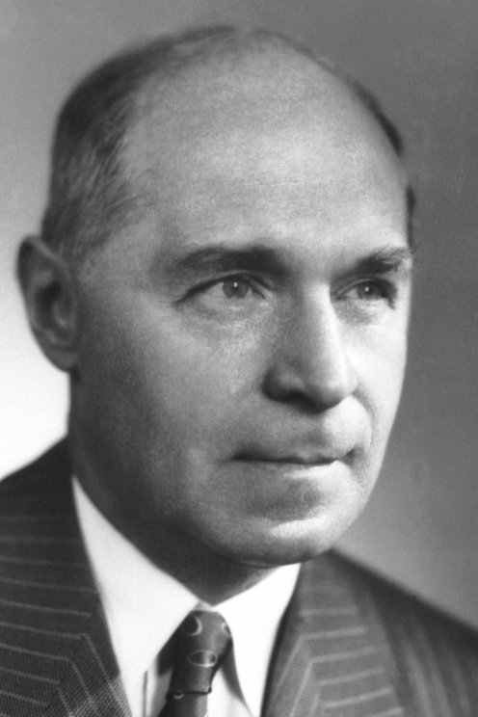
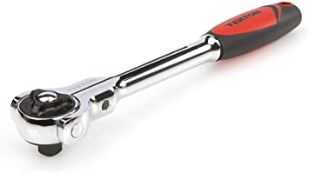
Muller's Ratchet
Hermann Joseph Muller 1890-1967 (Nobel Laureate in 1946)
Muller, H. J. (1932). "Some Genetic Aspects of Sex. American Naturalist 66: 118 - 138.
Muller first used the term "ratchet" in his 1964 paper (Mutat Res 106: 2-9), and "Muller's ratchet" was coined by Joe Felsenstein in 1974 (Genetics 78: 737-756)
"Sex" refers to exchange of genetic materials through mechanisms such as recombination during meiosis
Image credit: https://www.nobelprize.org/prizes/medicine/1946/muller/biographical/

Slide 8
Muller's Ratchet
H. J. Muller (1958, 1964)
Assumptions on mutation effect and rate:
Mutations on average are mildly deleterious so their elimination by selection is slow
Mutation rate is high so that a 2nd mutation can arrive before the carrier of the first is eliminated
Many linked loci on the chromosome
No mechanism such as recombination to regenerate genomes of fewer mutations.
Inference: It is possible for all genomes in the population to move from a state free of deleterious mutations to the state of one mutation, two mutation, and so on.
Prediction: an asexual population will progressively accumulate mutations with an associated decrease in average fitness, and will eventually become extinct (mutational meltdown).
A B C D E
A B C D E
A B c D E
A B C D e
A b c D E
A B C d e

Slide 9
Fate of new mutations: Muller’s ratchet
How fast the ratchet ticks depends on
selection coefficient s
mutation rate per chromosome
number of linked loci on a chromosome
rate of recombination (typically assumed zero in simulation software)
You can simulate Muller’s ratchet here: http://evolutiongenetics.georgetown.edu/simulations/mullers

Slide 10
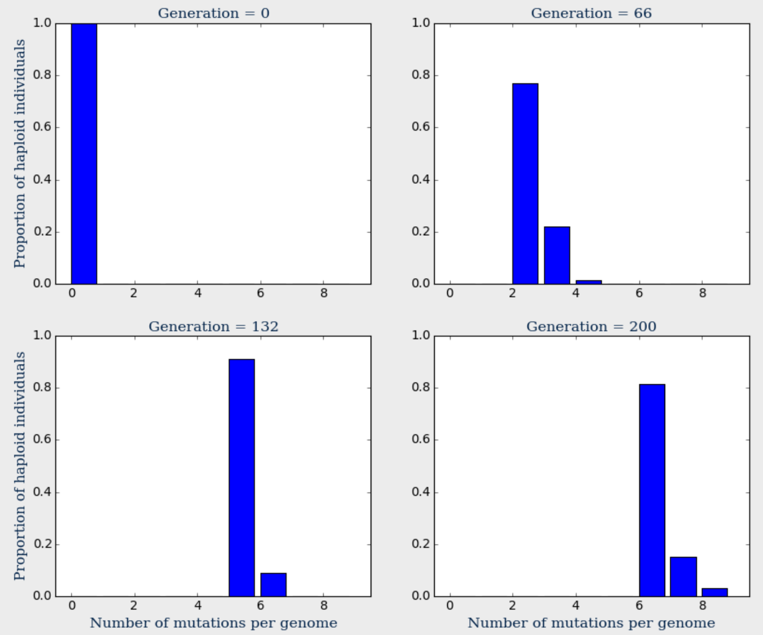
Mutation
Drift
Natural
selection

Slide 11
Nature's solution: Recombination
A b c D E
Haploid gametophte (n)
A B C d e
gamete
(n)
spores (n)
Recombination generates parental and recombinate gamates/haploids
AbcDE (2 deleterious)
ABCde (2 deleterious)
Abcde (4 deleterious)
ABCDE (0 deleterious)
Selection at haploid stage
AbcDE
ABCde
Abcde
ABCDE
zygote
(2n)
Diploid Sporophyte (2n)
 | AbcDE | ABCde | Abcde | ABCDE
AbcDE
ABCde
Abcde
ABCDE

Slide 12
Predictions
Strong positive association between mutation rate and recombination rate.
Strong but negative association between mutation rate and genome/chromosome size
Strong association between alternation of generation and recombination
Asexual lineages should be relatively young

Slide 13
Two-fold advantage
Strong positive association between mutation rate and recombination rate.
Strong but negative association between mutation rate and genome/chromosome size
Strong association between alternation of generation and recombination
Asexual lineages should be relatively young
♀
♀
♀
(A)
(B)
♂

Slide 14
Prediction on parthenogenesis
Sp1
Sp9
Sp31
Sp30
Sp26
Sp14
Sp6
Sp5
Sp18
Sp7
Sp25
Sp15
Sp29
Sp4
Sp13
Sp11
Sp10
Sp32
Sp12
Sp37
Sp39
Sp40
Sp38
Sp41
Sp24
Sp17
Sp23
Sp35
Sp22
Sp34
Sp28
Sp21
Sp20
Sp19
Sp27
Sp16
Sp36
Sp33
Sp3
Sp2
Sp8

Slide 15
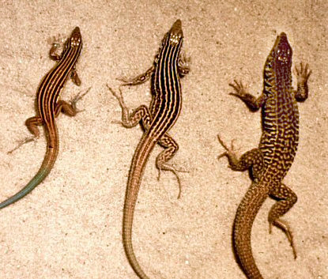
Aspidoscelis neomexicanus
A. inornatus
A. tigris
Image credit: Wikipedia
Recent derivatives: hybridization of A. inornatus and A. tigris can produce the parthenogenetic A. neumexicanus.
Numerous microchromosomes

Slide 16
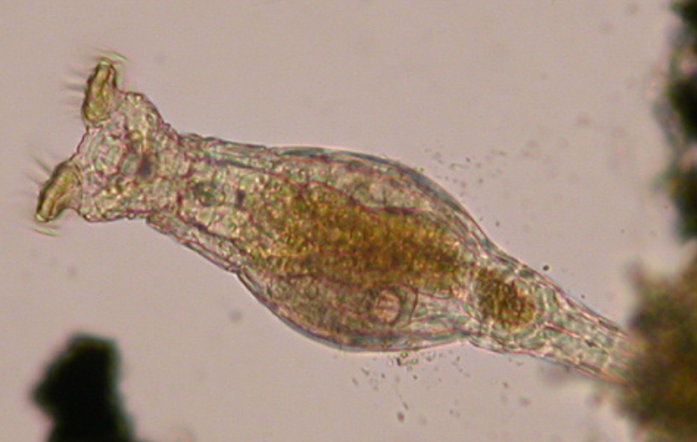
Exceptions?
It is often cited that bdelloid rotifers have existed for 40 million years, apparently without recombination.
How do researchers know that?
Phylogenetic dating: the common ancestors of rotifers is about 40 million years
All rotifer lineages have only females → The common ancestor most likely is parthenogenetic, which is inherited by its descendants
Are they really asexual? If mutation rate is low, they can be asexual for a long time.
Do they have a full set of conserved meiosis genes?

Slide 17
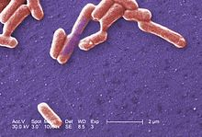
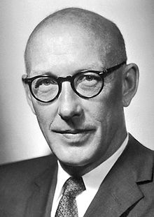
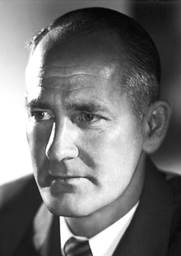
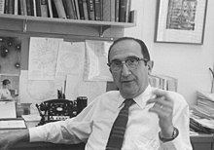
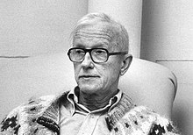
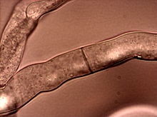
What about bacteria?
Edward Lawrie Tatum (1909 –1975)
George Wells Beadle (1903–1989)
Neurospora crassa + X-ray + nutritional mutants (e.g., pyridoxine)
Salvador Luria (1912-1991)
Max Delbruck (1906–1981)
Beadle, G. W. and E. L. Tatum (1941). "Genetic Control of Biochemical Reactions in Neurospora." PNAS 27: 499-506.
Image credit: Wikipedia
Image credit: Wikipedia

Slide 18
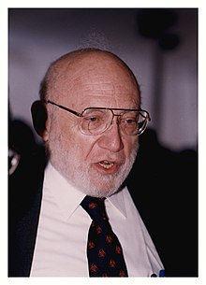
What about bacteria?
Parent1 ...M..p...
Parent2 ...m..P...
Recomb1 ...m..p...
Recomb2 ...M..P...
Strain1 ...M..p...
Strain2 ...m..P...
Joshua Lederberg (1925–2008)
Image credit: Wikipedia

Slide 19
What about bacteria?
Strain1 ...M..P...
Reversion
Parent1 ...M..p...
Parent2 ...m..P...
Recomb1 ...m..p...
Recomb2 ...M..P...
Strain1 ...M..p...
Strain2 ...m..P...
Reversion
Strain2 ...M..P...
Joshua Lederberg (1925–2008)
Image credit: Wikipedia

Slide 20
Double mutants
E. coli K12
Parent1 ...b..m....T..P...
Parent2 ...B..M....t..p...
Parent1 ...b..m....t..p...
Parent2 ...B..M....T..P...
Strain1 ...b..m....T..P...
Strain2 ...B..M....t..p...
To further exclude the possibility of revertants: culture the two strains separately and in mixture.
Conclusion: recombination exists; E. coli is safe from Muller’s ratchet →K12 strain
Exchange of genetic materials in bacteria:
Transformation: the uptake of exogenous DNA from the surrounding environment.
Transduction: the virus-mediated transfer of DNA between bacteria.
Conjugation: the transfer of DNA from one bacterium to another via cell-to-cell contact
Image credit: Wikipedia

Slide 21
Muller's ratchet and Y chromosome
Brian Charlesworth (1978)
Y chromosome carries sex determination genes
Recombination should therefore be suppressed (so the sex determination genes will stay on Y chromosome)
Y chromosome is then reproducing clonally (No YY individuals to permit recombination between two Y chromosomes)
Y chromosome subject to Muller's ratchet, and therefore cannot have many linked genes
Reduction of genes on Y chromosome.
Reduced Y chromosome size.
Dosage compensation in gene products

Slide 22
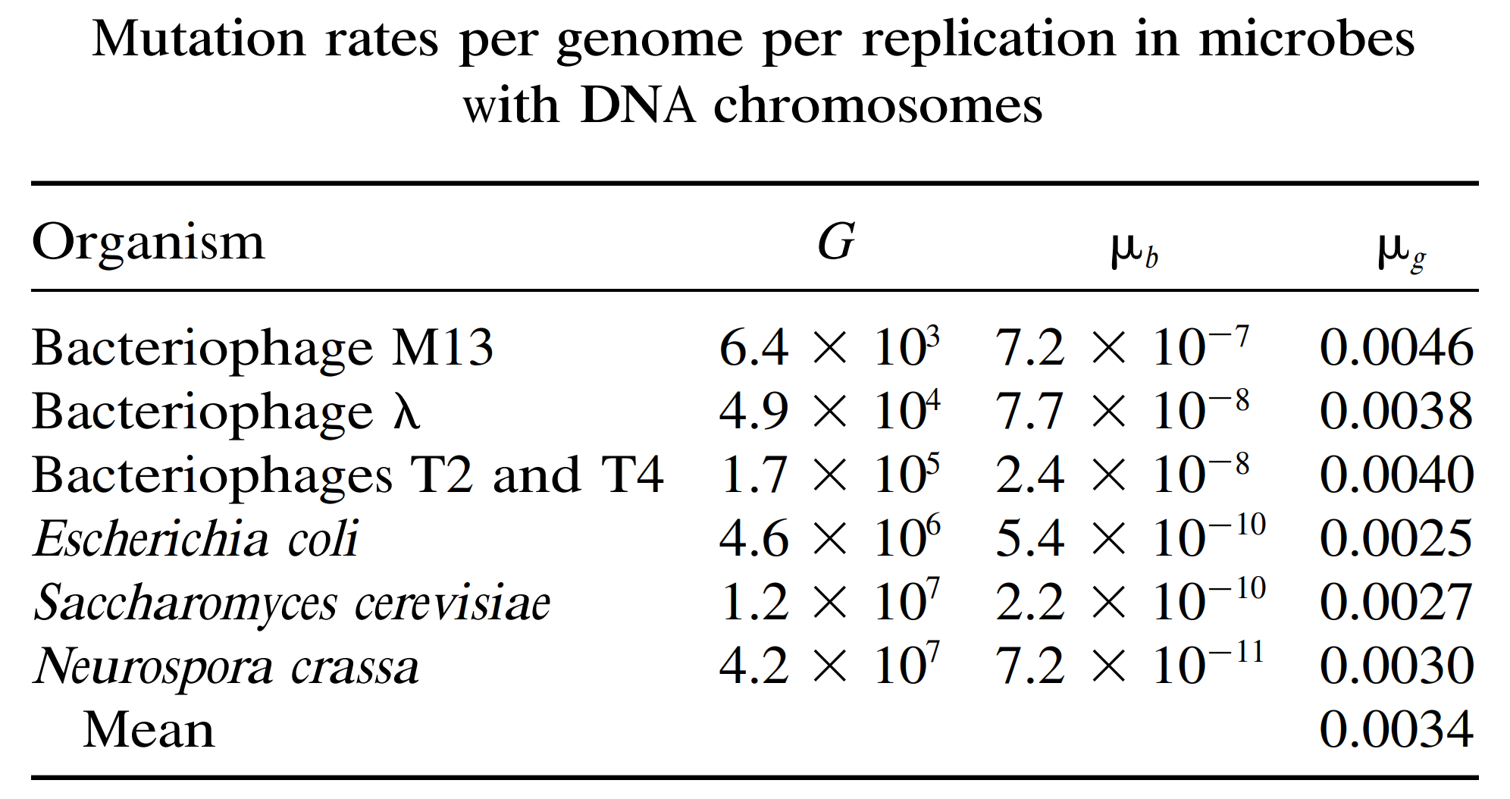
Drake et al. 1998 Genetics
Mutation rate per base is correlated with genome size

Slide 23
One-way and two-way mutations
Similarity between mutation and migration
Mutation effect on allele frequencies
One locus with two alleles $S$ and $F$
One-way mutation $S→F$
Two-way mutation $S↔F$
For a locus with more than two alleles, the F allele may be viewed as any allele that is not S.

Slide 24
Mutation and migration
Mutation is qualitatively similar to migration (gene flow), but quantitatively different from migration in its rate because $μ≪m$
First consider the simplest model of one-way mutation (analogous to one-way migration)
Define $μ$ as the probability of $S→F$
$p_{t+1}=p_{t}−μp_{t}=p_{t}(1−μ)$
where (1 – μ) represents the proportion of S alleles that do not mutate to F

Slide 25
Obtain a general solution
Two alleles with one-way mutation
$$p_{1}=p_{0}(1−μ)$$
$$p_{2}=p_{1}(1−μ)=p_{0}(1−μ)(1−μ) =p_{0}{\left(1−μ\right)}^{2}$$
$$p_{3}=p_{2}−μp_{2}=p_{0}{\left(1−μ\right)}^{3}$$
$$p_{t}=p_{t−1}−μp_{t−1}=p_{0}{\left(1−μ\right)}^{t}$$
Notes:
p_{t+1} = p_{t}(1-u)
p_{t+2} = p_{t+1}(1-u)
p_{t+2} =p_{t}(1-u)²
p_{t} = p₀(1-u)^{t}

Slide 26
Similarities with migration
The general solution for irreversible (i.e. one-way $S→F$) mutation is:
$$p_{t}=p_{0}{\left(1−μ\right)}^{t}$$
where μ is the mutation rate from $S→F$
The one-way migration model is
$$p_{t}=p_{m}+{\left(1−m\right)}^{t}\left(p_{0}−p_{m}\right)$$
When the mainland population does not have any S allele ($p_{m}=0$) so that all immigrants carry an F (i.e., non-S) allele, then the one-way migration model is equivalent to the one-way mutation model:
$p_{t}={p_{0}\left(1−m\right)}^{t}$

Slide 27
Similarity with migration
p_{t} = p₀(1 – μ)^{t}
(μ = 1.0 x 10⁻⁴)
p_{t} = p₀(1 – m)^{t}
(m = 0.01)
note the quantitative difference in the scales of the x-axes
mutation eventually turns all S alleles into F alleles but it takes a LONG time, so it’s short-term impact on allele frequencies is small

Slide 28
Homework
In a continent-island migration model, suppose p_{m} = 0, p₀ = 1, and m = 0.01 (i.e. 1% of the individuals in each population are migrants in each generation). How many generations are required for the island to achieve an allele frequency of 0.5?
$$p_{t}={\left(1−m\right)}^{t}p_{0}$$
b) In a one-way mutation model, suppose that p₀ = 1 and μ = 5×10⁻⁶. How many generations are required for the population to achieve an allele frequency of 0.5?
$$p_{t}=p_{0}{\left(1−μ\right)}^{t}$$
Notes:
Given p_{m} = 0, p₀ = 1, m = 0.01, p_{t} = 0.5
so: 0.5 = 1(1 – 0.01)^{t}
ln (0.5) = t ln(0.99)
t = ln(0.5)/ln(0.99) ≈ 69 generations
Given p₀ = 1, μ = 5×10⁻⁶, and p_{t} = 0.5
so: 0.5 = 1(1 - 5×10⁻⁶)^{t}
ln(0.5) = t ln(0.999995)
t = ln(0.5)/ln(0.999995) ≈ 138,629 generations

Slide 29
Two-way mutation
Define $μ$ as the probability of $S→F$
Define ν as the probability of $F→S$
A alleles lost through mutation
A alleles gained through mutation
$$p_{t+1}=p_{t}(1−μ)+ν\left(1−p_{t}\right)$$

Slide 30
Solution for two-way mutation
The general solution is
$$p_{t}={\left(1−μ−ν\right)}^{t}\left(p_{0}−\frac{ν}{μ+ν}\right)+\frac{ν}{μ+ν}$$
$t→∞:$ first term → 0. The last term is therefore the equilibrium solution of $p_{t}$, i.e., $p_{eq}$:
$$p_{eq}=\frac{ν}{μ+ν}$$
$t→0:{\left(1−μ−ν\right)}^{t}→1, p_{t}=p_{0}$
An alternative to obtain the equilibrium without the general equation: Set $p_{t+1}=p_{t}=p_{eq}$ in the following equation
$$p_{t+1}=p_{t}(1−μ)+ν\left(1−p_{t}\right)$$
$$p_{eq}=p_{eq}\left(1−μ\right)+ν\left(1−p_{eq}\right)→p_{eq}=\frac{ν}{μ+ν}$$
Notes:
p = p –up + v – vp
up + vp = v
p(u + v) = v
P = v/(u + v)
p^hat = v/(u + v)

Slide 31
Allele frequency over time
$μ=0.0001 (S→F)$
$ν=0.00001 (F→S)$
$$p_{0}=1$$
$$p_{eq}=\frac{ν}{μ+ν}=0.0909$$
$$p_{0}=0$$
population will converge on an equilibrium frequency that is closer to the frequency of the allele produced at the higher rate

Slide 32
Similarities with the island model of gene flow
The general solution for reversible mutation where μ is the probability of allele S mutating to allele F, and ν is the probability of F mutating to A:
$p_{t}={\left(1−μ−ν\right)}^{t}\left(p_{0}−\frac{ν}{μ+ν}\right)+\frac{ν}{μ+ν}$ ${p_{t}=\left[1−\left(μ+ν\right)\right]}^{t}\left(p_{0}−p_{eq}\right)+p_{eq}$
For our island model of migration, the general solution was:
$p_{t}={\left(1−m\right)}^{t}\left(p_{0}−\overline{p}\right)+\overline{p}$
here $\overline{p}$ is equivalent to $\frac{ν}{μ+ν}$ (equilibrium frequency), and $m$ (total migration) is equivalent to ($μ+ν$).
These equations correspond because both processes introduce and remove alleles from a population at constant rates.
Notes:
u = forward mutation rate (A to a)
v = reverse mutation rate (a to A)

Slide 33
Effect of mutation on autozygosity
Infinite-allele model: All mutations result in new alleles, i.e., any mutant allele is NOT autozygous to any existing allele.
Recall: rate of increase in f in a finite population under genetic drift:
$f_{t+1}=\frac{1}{2N}(1)+\left(1−\frac{1}{2N}\right)f_{t}$
Probability that the two alleles are not copies of the same allele. In this case, the probability of ibd is that from the previous generation, $f_{t}$
Probability that the same allele is drawn from the previous generation (1/2N). In this case the probability of ibd = 1
$$f_{t}=1−{\left(1−\frac{1}{2N}\right)}^{t}\left(1−f_{0}\right)$$
Notes:
fig.3.10 H&C p. 117

Slide 34
Remember how to add migration rate m to f_{t}?
$f_{t+1}=\frac{1}{2N}+\left(1−\frac{1}{2N}\right)f_{t}$
We anchor our thought on the continent-island model, and develop the model for the island population
In each generation, a fraction of m of the island population is from the mainland population.
When we randomly sample two allele in the island population at time t, there are three events with their probabilities following a binomial distribution ${\left[m+\left(1−m\right)\right]}^{2}$
Both alleles are immigrants. This event has probability $m^{2}$. $Pr\left(IBD\right)=f_{m}=0$
One is immigrant and the other local. This event has a probability of $2m\left(1−m\right).\operatorname{Pr}\left(IBD\right)=0$
Both are local. This event has a probability ${\left(1−m\right)}^{2}$, and is relevant to what we want to model.
Therefore
$f_{t+1}={\left(1−m\right)}^{2}\left[\frac{1}{2N}+\left(1−\frac{1}{2N}\right)f_{t}\right]$
Notes:
fig.3.10 H&C p. 117

Slide 35
Rate of increase in $f_{t}$ with mutation
$f_{t+1}=\frac{1}{2N}+\left(1−\frac{1}{2N}\right)f_{t}$
IBD can only occur if both alleles are not mutant (i.e. neither is newly arisen by mutation)
If μ is the mutation rate to new alleles (i.e. assuming an infinite alleles model), then (1 – μ) is the probability that an allele does not mutate and the probability that two randomly chosen alleles do not mutate is (1 – μ)²
Therefore:
$f_{t+1}={\left(1−μ\right)}^{2}\left[\frac{1}{2N}+\left(1−\frac{1}{2N}\right)f_{t}\right]$

Slide 36
Similarity between mutation & migration
Compare this with what we previously derived as the recursion equation of F_{t} with gene flow:
Mutation: $f_{t+1}={\left(1−μ\right)}^{2}\left[\frac{1}{2N}+\left(1−\frac{1}{2N}\right)f_{t}\right]$
Gene flow: $f_{t+1}={\left(1−m\right)}^{2}\left[\frac{1}{2N}+\left(1−\frac{1}{2N}\right)f_{t}\right]$

Slide 37
Equilibrium under drift and mutation
$f_{t+1}={\left(1−μ\right)}^{2}\left[\frac{1}{2N}+\left(1−\frac{1}{2N}\right)f_{t}\right]$
Setting $\hat{f}=f_{t+1}=f_{t}$
$\hat{f}={\left(1−μ\right)}^{2}\left[\frac{1}{2N}+\left(1−\frac{1}{2N}\right)\hat{f}\right]$
$\hat{f}=\frac{{\left(1−μ\right)}^{2}}{2N}+{\left(1−μ\right)}^{2}\left(1−\frac{1}{2N}\right)\hat{f}$
$\hat{f}\left(1−{\left(1−μ\right)}^{2}\left(1−\frac{1}{2N}\right)\right)=\frac{{\left(1−μ\right)}^{2}}{2N}$
$\hat{f}=\frac{{\left(1−μ\right)}^{2}}{2N\left(1−{\left(1−μ\right)}^{2}\left(1−\frac{1}{2N}\right)\right)}$
when $μ→0$, drop $μ^{2},μ/N$
$\hat{f}≈\frac{1}{2N\left(2μ+\frac{1}{2N}\right)}$
$\hat{f}≈\frac{1}{4Nμ+1}$
$Nμ$ is the number of individuals who are new mutants.
If $Nμ=1$, then $\hat{f}≈0.2$ (not much genetic drift)
Larger N requires smaller $μ$ to maintain $\hat{f}≈0.2$. This is because large N itself is resistant to genetic drift.
Rule of thumb: as long as at least one individual in the population is a new mutant, the population will be largely resistant to genetic drift.
$\hat{f}≈\frac{1}{4Nm+1}$

Slide 38
A general solution
$f_{t+1}={\left(1−μ\right)}^{2}\left[\frac{1}{2N}+\left(1−\frac{1}{2N}\right)f_{t}\right]$
$f_{t}=\frac{1}{2Nμ^{2}−4Nμ−{\left(1−μ\right)}^{2}}\left\{{\left[\frac{{\left(1−μ\right)}^{2}\left(2N−1\right)}{2N}\right]}^{t}\left[2Nμ^{2}f_{0}−4Nμf_{0}+{\left(1−μ\right)}^{2}(1−f_{0}) \right]−{\left(1−μ\right)}^{2}\right\}$
if $f_{0}=0$, then
$f_{t}=\frac{1}{2Nμ^{2}−4Nμ−{\left(1−μ\right)}^{2}}\left\{{\left[\frac{{\left(1−μ\right)}^{2}\left(2N−1\right)}{2N}\right]}^{t}\left[{\left(1−μ\right)}^{2} \right]−{\left(1−μ\right)}^{2}\right\}$
When there is no mutation, i.e., $μ=0$
$f_{t}=1−{\left(1−\frac{1}{2N}\right)}^{t}\left(1−f_{0}\right)$ (This is our familiar equation under genetic drift)

Slide 39
f(t) as a function of N and $μ$
$$f_{t}=\frac{1}{2Nμ^{2}−4Nμ−{\left(1−μ\right)}^{2}}\left\{{\left[\frac{{\left(1−μ\right)}^{2}\left(2N−1\right)}{2N}\right]}^{t}\left[{\left(1−μ\right)}^{2} \right]−{\left(1−μ\right)}^{2}\right\}$$
$\hat{f}≈\frac{1}{4Nμ+1}$
$$N=1000, μ={10}^{−9}$$
$$N=1000, μ={10}^{−5}$$
$$N=10000, μ={10}^{−9}$$
$$N=10000, μ={10}^{−5}$$

