Slide 1
Lecture 24
Selection and Mutation
Prof. Xuhua Xia
xxia@uottawa.ca
http://dambe.bio.uottawa.ca
©University of Ottawa

Slide 2


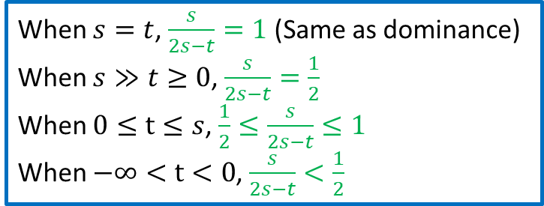

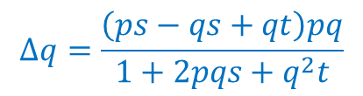
Over-dominance (hybrid superiority)
$Δq=\frac{pq\left[p\left(w_{12}−w_{11}\right)+q\left(w_{22}−w_{12}\right)\right]}{p^{2}w_{11}+2pqw_{12}+q^{2}w_{22}}$
Genotype A₁A₁ A₁A₂ A₂A₂
Fitness w₁₁=1 w₁₂=1+s w₂₂=1+t
Range ∞>s>0 -∞<t<s
$$Δq=\frac{\left(ps−qs+qt\right)pq}{1+2pqs+q^{2}t}$$
When $s=t$, $\frac{s}{2s−t}=1$ (Same as dominance)
When $s≫t≥0$, $\frac{s}{2s−t}=\frac{1}{2}$
When $0≤t≤s$, $\frac{1}{2}≤\frac{s}{2s−t}≤1$
When $−∞<t<0$, $\frac{s}{2s−t}<\frac{1}{2}$
equilibrium frequency $\tilde{q}$ when Δq = 0
$$\tilde{q}=0,1,\frac{s}{2s−t}$$
s = 0.2
t = 0
s = 0.2
t = 0.1

Slide 3

Equilibirum plot
$$Δq=\frac{\left(ps−qs+qt\right)pq}{1+2pqs+q^{2}t}$$
Homework:
Plot with s=0.3, t=0.1
unstable
unstable
stable
s = 0.2
t = 0.1
s = 0.2
t = 0
Three equilibrium points.
Checking stability by checking the slope of the lines tangential to the ∆q curve when it crosses zero:
Unstable if the slope is positive
Stable if the slope is negative.

Slide 4

Selection and $\overline{w}$
Genotype A₁A₁ A₁A₂ A₂A₂
Fitness w₁₁=1 w₁₂=1+s w₂₂=1+t
s = 0.2; t = 0.1

Slide 5

Selection and E(H)
Genotype A₁A₁ A₁A₂ A₂A₂
Fitness w₁₁=1 w₁₂=1+s w₂₂=1+t
s = 0.2; t = 0.1
$$q_{eq}=\frac{s}{2s−t}=\frac{0.2}{2×0.2−0.1}=0.667$$

Slide 6
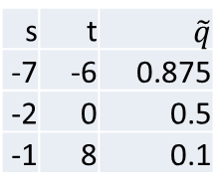
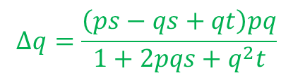

Heterozygote inferiority
Genotype A₁A₁ A₁A₂ A₂A₂
Fitness w₁₁=1 w₁₂=1+s w₂₂=1+t
Range -∞<s<0 ∞>t>s
$$s=−0.1,t=0.1, w_{11}=1, w_{12}=0.9, w_{22}=1.1$$
s | t | $$\tilde{q}$$
-7 | -6 | 0.875
-2 | 0 | 0.5
-1 | 8 | 0.1
$$Δq=\frac{\left(ps−qs+qt\right)pq}{1+2pqs+q^{2}t}$$
Equilibrium solutions: $\tilde{q}=0,1,\frac{s}{2s−t}$
$$s=−0.1, t=0.1, q=\frac{s}{2s−t}=\frac{−0.1}{2×\left(−0.1\right)−0.1}=\frac{1}{3}$$

Slide 7

Changes in $\overline{w}$ under selection

Slide 8
Summary of dominance patterns
(1)
(3)
(2)
(4)

Slide 9
Summary: Forms of selection
w_{AA} ≥ w_{Aa} ≥ w_{aa} Directional selection (favouring A) (At least one of the strict inequalities must be true, i.e., w_{AA} > w_{Aa} = w_{aa} , or w_{AA} = w_{Aa} > w_{aa}, w_{AA} > w_{Aa} > w_{aa}, but not w_{AA} = w_{Aa} = w_{aa})
w_{AA} ≤ w_{Aa} ≤ w_{aa} Directional selection (favouring a) (At least one of the strict inequalities must be true)
w_{AA} < w_{Aa} > w_{aa} Heterozygote superiority, balancing selection
w_{AA} > w_{Aa} < w_{aa} Heterozygote inferiority, disruptive selection

Slide 10

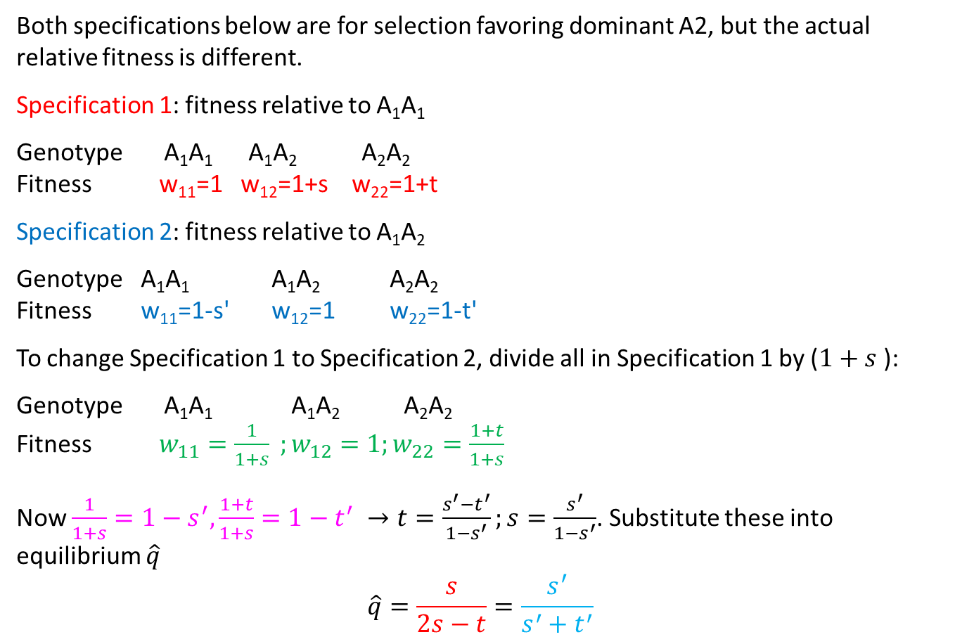
Alternative specifications
Both specifications below are for selection favoring dominant A2, but the actual relative fitness is different.
Specification 1: fitness relative to A₁A₁
Genotype A₁A₁ A₁A₂ A₂A₂
Fitness w₁₁=1 w₁₂=1+s w₂₂=1+t
Specification 2: fitness relative to A₁A₂
Genotype A₁A₁ A₁A₂ A₂A₂
Fitness w₁₁=1-s' w₁₂=1 w₂₂=1-t'
To change Specification 1 to Specification 2, divide all in Specification 1 by ($1+s$):
Genotype A₁A₁ A₁A₂ A₂A₂
Fitness $w_{11}=\frac{1}{1+s} ;w_{12}=1;w_{22}=\frac{1+t}{1+s}$
Now $\frac{1}{1+s}=1−s^{′},\frac{1+t}{1+s}=1−t^{′} →t=\frac{s^{′}−t^{′}}{1−s^{′}};s=\frac{s^{′}}{1−s^{′}}$. Substitute these into equilibrium $\hat{q}$
$$\hat{q}=\frac{s}{2s−t}=\frac{s^{′}}{s^{′}+t^{′}}$$
$$\hat{q}=\frac{s}{2s−t}$$

Slide 11
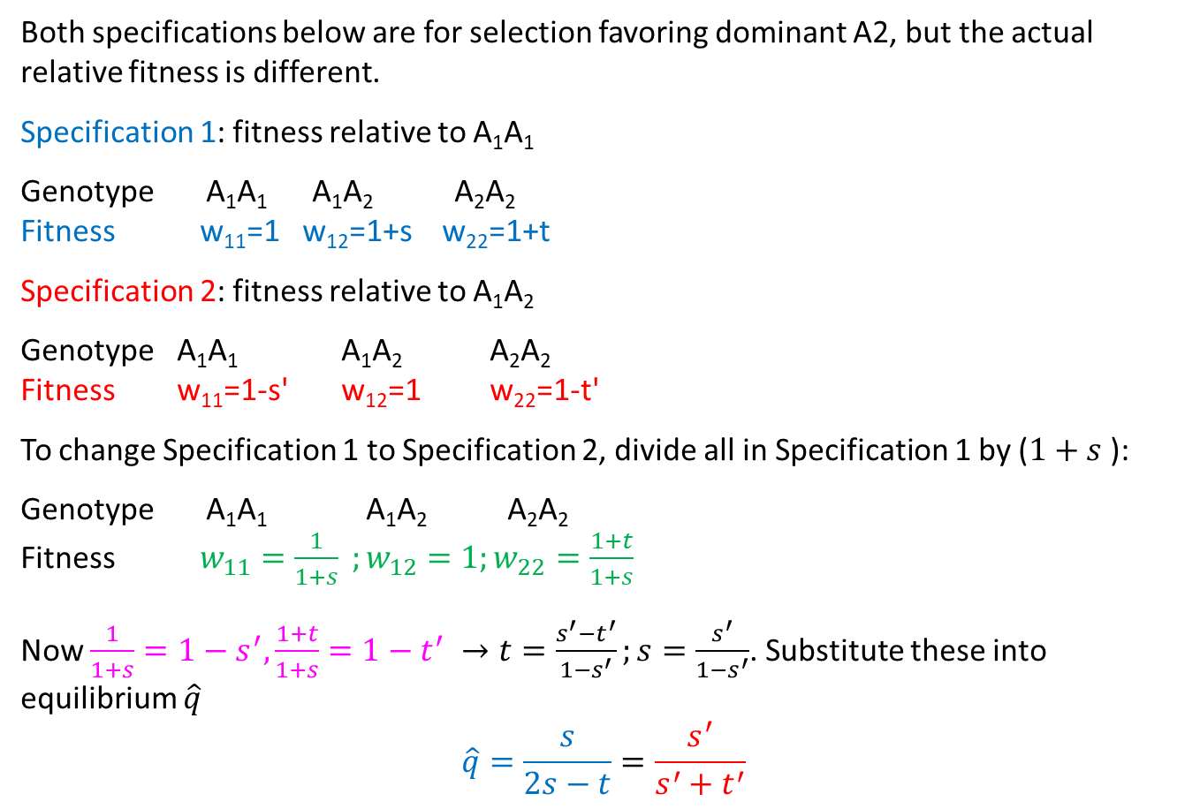

Alternative specifications
Both specifications below are for selection favoring dominant A2, but the actual relative fitness is different.
Specification 1: fitness relative to A₁A₁
Genotype A₁A₁ A₁A₂ A₂A₂
Fitness w₁₁=1 w₁₂=1+s w₂₂=1+t
Specification 2: fitness relative to A₁A₂
Genotype A₁A₁ A₁A₂ A₂A₂
Fitness w₁₁=1-s' w₁₂=1 w₂₂=1-t'
To change Specification 1 to Specification 2, divide all in Specification 1 by ($1+s$):
Genotype A₁A₁ A₁A₂ A₂A₂
Fitness $w_{11}=\frac{1}{1+s} ;w_{12}=1;w_{22}=\frac{1+t}{1+s}$
Now $\frac{1}{1+s}=1−s^{′},\frac{1+t}{1+s}=1−t^{′} →t=\frac{s^{′}−t^{′}}{1−s^{′}};s=\frac{s^{′}}{1−s^{′}}$. Substitute these into equilibrium $\hat{q}$
$$\hat{q}=\frac{s}{2s−t}=\frac{s^{′}}{s^{′}+t^{′}}$$
$$\hat{q}=\frac{s}{2s−t}$$

Slide 12
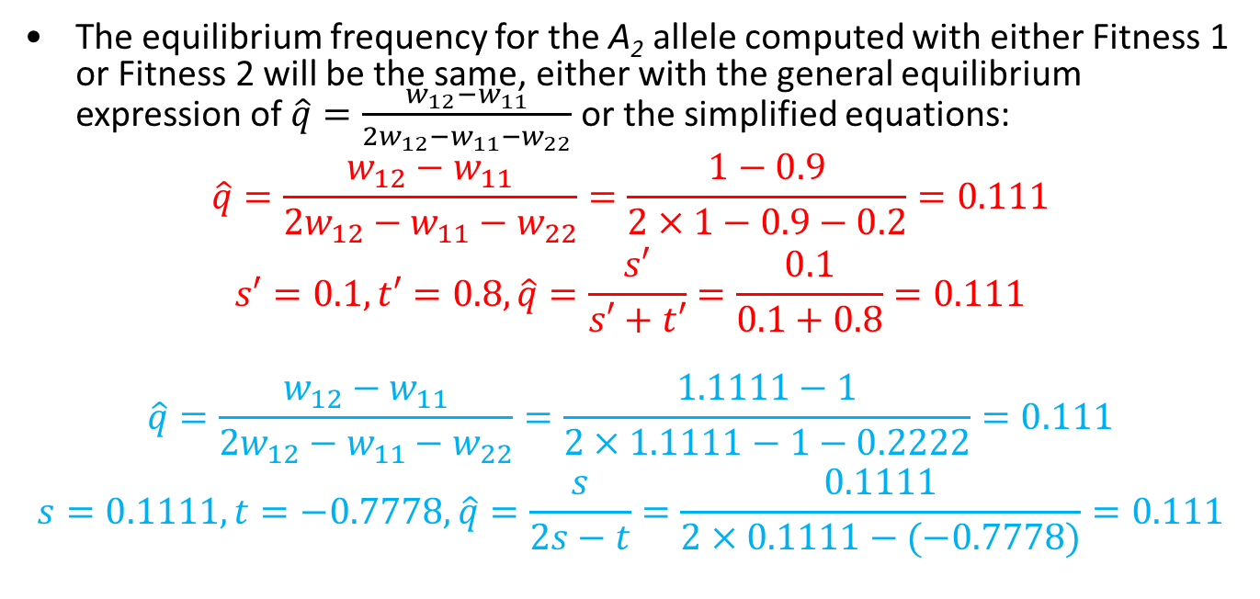
Illustration
Fitness estimates for a locus of two alleles (A and S) can be expressed in two ways:
Genotype A₁A₁ A₁A₂ A₂A₂
Fitness 1 0.9 1 0.2 (relative to fitness of AS genotype)
Fitness 2 1 1.1111 0.2222 (relative to fitness of AA genotype)
The equilibrium frequency for the A₂ allele computed with either Fitness 1 or Fitness 2 will be the same, either with the general equilibrium expression of $\hat{q}=\frac{w_{12}−w_{11}}{2w_{12}−w_{11}−w_{22}}$ or the simplified equations:
$$\hat{q}=\frac{w_{12}−w_{11}}{2w_{12}−w_{11}−w_{22}}=\frac{1−0.9}{2×1−0.9−0.2}=0.111$$
$$s′=0.1,t′=0.8,\hat{q}=\frac{s′}{s′+t′}=\frac{0.1}{0.1+0.8}=0.111$$
$$\hat{q}=\frac{w_{12}−w_{11}}{2w_{12}−w_{11}−w_{22}}=\frac{1.1111−1}{2×1.1111−1−0.2222}=0.111$$
$$s=0.1111,t=−0.7778,\hat{q}=\frac{s}{2s−t}=\frac{0.1111}{2×0.1111−(−0.7778)}=0.111$$

Slide 13



One locus with 3 alleles
s | 0.05
t | 0.05
u | 0.05
A1A1 | w11 | =1-s | 0.95
A1A2 | w12 | 1 | 1
A1A3 | w13 | 1 | 1
A2A2 | w22 | =1-t | 0.95
A2A3 | w23 | 1 | 1
A3A3 | w33 | =1-u | 0.95
$$p_{1}(t)$$
$$p_{2}(t)$$
$$p_{3}(t)$$

Slide 14



One locus with 3 alleles
s | 0.05
t | 0.1
u | 0.1
A1A1 | w11 | =1-s | 0.95
A1A2 | w12 | 1 | 1
A1A3 | w13 | 1 | 1
A2A2 | w22 | =1-t | 0.9
A2A3 | w23 | 1 | 1
A3A3 | w33 | =1-u | 0.9
$$p_{1}(t)$$
$$p_{2}(t)$$
$$p_{3}(t)$$

Slide 15



One locus with 3 alleles
s | 0.03
t | 0.07
u | 0.1
A1A1 | w11 | =1-s | 0.97
A1A2 | w12 | 1 | 1
A1A3 | w13 | 1 | 1
A2A2 | w22 | =1-t | 0.93
A2A3 | w23 | 1 | 1
A3A3 | w33 | =1-u | 0.9
$$p_{1}(t)$$
$$p_{2}(t)$$
$$p_{3}(t)$$

Slide 16
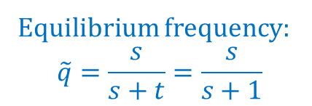
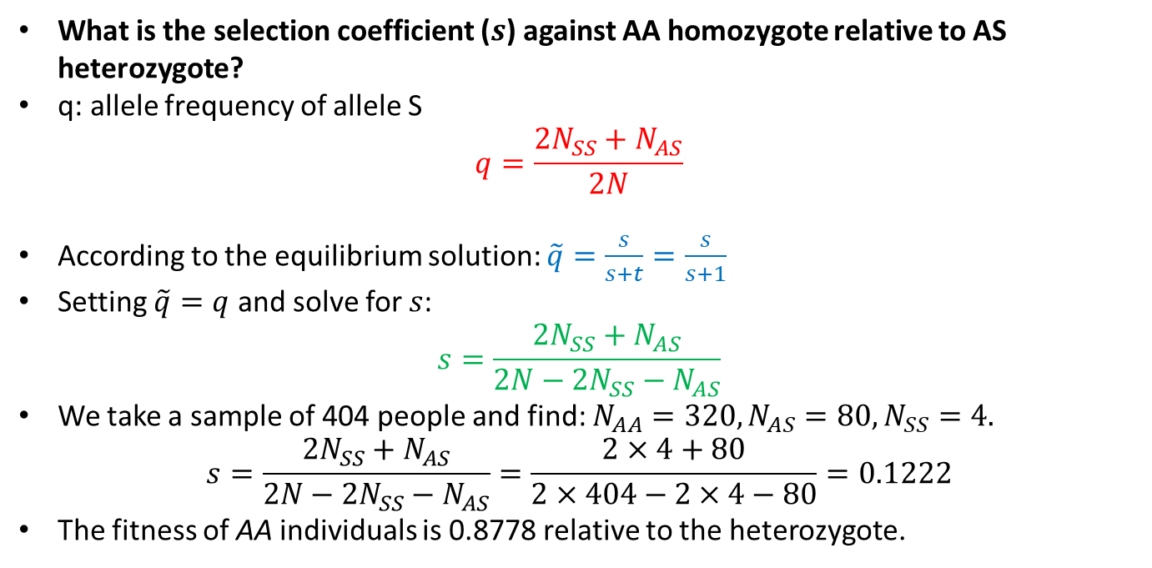
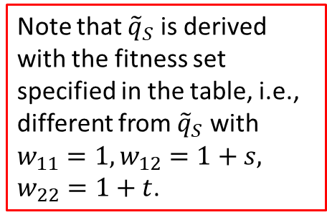
Estimating s
Genotype | N | N | w | w
AA | N_{AA} | 320 | w_{AA} | 1-s
AS | N_{AS} | 80 | w_{AS} | 1
SS | N_{SS} | 4 | w_{SS} | =1-t=0
t = 1 | s=?
Equilibrium frequency:
$$\tilde{q}=\frac{s}{s+t}=\frac{s}{s+1}$$
Sickle-cell anemia locus (A and S)
What is the selection coefficient ($s$) against AA homozygote relative to AS heterozygote?
q: allele frequency of allele S
$$q=\frac{2N_{SS}+N_{AS}}{2N}$$
According to the equilibrium solution: $\tilde{q}=\frac{s}{s+t}=\frac{s}{s+1}$
Setting $\tilde{q}=q$ and solve for $s$:
$$s=\frac{2N_{SS}+N_{AS}}{2N−2N_{SS}−N_{AS}}$$
We take a sample of 404 people and find: $N_{AA}=320, N_{AS}=80, N_{SS}=4.$
$$s=\frac{2N_{SS}+N_{AS}}{2N−2N_{SS}−N_{AS}}=\frac{2×4+80}{2×404−2×4−80}=0.1222$$
The fitness of AA individuals is 0.8778 relative to the heterozygote.
Note that ${\tilde{q}}_{S}$ is derived with the fitness set specified in the table, i.e., different from ${\tilde{q}}_{S}$ with $w_{11}=1,w_{12}=1+s,$
$w_{22}=1+t$.

Slide 17
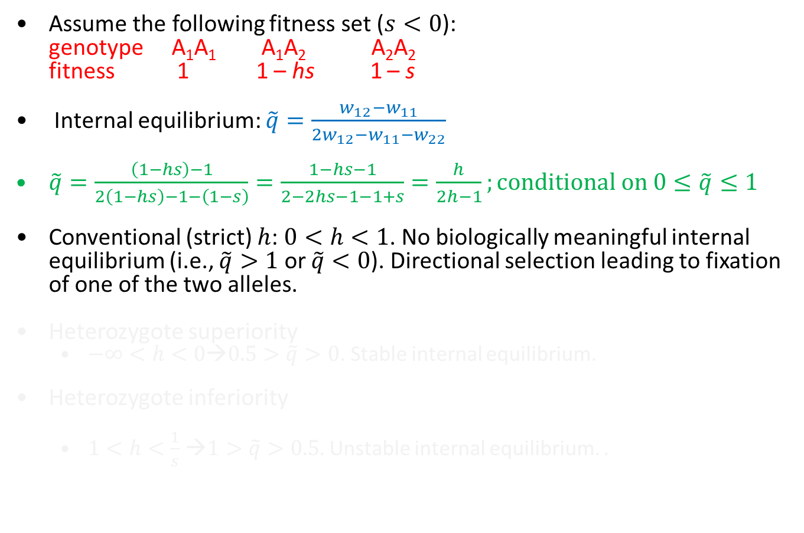
Dominance coefficient h
Assume the following fitness set ($s<0$):
genotype A₁A₁ A₁A₂ A₂A₂
fitness 1 1 – hs 1 – s
Internal equilibrium: $\tilde{q}=\frac{w_{12}−w_{11}}{2w_{12}−w_{11}−w_{22}}$
$\tilde{q}=\frac{\left(1−hs\right)−1}{2\left(1−hs\right)−1−\left(1−s\right)}=\frac{1−hs−1}{2−2hs−1−1+s}=\frac{h}{2h−1};conditional on 0≤\tilde{q}≤1$
Conventional (strict) $h$: $0<h<1$. No biologically meaningful internal equilibrium (i.e., $\tilde{q}>1$ or $\tilde{q}<0$). Directional selection leading to fixation of one of the two alleles.
Heterozygote superiority
  $−∞<h<0$→$0.5>\tilde{q}>0$. Stable internal equilibrium.
Heterozygote inferiority
  $1<h<\frac{1}{s}$ →$1>\tilde{q}>0.5$. Unstable internal equilibrium. .
Genotype A₁A₁ A₁A₂ A₂A₂
Fitness w₁₁=1 w₁₂=1+s w₂₂=1+t
Range ∞>s>0 -∞<t<s
Range -∞<hs<0 ∞>1>h

Slide 18

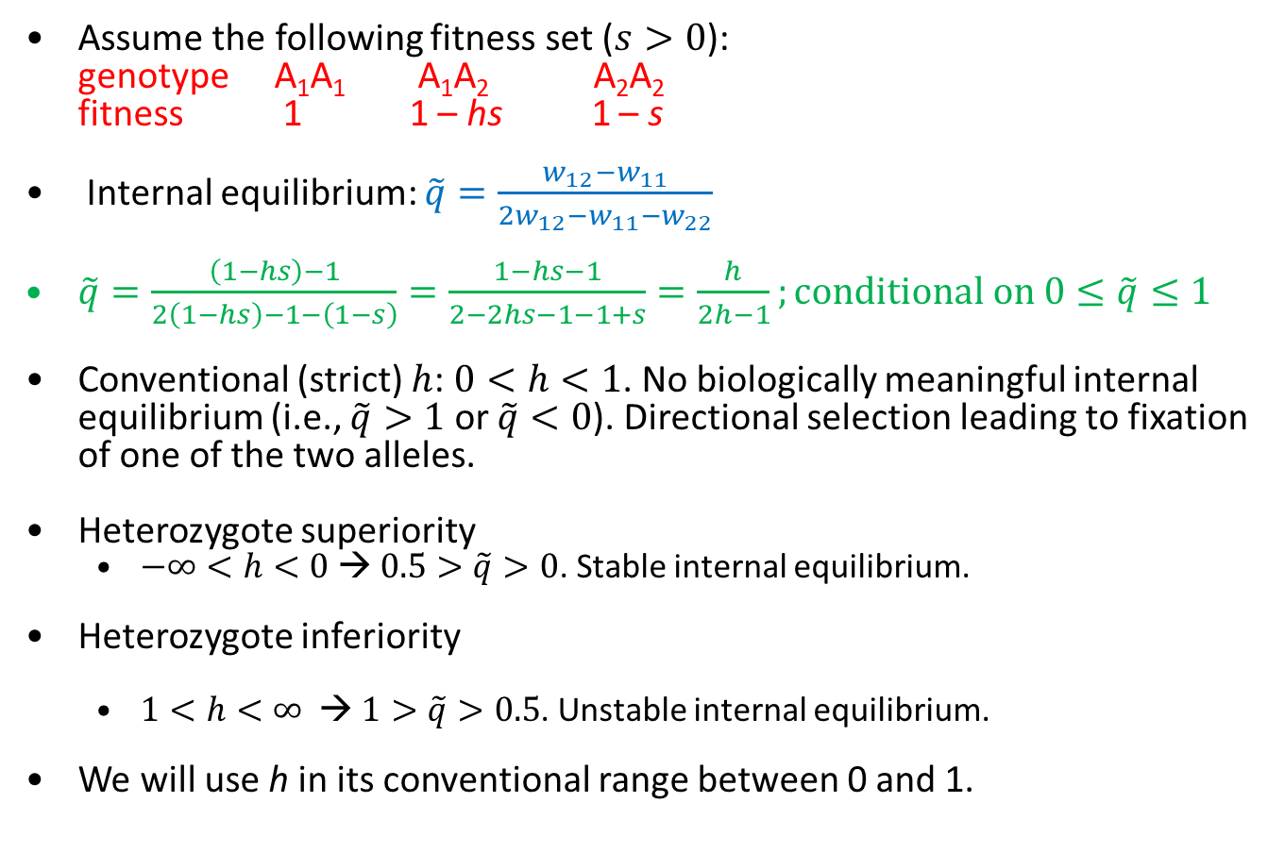
Dominance coefficient h
Assume the following fitness set ($s>0$):
genotype A₁A₁ A₁A₂ A₂A₂
fitness 1 1 – hs 1 – s
Internal equilibrium: $\tilde{q}=\frac{w_{12}−w_{11}}{2w_{12}−w_{11}−w_{22}}$
$\tilde{q}=\frac{\left(1−hs\right)−1}{2\left(1−hs\right)−1−\left(1−s\right)}=\frac{1−hs−1}{2−2hs−1−1+s}=\frac{h}{2h−1};conditional on 0≤\tilde{q}≤1$
Conventional (strict) $h$: $0<h<1$. No biologically meaningful internal equilibrium (i.e., $\tilde{q}>1$ or $\tilde{q}<0$). Directional selection leading to fixation of one of the two alleles.
Heterozygote superiority
  $−∞<h<0$ → $0.5>\tilde{q}>0$. Stable internal equilibrium.
Heterozygote inferiority
  $1<h<∞$ → $1>\tilde{q}>0.5$. Unstable internal equilibrium.
We will use h in its conventional range between 0 and 1.
1. $∵w_{12}>w_{22}$
$∴−hs>−s; h<1$
2. $∵w_{12}>w_{11}$
$∴−hs>0;h<0$

Slide 19
Mutation-selection balance
Mutation continually introduces new alleles and the vast majority of these are deleterious (i.e., reduce fitness), so selection will act to remove them.
Assume the following fitness set:
genotype A₁A₁ A₁A₂ A₂A₂
fitness 1 1 – hs 1 – s
Advantageous A₁ mutates to deleterious A₂ at the rate μ per generation
back-mutation (A₂ → A₁) can be ignored because q, being the allele frequency of the new mutant, will be small.
Mutation creates deleterious allele A₂, and selection removes deleterious allele A₂

Slide 20
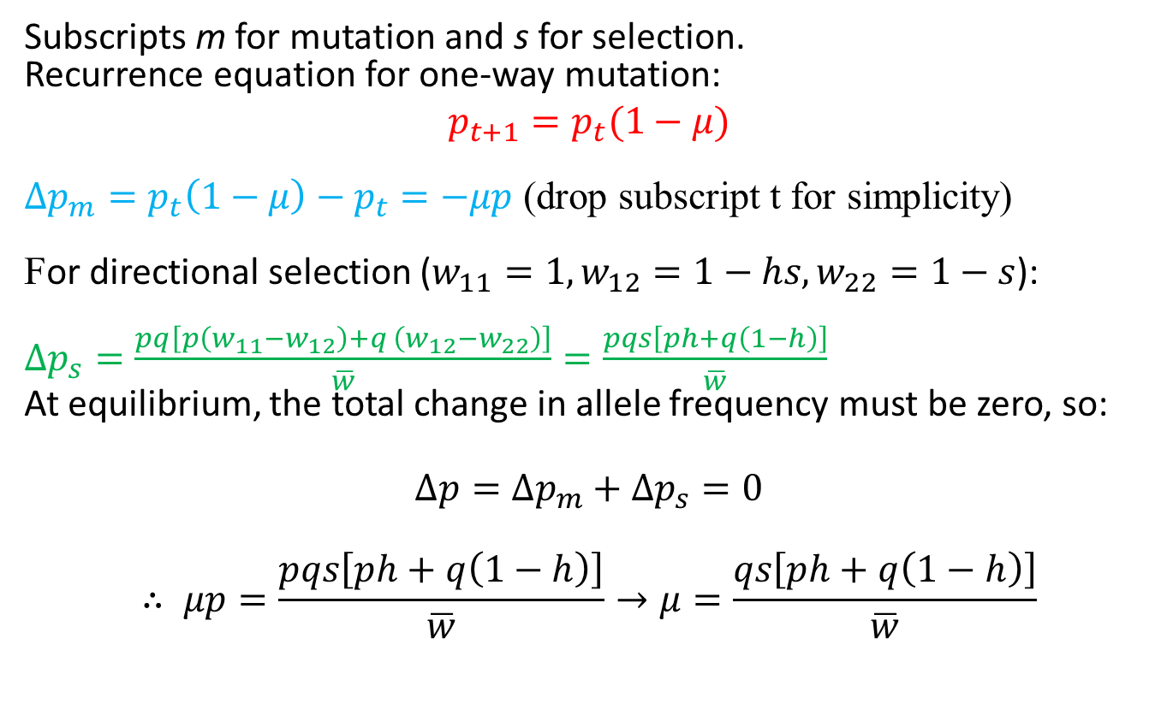
Mutation-selection balance
Subscripts m for mutation and s for selection.
Recurrence equation for one-way mutation:
$$p_{t+1}=p_{t}(1−μ)$$
$∆p_{m}=p_{t}\left(1−μ\right)−p_{t}=−μp$ (drop subscript t for simplicity)
For directional selection ($w_{11}=1, w_{12}=1−hs,w_{22}=1−s$):
$∆p_{s}=\frac{pq\left[p\left(w_{11}−w_{12}\right)+q \left(w_{12}−w_{22}\right)\right]}{\overline{w}}=\frac{pqs\left[ph+q\left(1−h\right)\right]}{\overline{w}}$
At equilibrium, the total change in allele frequency must be zero, so:
$$∆p=∆p_{m}+∆p_{s}=0$$
$$∴ μp=\frac{pqs\left[ph+q\left(1−h\right)\right]}{\overline{w}}→μ=\frac{qs\left[ph+q\left(1−h\right)\right]}{\overline{w}}$$

Slide 21
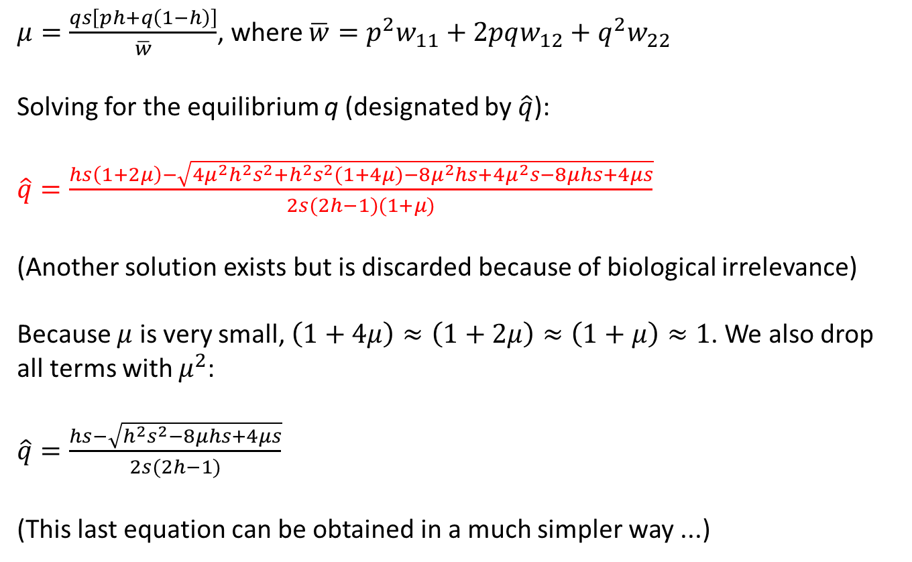
Mutation-selection balance
$μ=\frac{qs\left[ph+q\left(1−h\right)\right]}{\overline{w}}$, where $\overline{w}=p^{2}w_{11}+2pqw_{12}+q^{2}w_{22}$
Solving for the equilibrium q (designated by $\hat{q}$):
$\hat{q}=\frac{hs\left(1+2μ\right)−\sqrt{4μ^{2}h^{2}s^{2}+h^{2}s^{2}(1+4μ)−8μ^{2}hs+4μ^{2}s−8μhs+4μs}}{2s(2h−1)(1+μ)}$
(Another solution exists but is discarded because of biological irrelevance)
Because $μ$ is very small, $\left(1+4μ\right)≈\left(1+2μ\right)≈\left(1+μ\right)≈1$. We also drop all terms with $μ^{2}$:
$\hat{q}=\frac{hs−\sqrt{h^{2}s^{2}−8μhs+4μs}}{2s(2h−1)}$
(This last equation can be obtained in a much simpler way ...)

Slide 22
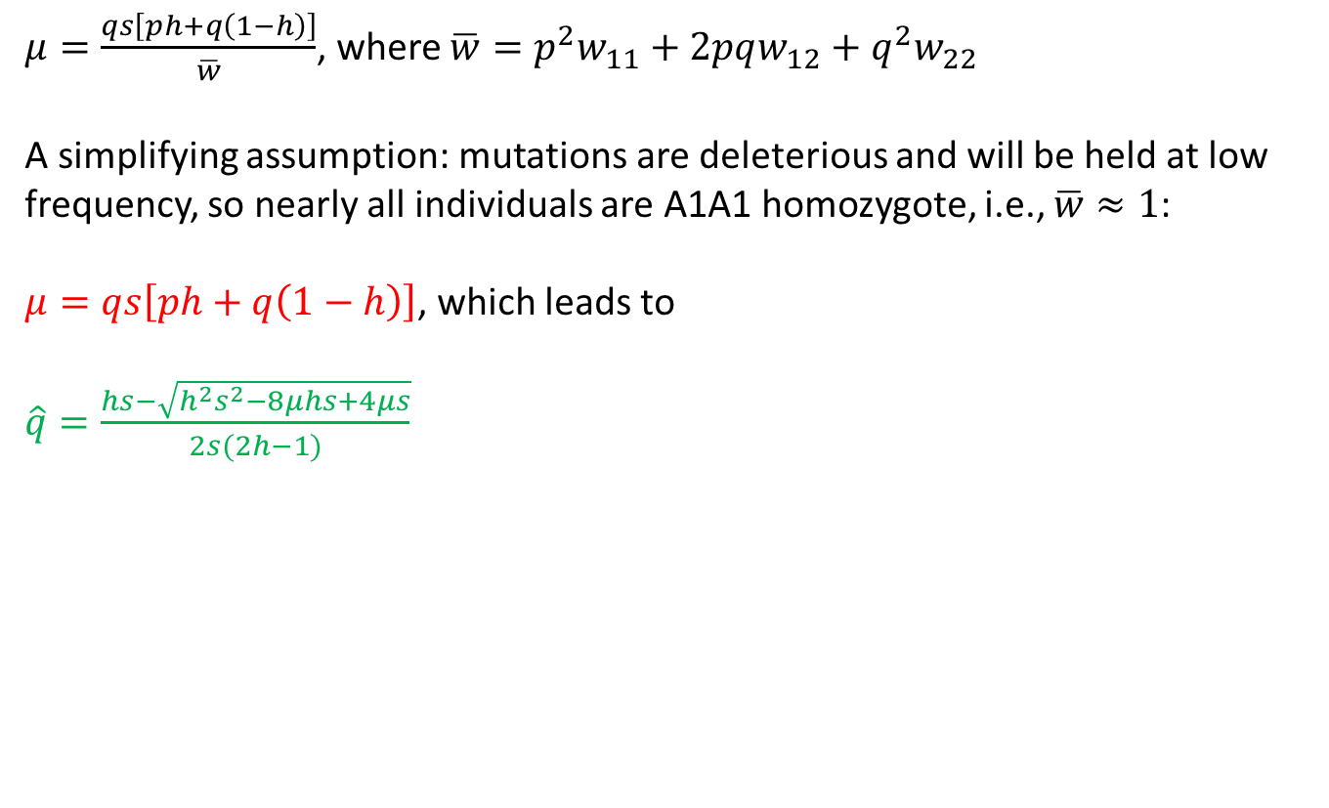
Mutation-selection balance
$μ=\frac{qs\left[ph+q\left(1−h\right)\right]}{\overline{w}}$, where $\overline{w}=p^{2}w_{11}+2pqw_{12}+q^{2}w_{22}$
A simplifying assumption: mutations are deleterious and will be held at low frequency, so nearly all individuals are A1A1 homozygote, i.e., $\overline{w}≈1$:
$μ=qs\left[ph+q\left(1−h\right)\right]$, which leads to
$\hat{q}=\frac{hs−\sqrt{h^{2}s^{2}−8μhs+4μs}}{2s(2h−1)}$

Slide 23
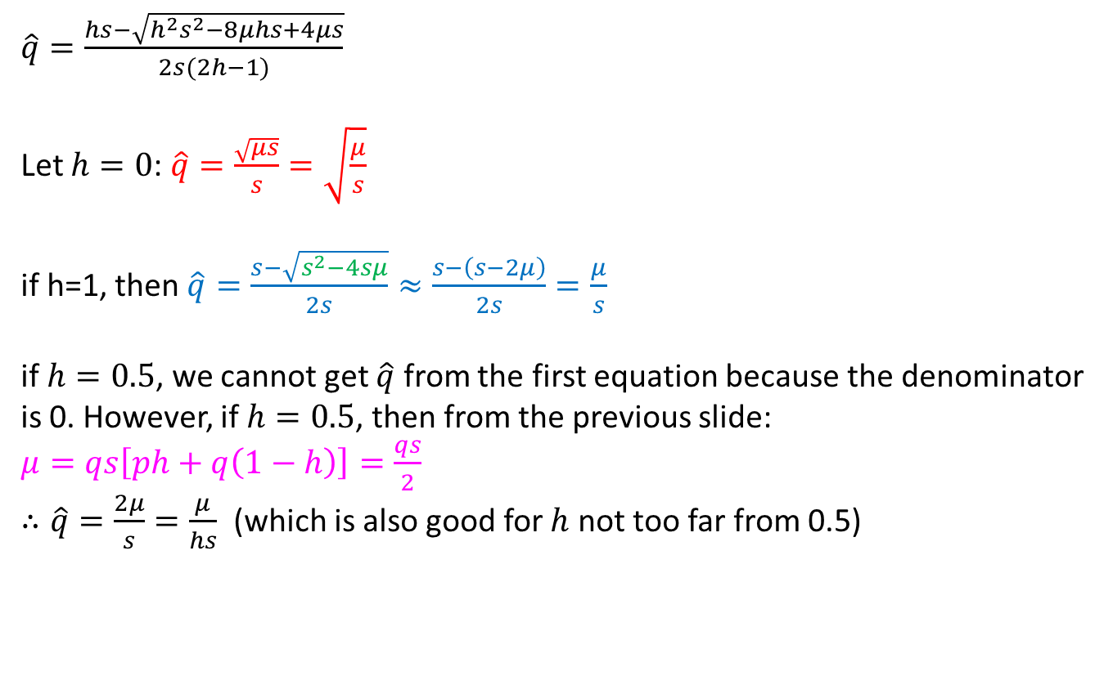

Mutation-selection balance: h=c
$\hat{q}=\frac{hs−\sqrt{h^{2}s^{2}−8μhs+4μs}}{2s(2h−1)}$
  Let $h=0$: $\hat{q}=\frac{\sqrt{μs}}{s}=\sqrt{\frac{μ}{s}}$
  if h=1, then $\hat{q}=\frac{s−\sqrt{s^{2}−4sμ}}{2s}≈\frac{s−\left(s−2μ\right)}{2s}=\frac{μ}{s}$
  if $h=0.5$, we cannot get $\hat{q}$ from the first equation because the denominator is 0. However, if $h=0.5$, then from the previous slide:
  $μ=qs\left[ph+q\left(1−h\right)\right]=\frac{qs}{2}$
  $∴\hat{q}=\frac{2μ}{s}=\frac{μ}{hs}$ (which is also good for $h$ not too far from 0.5)
$$s^{2}−4sμ=s^{2}−4sμ+{\left(2μ\right)}^{2}−{\left(2μ\right)}^{2} \\ ={\left(s−2μ\right)}^{2}−{\left(2μ\right)}^{2} \\ ≈{\left(s−2μ\right)}^{2}$$

Slide 24
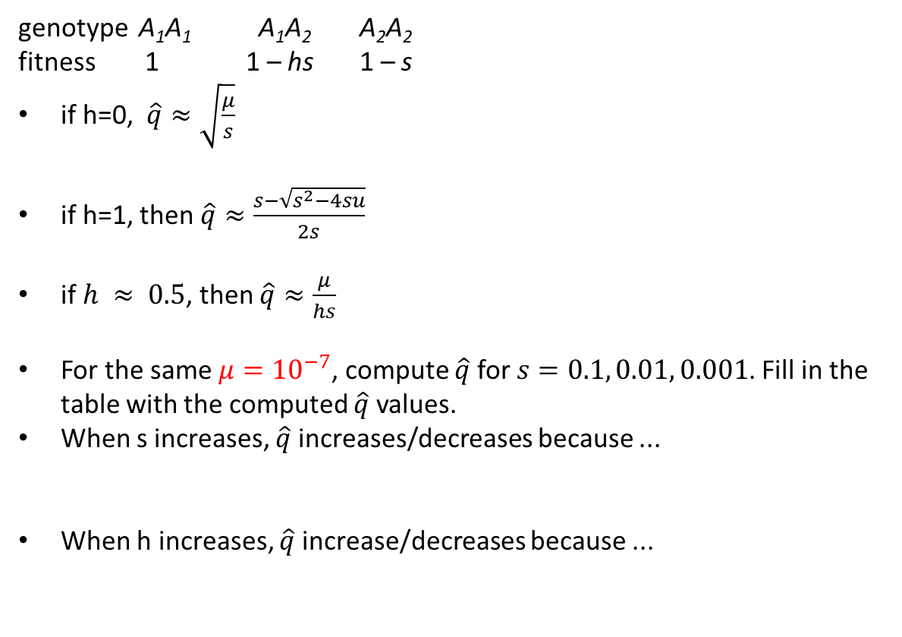
Assignment: The effect of h
genotype A₁A₁ A₁A₂ A₂A₂
fitness 1 1 – hs 1 – s
if h=0, $\hat{q}≈\sqrt{\frac{μ}{s}}$
if h=1, then $\hat{q}≈\frac{s−\sqrt{s^{2}−4su}}{2s}$
if $h ≈ 0.5$, then $\hat{q}≈\frac{μ}{hs}$
For the same $μ={10}^{−7}$, compute $\hat{q}$ for $s=0.1, 0.01, 0.001$. Fill in the table with the computed $\hat{q}$ values.
When s increases, $\hat{q}$ increases/decreases because ...
When h increases, $\hat{q}$ increase/decreases because ...
h | s=0.1 | s=0.01 | s=0.001
0
0.4
0.5
0.6
1
Name:
ID:

Slide 25
Application
Huntington disease is an autosome-dominant genetic disorder resulting from large n in (CAG)_{n} repeats. Assume only two alleles: small-n allele (normal allele A) and large-n allele (disease allele H). N_{O} is the number of offspring as an approximation to fitness
If the frequency of Huntington disease sufferers in a population is 5 × 10⁻⁵, what is the A→H mutation rate?
Genotype | N_{ij} | N_{O} | W | w
AA | 100 | 220 | 2.2 | 1
AH | 18 | 32 | 1.777778 | 0.81
HH | 0 | ? | ? | ?

Slide 26

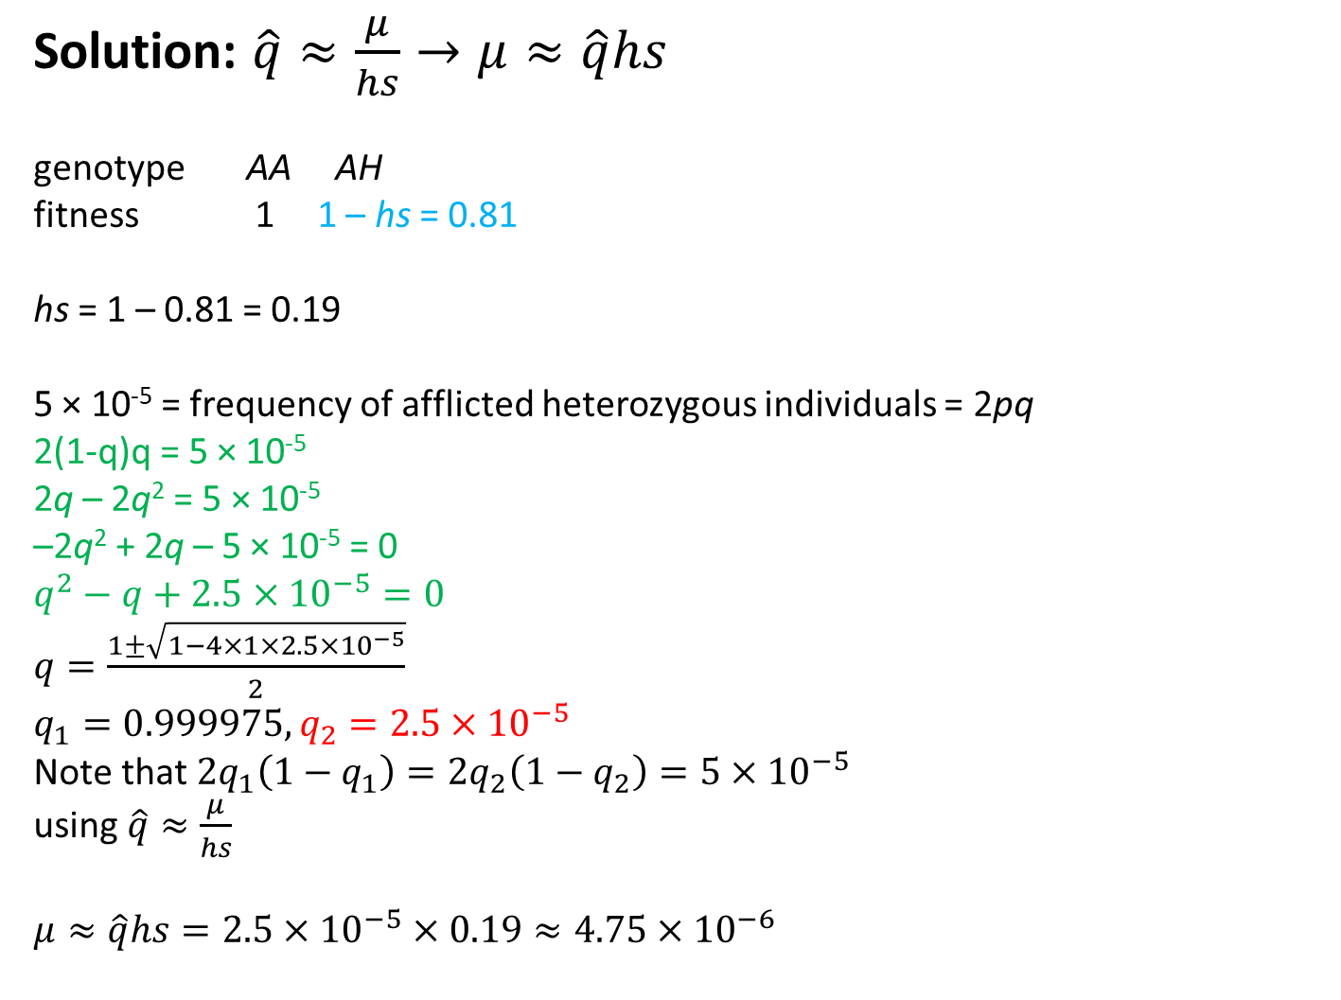
Solution: $\hat{q}≈\frac{μ}{hs}→μ≈\hat{q}hs$
genotype AA AH
fitness 1 1 – hs = 0.81
hs = 1 – 0.81 = 0.19
5 × 10⁻⁵ = frequency of afflicted heterozygous individuals = 2pq
2(1-q)q = 5 × 10⁻⁵
2q – 2q² = 5 × 10⁻⁵
–2q² + 2q – 5 × 10⁻⁵ = 0
$q^{2}−q+2.5×{10}^{−5}=0$
$q=\frac{1±\sqrt{1−4×1×2.5×{10}^{−5}}}{2}$
$q_{1}=0.999975, q_{2}=2.5×{10}^{−5}$
Note that $2q_{1}\left(1−q_{1}\right)=2q_{2}\left(1−q_{2}\right)=5×{10}^{−5}$
using $\hat{q}≈\frac{μ}{hs}$
$μ≈\hat{q}hs=2.5×{10}^{−5}×0.19≈4.75{×10}^{−6}$
$$ax^{2}+bx+c=0$$
$$x=\frac{−b±\sqrt{b^{2}−4ac}}{2a}$$

Slide 27

Optional: quadratic equation solution
$$ax^{2}+bx+c=0$$
$$x^{2}+\left(\frac{b}{a}\right)x+\frac{c}{a}=0$$
$$x^{2}+\left(\frac{b}{a}\right)x=−\frac{c}{a}$$
Aim to get $x^{2}+2Cx+C^{2}$, so that ${\left(x+C\right)}^{2}$.
$$∵\frac{b}{a}=2C; ∴C=\frac{b}{2a}$$
$$x^{2}+\left(\frac{b}{a}\right)x+{\left(\frac{b}{2a}\right)}^{2}=−\frac{c}{a}+{\left(\frac{b}{2a}\right)}^{2}$$
$${\left(x+\frac{b}{2a}\right)}^{2}=−\frac{c}{a}+{\left(\frac{b}{2a}\right)}^{2}=\frac{b^{2}−4ac}{4a^{2}}$$
$$x+\frac{b}{2a}=±\sqrt{\frac{b^{2}−4ac}{4a^{2}}}=±\frac{\sqrt{b^{2}−4ac}}{2a}$$
$$x=\frac{−b±\sqrt{b^{2}−4ac}}{2a}$$

Slide 28
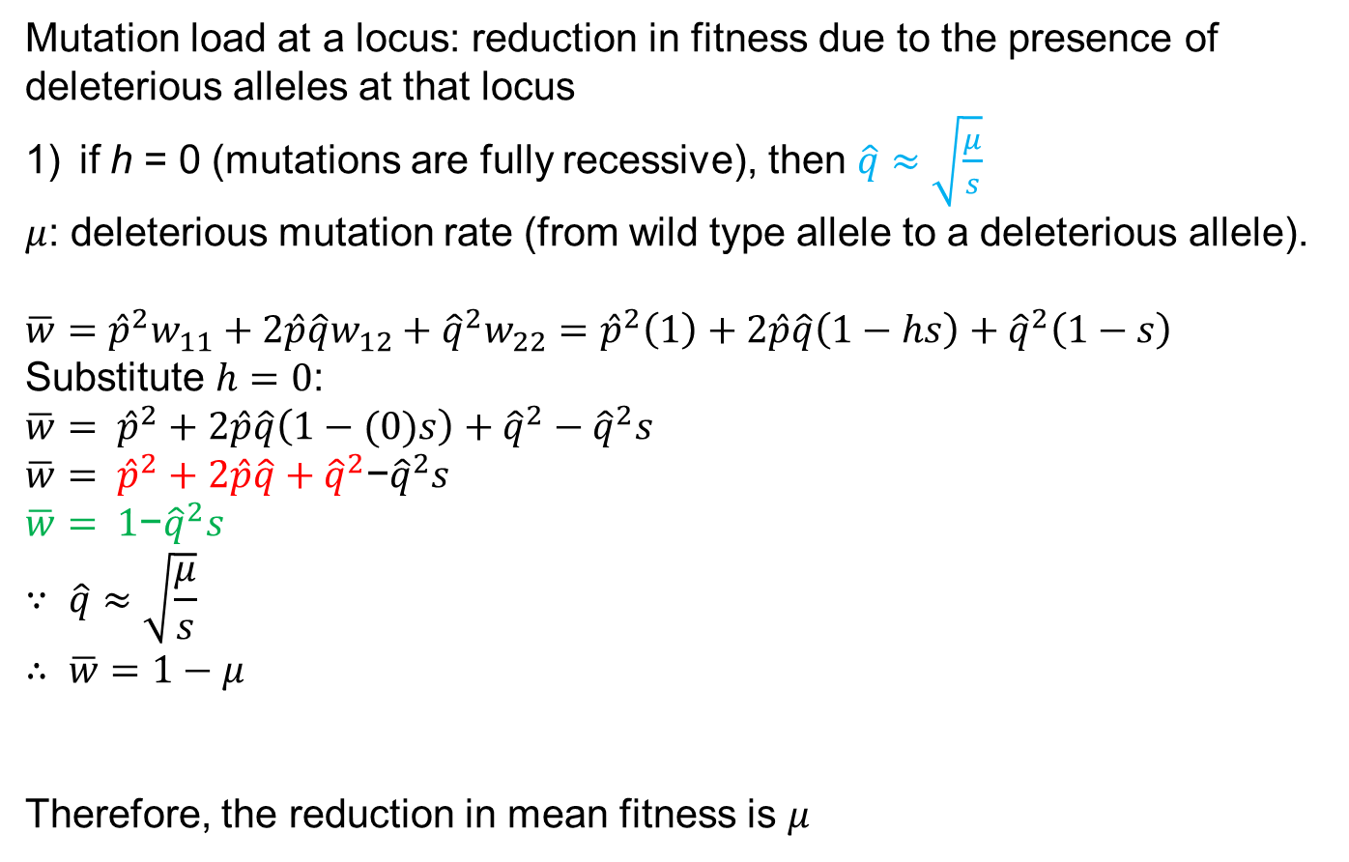
Mutation load
Mutation load at a locus: reduction in fitness due to the presence of deleterious alleles at that locus
if h = 0 (mutations are fully recessive), then $\hat{q}≈\sqrt{\frac{μ}{s}}$
$μ$: deleterious mutation rate (from wild type allele to a deleterious allele).
$$\overline{w}={\hat{p}}^{2}w_{11}+2\hat{p}\hat{q}w_{12}+{\hat{q}}^{2}w_{22}={\hat{p}}^{2}\left(1\right)+2\hat{p}\hat{q}\left(1−hs\right)+{\hat{q}}^{2}\left(1−s\right)$$
Substitute $h=0$:
$$\overline{w}= {\hat{p}}^{2}+2\hat{p}\hat{q}\left(1−(0)s\right)+{\hat{q}}^{2}−{\hat{q}}^{2}s \\ \overline{w}= {\hat{p}}^{2}+2\hat{p}\hat{q}+{\hat{q}}^{2}\text{−}{\hat{q}}^{2}s$$
$$\overline{w}= \text{1}\text{−}{\hat{q}}^{2}s$$
$$∵ \hat{q}≈\sqrt{\frac{μ}{s}}$$
$$∴ \overline{w}=1−μ$$
Therefore, the reduction in mean fitness is $μ$

Slide 29

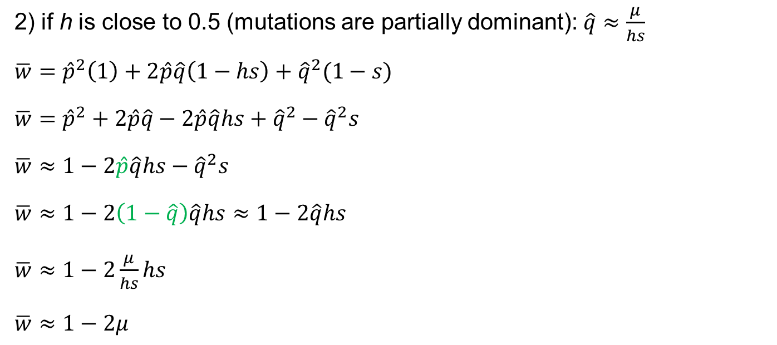


Mutation load (h close to 0.5)
2) if h is close to 0.5 (mutations are partially dominant): $\hat{q}≈\frac{μ}{hs}$
$\overline{w}={\hat{p}}^{2}\left(1\right)+2\hat{p}\hat{q}\left(1−hs\right)+{\hat{q}}^{2}(1−s)$
$\overline{w}={\hat{p}}^{2}+2\hat{p}\hat{q}−2\hat{p}\hat{q}hs+{\hat{q}}^{2}−{\hat{q}}^{2}s$
$\overline{w}≈1−2\hat{p}\hat{q}hs−{\hat{q}}^{2}s$
$\overline{w}≈1−2\left(1−\hat{q}\right)\hat{q}hs≈1−2\hat{q}hs$
$\overline{w}≈1−2\frac{μ}{hs}hs$
$\overline{w}≈1−2μ$
recall: $p2 + 2pq + q2 = 1$
ignore terms with ${\hat{q}}^{2}$ because they are so small
$$\left(1−\hat{q}\right)\hat{q}=\hat{q}−{\hat{q}}^{2}≈\hat{q}$$

Slide 30

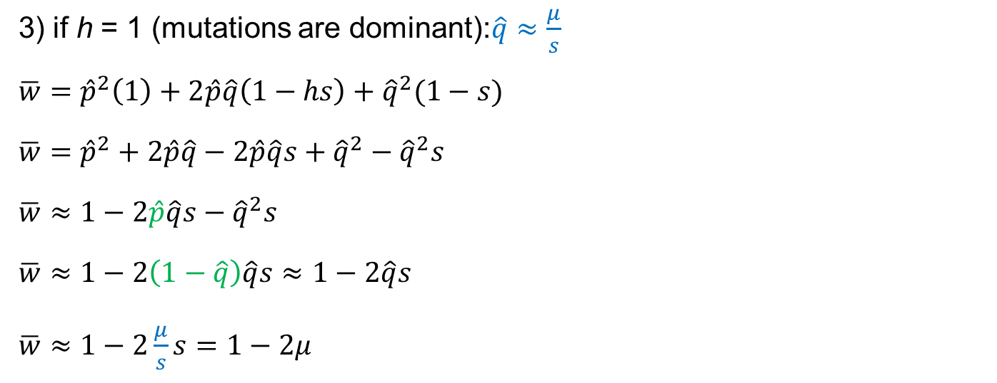


Mutation load (h = 1)
3) if h = 1 (mutations are dominant):$\hat{q}≈\frac{μ}{s}$
$\overline{w}={\hat{p}}^{2}\left(1\right)+2\hat{p}\hat{q}\left(1−hs\right)+{\hat{q}}^{2}(1−s)$
$\overline{w}={\hat{p}}^{2}+2\hat{p}\hat{q}−2\hat{p}\hat{q}s+{\hat{q}}^{2}−{\hat{q}}^{2}s$
$\overline{w}≈1−2\hat{p}\hat{q}s−{\hat{q}}^{2}s$
$\overline{w}≈1−2\left(1−\hat{q}\right)\hat{q}s≈1−2\hat{q}s$
$\overline{w}≈1−2\frac{μ}{s}s=1−2μ$
recall: $p2 + 2pq + q2 = 1$
ignore terms with ${\hat{q}}^{2}$ because they are so small
$$\left(1−\hat{q}\right)\hat{q}=\hat{q}−{\hat{q}}^{2}≈\hat{q}$$

Slide 31
Summary of mutation load
is the reduction in average population fitness caused by recurrent mutation and it ranges between μ ↔ 2μ (depending on dominance of the mutations)
this is dependent only on the mutation rate and not how harmful the mutations are (Haldane-Muller Principle) because more harmful mutations equilibrate at a lower frequency
This is for a single locus. When mutations across the entire genome are considered, the average individual at mutation-selection balance is less that 60% as fit as they would be in the absence of mutation (assuming a genome wide mutation rate of approximately one)
Geneticists have therefore suggested that mutation load may contribute to population extinction and that many biological features (e.g., recombination, outcrossing, genome size) evolved to alleviate mutation load.

Slide 32
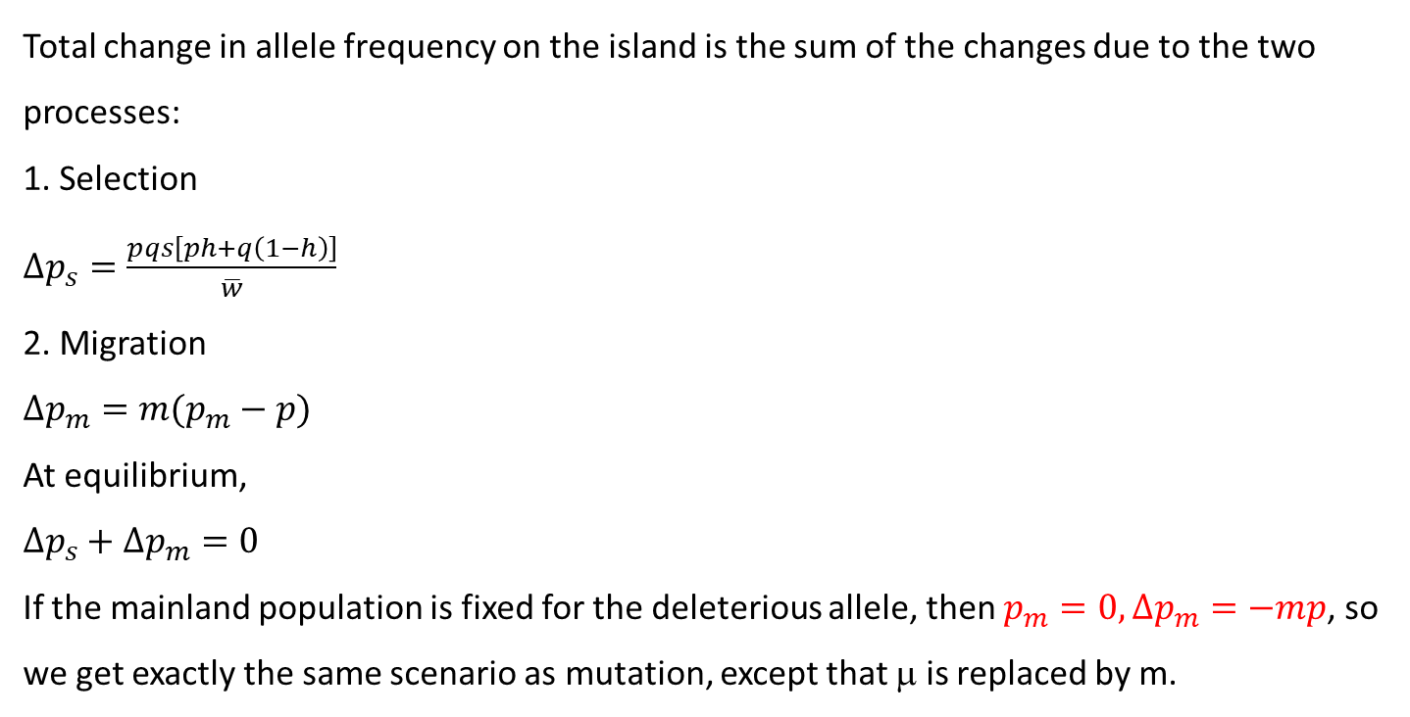
Migration-selection balance
Total change in allele frequency on the island is the sum of the changes due to the two processes:
1. Selection
$Δp_{s}=\frac{pqs\left[ph+q\left(1−h\right)\right]}{\overline{w}}$
2. Migration
$Δp_{m}=m(p_{m}−p)$
At equilibrium,
$Δp_{s}+Δp_{m}=0$
If the mainland population is fixed for the deleterious allele, then $p_{m}=0, Δp_{m}=−mp$, so we get exactly the same scenario as mutation, except that μ is replaced by m.

