Slide 1
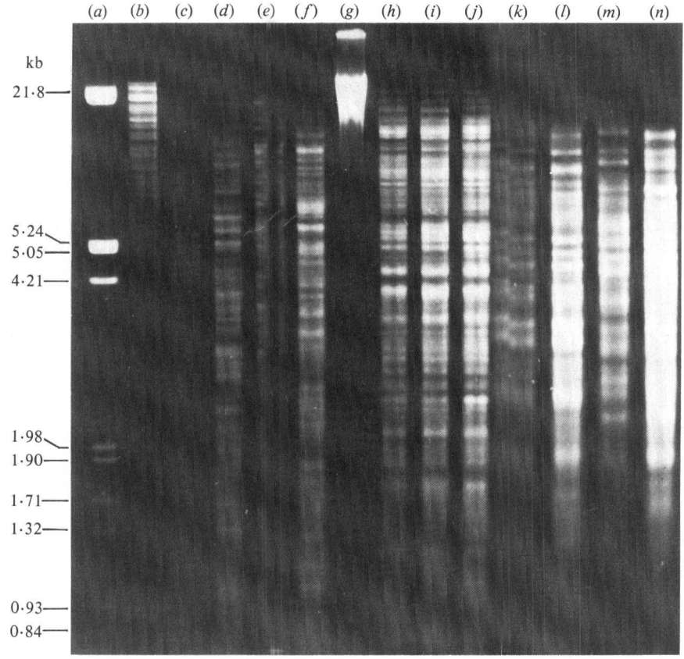
Introduction to Genetic Variation
Prof. Xuhua Xia
xxia@uottawa.ca
http://dambe.bio.uottawa.ca
©University of Ottawa
$$=\frac{\sum_{ij,i≠j}{π_{ij}}}{n(n−1)/2}$$
Math/Stats

Slide 2
Learning objectives
By the end of this section you should:
Appreciate the contribution of mutation to genetic variation and applications based on genetic variation
be comfortable with simple terminology (e.g., loci, gene, allele, the number of polymorphic loci, nucleotide diversity, heterozygosity, Shannon entropy)
be familiar with commonly used methods (indices) for quantifying genetic variation
be able to calculate genotype frequencies from absolute numbers of different genotypes, allele frequencies from genotype frequencies, and other simple indices of genetic variation
be able to recount practical applications based on genetic variation and think of new applications

Slide 3
Population and population genetics
Abstract population: exists in models in population genetics, e.g., a population in the Wright-Fisher model
Real Population:
consists of members of the same species
has its members potentially mating with any other member in the population, although not always with the same probability
has members continuously distributed geographically during mating season
will typically last for many generations
has population-level features, e.g.,
size of a population
frequency of a particular allele or genotype in that population
exhibits genetic variation that can be quantified over space and time
Population genetics
Seeks to understand the structure and dynamics of genetic variation both within and among populations/species (which can be either abstract or real)
Study factors (mutation, migration, selection, etc.) contributing to the origin, maintenance and change in genetic variation

Slide 4
Paternal chromosome
A₁ = allele
A locus
Maternal chromosome
A₂ = allele
Relationship among alleles
Two alleles within one individual
Two randomly sampled alleles

Slide 5
Genetic Variation
Mutation is the ultimate source of genetic variation
Point mutation
Insertion/deletion
Inversion
Duplication
...
All evolutionary processes require genetic variation to have any affect:
natural selection
genetic drift
gene flow/migration
Inbreeding/assortative mating
Genotype and phenotype
Phenotype with unknown genotype
Genotype with unknown phenotype
Both known
Notes:
mutation!

Slide 6
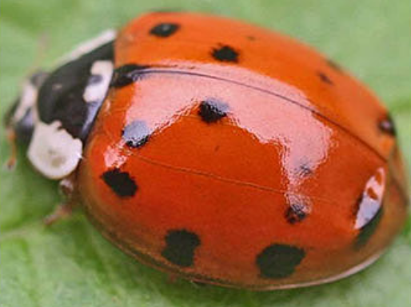
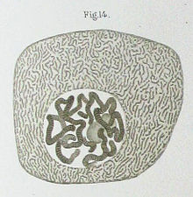
What do alleles look like?
From Mendel to 1950s: Alleles were seen indirectly through discrete phenotypes:
Round seeds, wrinkled seeds in peas
White-eyed and red-eyed flies in fruit flies
Color pattern in beetle elytra.
From 1920s early 1960s: Visible chromosome bands, inversions and other differences on chromosome
Dobzhansky and his students work on insects
McClintock and her students
Electromorphs (mid-1960s to present, but rarely used after 1980s): Lewontin and Hubby (1966)
DNA fingerprinting and forensics based on polymorphic DNA, especially on minisatellite and microsatellite DNA (Alec Jeffreys, 1980s)
Nucleotide and genomic sequences (1980s to present)
Image credit: wikipedia

Slide 7
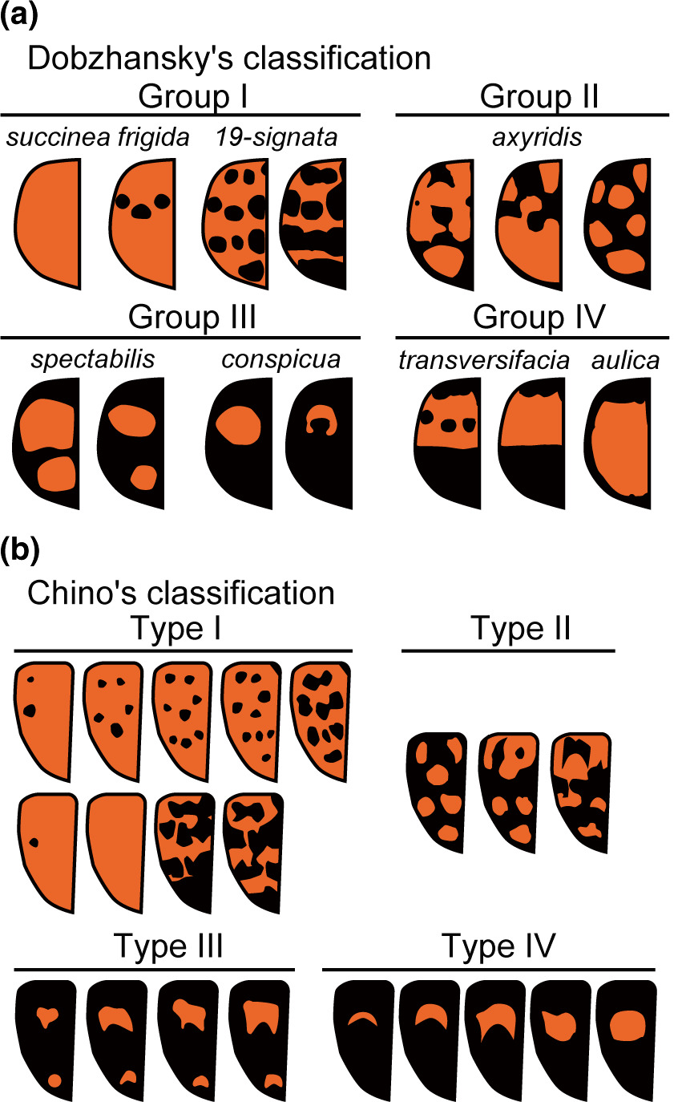
Elytral color patterns
CC Tan and JC Li (1934, Am Nat)
CC Tan (1946, Genetics)
Harmonia axyridis
105 named morphs
classified into several genera
Detailed breeding and bookkeeping:
A single species
A single locus with 12 alleles.
Two lessons:
a large "diversity" can ben generated by very little genetic variation
These different alleles appear neutral
Ando, T, Niimi, T. Development and evolution of color patterns in ladybird beetles: A case study in Harmonia axyridis. Develop Growth Differ. 2019; 61: 73– 84.

Slide 8
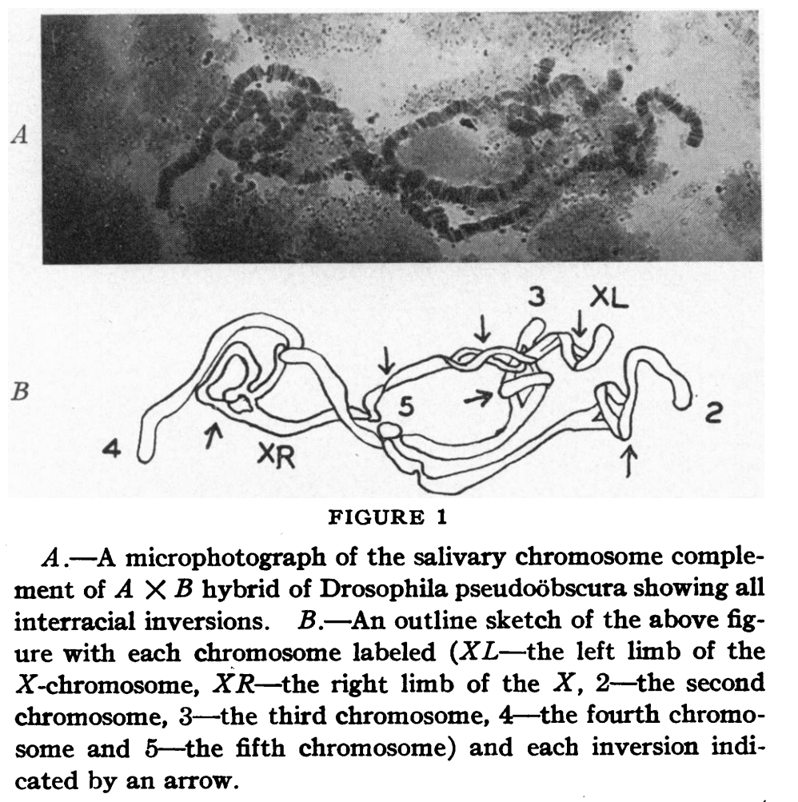
Saliary gland polytene chromosome
Drosophila obscura
Drosophila persimilis
Drosophila pseodoobscura
CC Tan 1935. PNAS
Two morphologically nearly identical "races" turned out to belong to two different species, with multiple chromosomal inversions.

Slide 9
Saliary gland polytene chromosome
Drosophila obscura
Drosophila persimilis
Drosophila pseodoobscura
CC Tan 1935. PNAS
Much genetic difference may correspond to little morphological variation
Little genetic variation may correspond to much morphological variation
Rizki 1951. PNAS
Two morphologically nearly identical "races" turned out to belong to two different species, with multiple chromosomal inversions.

Slide 10
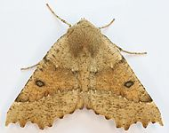
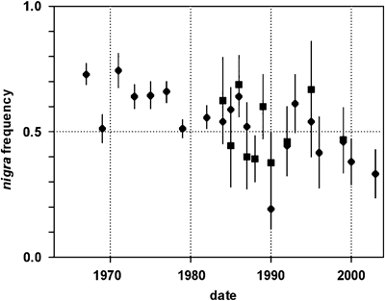
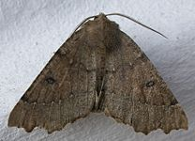
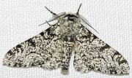
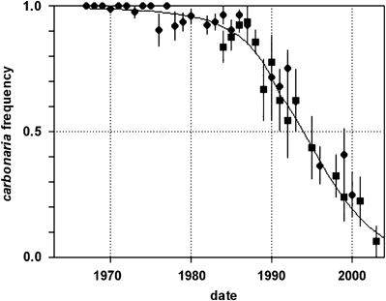
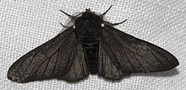
Natural selection and genetic variation
Industrial melanism
Odontopera bidentata
scalloped hazel moth
Biston betularia the peppered moth
https://en.wikipedia.org/wiki/Industrial_melanism
Cook, L. M.; Turner, J. R. G. (2008). "Decline of melanism in two British moths: spatial, temporal and inter-specific variation". Heredity. 101 (6): 483–489

Slide 11
Alleles visualized in electrophoresis
Samples
Gel with alkaline running buffer
These bands are invisible without staining.
FF
FF
FF
FF
FS
SS
SS
Proteins, negatively charged in alkaline buffer, migrate towards the positive pole.

Slide 12
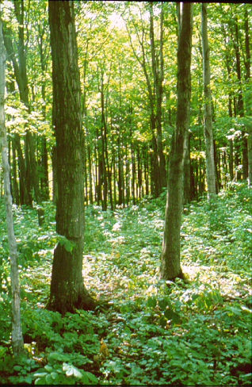
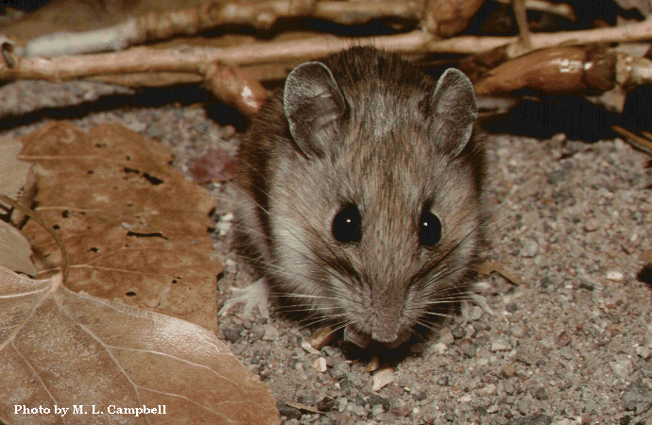
Detect multiple Paternity (esterase-1)
Table 3. Litters with multiple paternity in 1987 and 1988.
Year | Mother | Offspring
1987 | AA | AB | AA | AD
1988 | AA | AA | AB | AB | AD | AD
 | AA | AA | AB | AB | AB | AC | AD
 | AA | AA | AB | AB | AB | AD
 | AA | AA | AA | AA | AB | AB | AD
 | AA | AA | AA | AB | AB | AD
 | AA | AA | AB | AB | AD | AD | AD
Xia X, Millar JS. 1991. Genetic evidence of promiscuity in Peromyscus leucopus. Behavioral Ecology and Sociobiology 28:171-178.

Slide 13
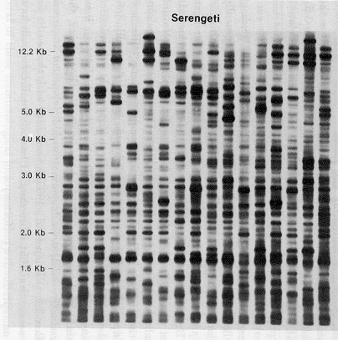
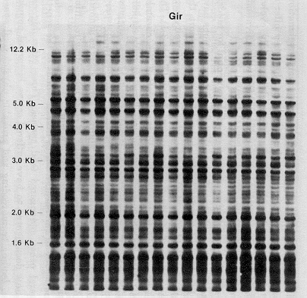
Inbreeding/drift & genetic variation
Serengeti
Three individuals with fragment length polymorphism
Individual 1:
Individual 2:
Individual 3:
Gir
Repeated DNA
Conserved region
Forward and reverse PCR primers to amplify the fragment (colored yellow)
Gilbert DA et al., 1991. JH

Slide 14
Applications of DNA fingerprinting
Forensics (Alec Jeffreys)
Family relationship
Criminal identification
Where is this salmon from?
Pacific salmon stock represents important resources for west coast fishermen in both US and Canada
Overfish can causing serious problems
Given N salmon that can be harvested from the Pacific salmon stock, what proportion (p) should be allocated to US fishermen and (1-p) to Canadian fishermen?
What is a fair p?
The equity principle of allocation
Disease diagnosis

Slide 15
Identification of bacterial pathogen
Fig. 2. Agarose gel electrophoresis through a 1% gel of 3μg mycobacterial DNA digested with PstI. Bacteriophage λ DNA digested with HindIII and EcoRI was used as size markers (lane a). Lanes: (b) E. coli; (c) M. smegmatis; (d) M. phlei; (e) M. scrojulaceum; (f) M. marinum; (g) M. lepraemurium; (h) M. tuberculosis H37Rv; (i) M. tuberculosis H37Ra; (j) M. tuberculosis H4Ra; (k) M. avium no. 214; (1) M. avium no. 8063; (m) M. intracellulare; (n) ‘M. lufu’.
Patel et al. 1986. JGM

Slide 16
What do alleles look like? fruit fly Adh
5’UTR
“slow”
allele
“fast”
allele
“Exons are shown as boxes; translated regions are in black”.
Note: only the nts which differ from consensus are shown
These are not neighboring nucleotides
Asterisk (C*) = site of Lys-for-Thr replacement responsible for mobility difference between fast (F) and slow (S) electrophoretic alleles
Lys: AAR
Point mutation : A vs. C in 2nd position of codon
Thr: ACN
Figure from Graur and Li (2000), original data from Kreitman (1983) Polymorphic sites in Drosophila Adh gene
Notes:
Rotting fruit may contain more than 4% of ethanol →ADH. ADH-3 is also a key component of nitric oxide signaling which is associated with penile erection in human

Slide 17
Different methods & different results
5’UTR
“slow”
allele
“fast”
allele
Based on nucleotide sequences
Allele N p
1 1/11
1 1/11
1 1/11
1 1/11
1 1/11
1 1/11
1 1/11
1 1/11
1 1/11
1 1/11
1 1/11
Based on electromnorph:
Allele N p
Fast 6 6/11
Slow 5 5/11

Slide 18
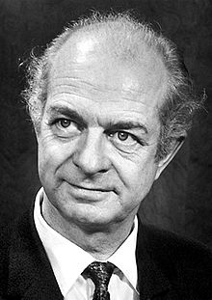
Point mutation:
Sickle-cell anemia
Normal β polypeptide (Hb-A): Val-His-Leu-Thr-Pro-Glu-Glu…… GAA
Sickel-cell GUA β polypeptide (Hb-S): Val-His-Leu-Thr-Pro-Val-Glu……
The first methionine is cleaved during posttranslational modification. It is typically cut off if the second amino acid is small and nonpolar.
Linus Pauling
2/28/1901 – 8/19/1994

Slide 19
Insertion: β-Thalassemia HBb
10 20 30 40 50 60
----|----|----|----|----|----|----|----|----|----|----|----|--
Normal AUGGUGCACCUGACUCCUGAGGAGAAGUCUGCCGUUACUGCCCUGUGGGGCAAGGUGAACGU
Thalass. AUGGUGCACCUGACUCCUGAGGAGAAGUCUGCCGUUACUGCCCUGUGGGGCAAGGUGAACGU
**************************************************************
70 80 90 100 110 120
--|----|----|----|----|----|----|----|----|----|----|----|----
Normal GGAUGAAGUUGGUGGU-GAGGCCCUGGGCAGGUUGGUAUCAAGGUUACAAGACAGG......
Thalass. GGAUGAAGUUGGUGGUUGAGGCCCUGGGCAGGUUGGUAUCAAGGUUACAAGACAGG......
**************** ***************************************
An insertion leading to the creation of a stop codon and a truncated protein
Easy diagnosis: electrophoresis would show two bands, one rapidly migrating short protein and one slowly migrating long (normal) protein
Given that it is deleterious, why is it quite frequent in some areas?
Hypotheses on fetal hemoglobin

Slide 20
Trinucleotide repeats & Huntington’s Disease
HTT coding sequence and its translated protein (<27 repeats, > 40 repeats)
HTT AUGGCGACCCUGGAAAAGCUGAUGAAGGCCUUCGAGUCCCUCAAGUCCUUCCAGCAGCAGCAGCAGCAGCAGCAGCAG
M A T L E K L M K A F E S L K S F Q Q Q Q Q Q Q Q Q
HTT CAGCAGCAGCAGCAGCAGCAGCAGCAGCAGCAACAGCCGCCACCGCCGCCGCCGCCGCCGCCGCCUCCUCAG ...
Q Q Q Q Q Q Q Q Q Q Q Q P P P P P P P P P P P Q ...

Slide 21
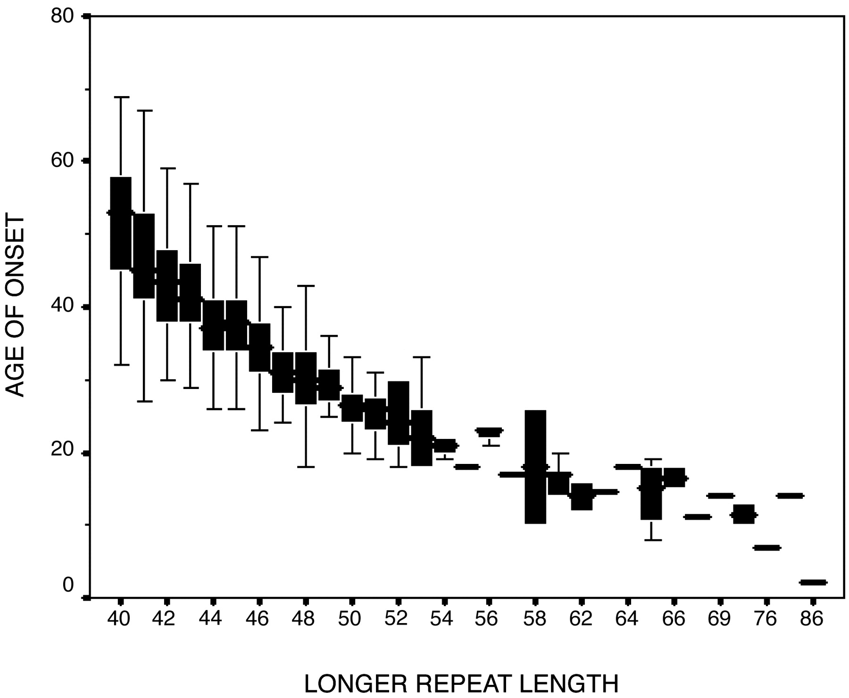
Duplication of trinucleotide repeats
HTT coding sequence and its translated protein
HTT AUGGCGACCCUGGAAAAGCUGAUGAAGGCCUUCGAGUCCCUCAAGUCCUUCCAGCAGCAGCAGCAGCAGCAGCAGCAG
M A T L E K L M K A F E S L K S F Q Q Q Q Q Q Q Q Q
HTT CAGCAGCAGCAGCAGCAGCAGCAGCAGCAGCAACAGCCGCCACCGCCGCCGCCGCCGCCGCCGCCUCCUCAG ...
Q Q Q Q Q Q Q Q Q Q Q Q P P P P P P P P P P P Q ...
The U. S. –Venezuela Collaborative Research Project, Wexler NS. 2004. Proc. Natl. Acad. Sci. U S A 101(10):3498.

Slide 22
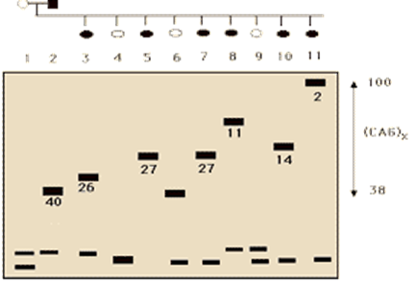
Duplication of trinucleotide repeats
HTT coding sequence and its translated protein
HTT AUGGCGACCCUGGAAAAGCUGAUGAAGGCCUUCGAGUCCCUCAAGUCCUUCCAGCAGCAGCAGCAGCAGCAGCAGCAG
M A T L E K L M K A F E S L K S F Q Q Q Q Q Q Q Q Q
HTT CAGCAGCAGCAGCAGCAGCAGCAGCAGCAGCAACAGCCGCCACCGCCGCCGCCGCCGCCGCCGCCUCCUCAG ...
Q Q Q Q Q Q Q Q Q Q Q Q P P P P P P P P P P P Q ...
(A)
(B)
Number under band: age of disease onset.
The U. S. –Venezuela Collaborative Research Project, Wexler NS. 2004. Proc. Natl. Acad. Sci. U S A 101(10):3498.

Slide 23
Duplication of trinucleotide repeats
HTT coding sequence and its translated protein
HTT AUGGCGACCCUGGAAAAGCUGAUGAAGGCCUUCGAGUCCCUCAAGUCCUUCCAGCAGCAGCAGCAGCAGCAGCAGCAG
M A T L E K L M K A F E S L K S F Q Q Q Q Q Q Q Q Q
HTT CAGCAGCAGCAGCAGCAGCAGCAGCAGCAGCAACAGCCGCCACCGCCGCCGCCGCCGCCGCCGCCUCCUCAG ...
Q Q Q Q Q Q Q Q Q Q Q Q P P P P P P P P P P P Q ...
(A)
(B)
Number under band: age of disease onset.
The U. S. –Venezuela Collaborative Research Project, Wexler NS. 2004. Proc. Natl. Acad. Sci. U S A 101(10):3498.
Autosome dominant
DNA replication slippage → variation

Slide 24
Duplication of trinucleotide repeats
HTT coding sequence and its translated protein
HTT AUGGCGACCCUGGAAAAGCUGAUGAAGGCCUUCGAGUCCCUCAAGUCCUUCCAGCAGCAGCAGCAGCAGCAGCAGCAG
M A T L E K L M K A F E S L K S F Q Q Q Q Q Q Q Q Q
HTT CAGCAGCAGCAGCAGCAGCAGCAGCAGCAGCAACAGCCGCCACCGCCGCCGCCGCCGCCGCCGCCUCCUCAG ...
Q Q Q Q Q Q Q Q Q Q Q Q P P P P P P P P P P P Q ...
N_{CAG} | Age | Age Range
39 | 66 | 72-59
40 | 59 | 61-56
41 | 54 | 56-52
42 | 49 | 50-48
43 | 44 | 45-42
44 | 42 | 43-40
45 | 37 | 39-36
46 | 36 | 37-35
47 | 33 | 35-31
48 | 32 | 34-30
49 | 28 | 32-25
50 | 27 | 30-24
(A)
(B)
Brinkman RR et al. 1997. Am J Hum Genet
young child

Slide 25
Indices used to measure genetic variation

Slide 26
Allele and genotype frequencies
Alleles and allele frequencies: Given two different alleles A₁ and A₂ in a sample of N diploid individuals with number of A₁ and A₂ alleles being $N_{A_{1}}$ and $N_{A_{2}}$, we have allele frequencies $p_{1}=\frac{N_{A_{1}}}{2N}, p_{2}=\frac{N_{A_{2}}}{2N}, N=N_{A_{1}}+N_{A_{2}},\sum{p_{i}}=1$
Diploid genotype and genotype frequencies: There are three possible genotypes for two alleles (i.e., diploid combinations): A₁A₁, A₁A₂, and A₂A₂, with corresponding genotype frequencies $P11=\frac{N_{11}}{N}, P12=\frac{N_{12}}{N}, P22=\frac{N_{22}}{N}, P11+P12+P22 =1$
Ideally, genotypes are fully reflected by phenotypes, so one can distinguish among A₁A₁, A₁A₂, and A₂A₂, so one can obtain N₁₁, N₁₂ and N₂₂ can
By convention, small-case p for allele frequency and capital-case P for genotype frequencies
A₁A₂ and A₂A₁ are treated as the same genotype and represented by the conventional notation of A₁A₂. Note that there are two distinct forms (A₁ sperm and A₂ egg and A₁ egg and A₂ sperm) – we’ll see later some situations in which this matters

Slide 27
Allele and genotype frequencies
A sample of N individuals for one locus with two alleles:
Genotype | N_{ij} | P_{ij}
A₁A₁ | N₁₁ | P₁₁=N₁₁/N
A₁A₂ | N₁₂ | P₁₂=N₁₂/N
A₂A₂ | N₂₂ | P₂₂=N₂₂/N
Sum | N | 1
With large N, P₁₁ may be thought of as the probability of choosing a random individual from the population with the genotype A₁A₁ (e.g. P₁₁ = Pr(X = A₁A₁) in a random draw of an individual from the population
$$p_{i}=P_{ii}+\sum_{j=1,j≠i}^{n}{\frac{P_{ij}}{2}};$$
$$p_{i}=\frac{2N_{ii}+\sum_{j=1,j≠i}^{n}{N_{ij}}}{2N}$$
$$p_{1}=P_{11}+\frac{P_{12}}{2}$$
$$p_{1}=\frac{2N_{11}+N_{12}}{2N}$$
$$p_{2}=1−p_{1}$$
A general equation
Expected genotype frequencies under HWE
$$P_{ii}=p_{i}^{2} \\ P_{ij}=2p_{i}p_{j}$$
Notes:
A frequency from a finite sample is an approximation to a probability.

Slide 28
Homework
Genotype | 1987 |  |  |  | 1988
 | Dam |  | Young |  | Dam |  | Young
 | O | E | O | E | O | E | O | E
AA | 22 | 21.675 | 93 | 90.14961 | 14 | 13.59559 | 43 | 41.00154
AB | 3 | 4.25 | 19 | 21.06299 | 10 | 12.01471 | 51 | 63.89198
AC | 2 | 1.7 | 4 | 3.370079 | 0 | 0 | 1 | 1.006173
AD | 2 | 1.7 | 5 | 9.267717 | 5 | 3.794118 | 25 | 16.09877
BB | 1 | 0.208333 | 3 | 1.230315 | 4 | 2.654412 | 34 | 24.89043
BC | 0 | 0.166667 | 0 | 0.393701 | 0 | 0 | 1 | 0.783951
BD | 0 | 0.166667 | 0 | 1.082677 | 1 | 1.676471 | 7 | 12.54321
CC | 0 | 0.033333 | 0 | 0.031496 | 0 | 0 | 0 | 0.006173
CD | 0 | 0.066667 | 0 | 0.173228 | 0 | 0 | 0 | 0.197531
DD | 0 | 0.033333 | 3 | 0.238189 | 0 | 0.264706 | 0 | 1.580247
Sum | 30 | 30 | 127 | 127 | 34 | 34 | 162 | 162
A | 0.85 |  | 0.84252 |  | 0.632353 |  | 0.503086
B | 0.083333 |  | 0.098425 |  | 0.279412 |  | 0.391975
C | 0.033333 |  | 0.015748 |  | 0 |  | 0.006173
D | 0.033333 |  | 0.043307 |  | 0.088235 |  | 0.098765
sum | 1 |  | 1 |  | 1 |  | 1
Allele frequencies
From observed genotype frequencies (O), one can obtain allele frequencies and expected genotype frequencies (E). The table shows O for Dam and Young in 1987 and 1988. Calculate allele frequencies and expected genotype frequencies. The answers are provided in gray. You can do this quickly in EXCEL or R

Slide 29
Indices: Proportion of polymorphic loci
Proportion of polymorphic loci (a polymorphic locus is one with no allele frequency equal to 1)
$$P_{poly}=\frac{N_{poly}}{N}=\frac{3}{6}=0.5$$
Locus | AA | Aa | aa | Sum | p_{A} | Polymorphism
L1 | 10 | 0 | 0 | 10 | 1 | monomorphic
L2 | 3 | 4 | 3 | 10 | 0.5 | polymorphic
L3 | 6 | 3 | 1 | 10 | 0.75 | polymorphic
L4 | 1 | 1 | 8 | 10 | 0.15 | polymorphic
L5 | 0 | 0 | 10 | 10 | 0 | monomorphic
L6 | 10 | 0 | 0 | 10 | 1 | monomorphic
2. Is it likely that the result is from a population with a true $P_{poly}=0.4$?
$$\operatorname{Pr}\left(X=3 | P_{poly}=0.4,n=6\right)=\frac{6!}{3!\left(6−3\right)!}{0.4}^{3}{\left(1−0.4\right)}^{6−3}=0.27648$$

Slide 30
Homework
1. You have 2 polymorphic loci out of 7. What is the probability that the population has a true P_{poly} = 0.5?
2. You have 20 polymorphic loci out of 70. What is the probability that the population has a true P_{poly} = 0.5?

Slide 31
Confidence interval of P_{poly}=0.5
Locus | AA | Aa | aa | Sum | p_{A} | Polymorphism
L1 | 10 | 0 | 0 | 10 | 1 | monomorphic
L2 | 3 | 4 | 3 | 10 | 0.5 | polymorphic
L3 | 6 | 3 | 1 | 10 | 0.75 | polymorphic
L4 | 1 | 1 | 8 | 10 | 0.15 | polymorphic
L5 | 0 | 0 | 10 | 10 | 0 | monomorphic
L6 | 10 | 0 | 0 | 10 | 1 | monomorphic
x | N_{Poly} | Pr(x)
0 | 0 | 0.015625
1 | 0.166667 | 0.09375
2 | 0.333333 | 0.234375
3 | 0.5 | 0.3125
4 | 0.666667 | 0.234375
5 | 0.833333 | 0.09375
6 | 1 | 0.015625
$$P_{poly}=\frac{N_{poly}}{N}=\frac{3}{6}=0.5$$
Binomial distribution: ${\left(p+q\right)}^{6}$ with
$$p=P_{poly}, q=1−P_{poly}$$
$$\operatorname{Pr}\left(x\right)=\frac{n!}{x!\left(n−x\right)!}p^{x}{\left(1−p\right)}^{n−x}$$
When N is small, we cannot use normal approximation to attach confidence interval (CI). However, with small N, it is easy to compute exact probability as shown in the top-right table. For 95% CI, we can exclude the two extreme values because their summation is only 0.03125, so the 95% CI is
$0.16667≤P_{poly}≤0.83333$ (This CI is disputed by Bayesians but we will not go there)

Slide 32
Indices of genetic variation
Proportion of polymorphic loci (a polymorphic locus is one with no allele frequency equal to 1)
$$P_{poly}=\frac{N_{poly}}{N}=\frac{3}{6}=0.5$$
2. var(p) = pq/(2N), convenient for a locus with only two alleles
Inapplicable for extreme p values e.g., p ≈ 0 or p ≈ 1
N should be large, e.g., N > 25.
Locus | AA | Aa | aa | Sum | p_{A} | Polymorphism | var(p_{A})
L1 | 10 | 0 | 0 | 10 | 1 | monomorphic | 0
L2 | 3 | 4 | 3 | 10 | 0.5 | polymorphic | 0.0125
L3 | 6 | 3 | 1 | 10 | 0.75 | polymorphic | 0.0094
L4 | 1 | 1 | 8 | 10 | 0.15 | polymorphic | 0.0064
L5 | 0 | 0 | 10 | 10 | 0 | monomorphic | 0
L6 | 10 | 0 | 0 | 10 | 1 | monomorphic | 0
var(p_{A}) provides more information. However, with three or more alleles with allele frequencies p₁, p₂, p₃, ..., var(p_{A}) becomes allele-specific and cannot summarize genetic variation in a locus with a single value.

Slide 33
Indices: Shannon H
Proportion of polymorphic loci (a polymorphic locus is one with no allele frequency equal to 1)
var(p) = pq/(2N) , for a locus with only two alleles.
Shannon entropy from allele frequencies: $H_{p}=−\sum_{i=1 }^{n}{p_{i}\log_{2}{p_{i}}}$ (Note logarithm with base of 2. p_{i} values equal to 0 are omitted in calculation. )
Locus | AA | Aa | aa | Sum | p_{A} | Polymorphism | var(p_{A}) | H_{pA}
L1 | 10 | 0 | 0 | 10 | 1 | monomorphic | 0 | 0
L2 | 3 | 4 | 3 | 10 | 0.5 | polymorphic | 0.0125 | 1
L3 | 6 | 3 | 1 | 10 | 0.75 | polymorphic | 0.0094 | 0.8113
L4 | 1 | 1 | 8 | 10 | 0.15 | polymorphic | 0.0064 | 0.6098
L5 | 0 | 0 | 10 | 10 | 0 | monomorphic | 0 | 0
L6 | 10 | 0 | 0 | 10 | 1 | monomorphic | 0 | 0
$$=−(0.75\log_{2}{0.75+0.25\log_{2}{0.25)}}$$
Shannon H summarize genetic variation at a locus with any number of alleles.

Slide 34
Nucleotide diversity π
Nucleotide diversity:
$$π_{ij}=\frac{N_{diff.ij}}{L}$$
A ACCGCTTAGC
B ACTGCTTAGC
C ACCACTTAGC
(Also known as Hamming distance)
$$π=\frac{\sum_{ij,i≠j}{π_{ij}}}{n(n−1)/2}=θ_{T}$$
Pair | N_{Diff} | π_{ij}
A..B | 1 | 0.1
A..C | 1 | 0.1
B..C | 2 | 0.2
π and θ_{T} are synonymous
$=\frac{\sum_{ij,i≠j}{π_{ij}}}{n(n−1)/2}=\frac{0.1+0.1+0.2}{3}=0.1333$
Nei, M., Li, W-H 1979 Mathematical Model for Studying Genetic Variation in Terms of Restriction Endonucleases". PNAS. 76 (10): 5269–73.

Slide 35
Homework
We sampled three sequences (A, B and C) from each of three populations (Pop1, Pop2 and Pop3). We have already computed nucleotide diversity π for the three sequences from the first population (See detail in the previous slide). Now you calculate π for the three sequences from Pop2 and Pop3, respectively. You do not need to submit.
Suppose you have sampled 100 sequences of 30 nt from a population. Only 3 sequences (A, B and C shown below) are unique. There are 20 sequences identical to A, 30 identical to B, and 50 identical to C. How to compute π?
A ACCGCTTAGCATCACGTCGCGCTGGTAAGC
B ACTGCTTAGCATCGCGTCGCGCTGGCAAGC
C ACCACTTAGCATCACGTCGCGCTAGTAGGC
There would be 100*99/2 (=4950) pairwise comparisons and 4950 π_{ij} values. Are you going to compute all these π_{ij} values, summing them up and then divide by 4950 to get π?
Note that we have 3 unique alleles (A, B, and C) with allele frequencies $p_{A}=\frac{20}{100},p_{B}=\frac{30}{100};p_{C}=\frac{50}{100}$, so only 3 pairwise comparisons (π_{AB}, π_{AC}, π_{BC}):
$$π=\frac{n}{n−1}\sum_{ij,i≠j}{{2p}_{i}p_{j}π_{ij}}=0.092929$$
Pop1 Pop2 Pop3
A ACCGCTTAGC ATCACGTCGC GCTGGTAAGC
B ACTGCTTAGC ATCGCGTCGC GCTGGCAAGC
C ACCACTTAGC ATCACGTCGC GCTAGTAGGC
Pair | N_{Diff} | π_{ij} | π
Pop1A..Pop1B | 1 | 0.1
Pop1A..Pop1C | 1 | 0.1
Pop1B..Pop1C | 2 | 0.2 | 0.1333
Pop2A..Pop2B
Pop2A..Pop2C
Pop2B..Pop2C
Pop3A..Pop3B
Pop3A..Pop3C
Pop3B..Pop3C

Slide 36
Indices of genetic variation
Proportion of polymorphic loci (a polymorphic locus is one with no allele frequency equal to 1)
var(p) = pq/(2N) , good for a locus with only 2 alleles with p and q not close to 1 or 0, and large N.
Shannon entropy: $H_{p}=−\sum_{i=1 }^{n}{p_{i}\log_{2}{p_{i}}}$ (Note logarithm with base of 2. p_{i} values equal to 0 are omitted in calculation)
Nucletide diversity π
All these indices are based on allele or nucleotide frequencies.
If we sample a locus with two alleles in two populations (Pop1 and Pop2) and obtain the following data:
genotype | Pop1 | Pop2
AA | 25 | 10
Aa | 50 | 80
aa | 25 | 10
They both have p = q = 0.5, so any indices based on allele frequencies will tell us that the two population are equally variable at allele frequency level, which is correct. However, we see clear difference in genotype differences. In particular, Pop2 has an excess of heterozygotes. We need an index to show such differences.

Slide 37
Indices of genetic variation
Proportion of polymorphic loci (a polymorphic locus is one with no allele frequency equal to 1)
var(p) = pq/(2N), good for a locus with only 2 alleles with p and q not close to 1 or 0, and large N.
Shannon entropy: $H_{p}=−\sum_{i=1 }^{n}{p_{i}\log_{2}{p_{i}}}$ (Note logarithm with base of 2. p_{i} values equal to 0 are omitted in calculation)
Nucletide diversity π
Observed and expected heterozygosity
Observed heterozygosity (h): the frequency of heterozygotes. $h=\sum{P_{ij}}$
Expected heterozygosity (assuming HWE): $\hat{h}=1−\sum{p_{i}^{2}}$
Mean h: $H=\frac{\sum{h_{i}}}{n}$, where n is number of loci.
Mean $\hat{h}$: $\hat{H}=\frac{\sum{{\hat{h}}_{i}}}{n}$

Slide 38
Observed and expected heterozygosity
genotype | Pop1 | Pop2
AA | 25 | 10
Aa | 50 | 80
aa | 25 | 10
Sum | 100 | 100
p | 0.5 | 0.5
q | 0.5 | 0.5
h | 0.5 | 0.8
$\hat{h}$ | 0.5 | 0.5

Slide 39
Observed and expected heterozygosity
Locus | AA | Aa | aa | p | Polymorphism | h | $$\hat{h}$$
L1 | 10 | 0 | 0 | 1.0 | M | 0 | 0
L2 | 3 | 4 | 3 | 0.5 | P | 0.4 | $$0.5$$
L3 | 6 | 3 | 1 | 0.75 | P | 0.3 | $$0.375$$
L4 | 1 | 1 | 8 | 0.15 | P | 0.10 | $$0.225$$
L5 | 0 | 0 | 10 | 0 | M | 0 | 0
L6 | 10 | 0 | 0 | 1.0 | M | 0 | 0
Notes:
Example of how to calculate heterozygosity. For example, in B, 4 of the 10 are heterozygotes

Slide 40
Why is genetic variation important?
Animal conservation
Lions in Serengeti and Gir, Cheetah
Endangered whale species
Allocation of Pacific salmon fishing quota
Viral genetic diversity
New pathogenic viral strain
Recombinants
Tracing viral origin
Vaccine development
Forensics:
Paternal identification
Matching of crime-scene DNA and suspect DNA
Tracing ancestors
Disease diagnosis and mapping

Slide 41
Assignment (Lec3)
Frequency of alkaline phosphatase in a sample of English people, from Table 9 in Harris (1966)
Genotype | Number | Obs. P_{ij} | Exp. P_{ij}
SS | 141
SF | 111
FF | 28
SI | 32
FI | 15
II | 5
Total | 332
Obs. P_{ij}: observed genotype frequencies
Exp. P_{ij}: expected genotype frequencies under HWE
Fill in the blanks and submit the slide with your
Name:
ID:
Allele | N_{i} | p_{i}
S
F
I
Total | 2N | 1
Index | Value
h
$\hat{h}$
Shannon H_{p}

