Slide 1
Least-squares, Maximum likelihood and Bayesian methods
Xuhua Xia
xxia@uottawa.ca
http://dambe.bio.uottawa.ca

Slide 2
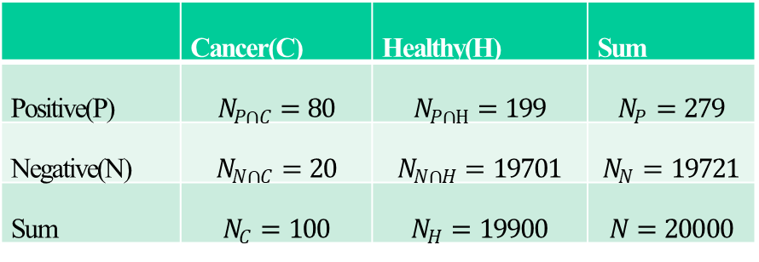
Bayesian inference: Basic terms
Conditional probability, e.g., p(P|C) = 10/100
Joint probability
Marginal probability
Prior: Prior probability distribution
Posterior: Posterior probability distribution
 | Cancer(C) | Healthy(H) | Sum
Positive(P) | $$N_{P∩C}=80$$ | $$N_{P∩H}=199$$ | $$N_{P}=279$$
Negative(N) | $$N_{N∩C}=20$$ | $$N_{N∩H}=19701$$ | $$N_{N}=19721$$
Sum | $$N_{C}=100$$ | $$N_{H}=19900$$ | $$N=20000$$

Slide 3



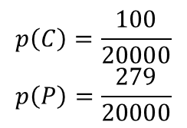
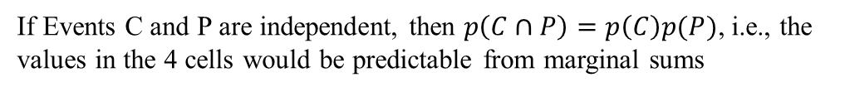
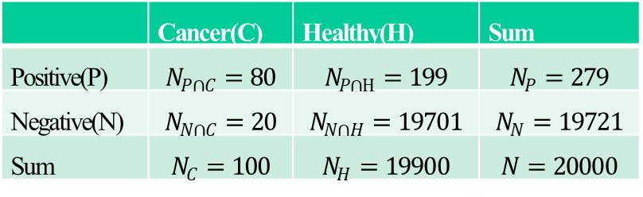
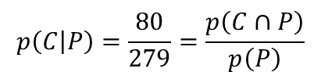
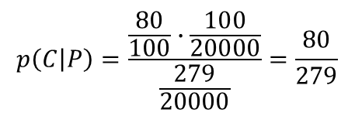
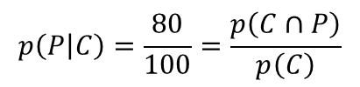
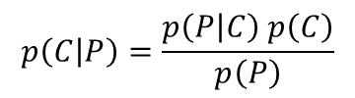
Derivation of Bayes' theorem
Large-scale breast cancer screening
 | Cancer(C) | Healthy(H) | Sum
Positive(P) | $$N_{P∩C}=80$$ | $$N_{P∩H}=199$$ | $$N_{P}=279$$
Negative(N) | $$N_{N∩C}=20$$ | $$N_{N∩H}=19701$$ | $$N_{N}=19721$$
Sum | $$N_{C}=100$$ | $$N_{H}=19900$$ | $$N=20000$$
Event C: a random woman sampled has cancer
Event P: a random woman sampled tested positive
$$p\left(C\right)=\frac{100}{20000}$$
$$p\left(P\right)=\frac{279}{20000}$$
$$p\left(C∩P\right)=\frac{80}{20000}$$
If Events C and P are independent, then $p\left(C∩P\right)=p\left(C\right)p(P)$, i.e., the values in the 4 cells would be predictable from marginal sums
$$p\left(P | C\right)=\frac{80}{100}=\frac{p\left(C∩P\right)}{p\left(C\right)}$$
$$p\left(C∩P\right)=p\left(P | C\right) p\left(C\right)$$
$$p\left(C | P\right)=\frac{80}{279}=\frac{p\left(C∩P\right)}{p\left(P\right)}$$
$$p\left(C∩P\right)=p\left(C | P\right) p\left(P\right)$$
$$p\left(C | P\right)=\frac{p\left(P | C\right) p\left(C\right)}{p\left(P\right)}$$
Joint probability
Marginal probability
$$p\left(C | P\right)=\frac{\frac{80}{100}∙\frac{100}{20000}}{\frac{279}{20000}}=\frac{80}{279}$$

Slide 4
Bayes’ theorem
Joint probability
Marginal probability
likelihood × prior
Marginal likelihood
Bayesian inference: all based on the posterior distribution
Likelihood-based inference: all based on data, and data only
Statistical inference typically involves inference of parameters and the variation of their estimates
Probability mass for discrete variables and probability density for continuous variables
not probabilities
Notes:
Relevant Bayesian problems:
1. Suppose 60% of women carry a handbag, and only 5% of men carry a handbag. Now we have a person carrying a handbag, what is the probability that the person is a woman?
2. Suppose body height distribution is N(170,20) for men, and N(165, 20) for women. Now we have a person with body height of 180, what is his chance of being a man?
2

Slide 5
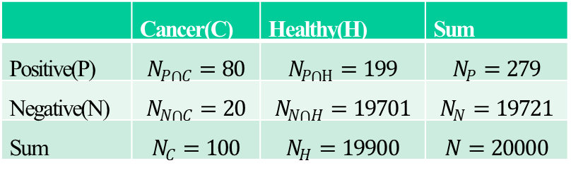
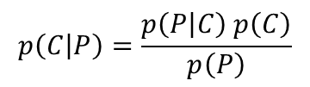
Isn't Bayes rule boring?
Likelihood
prior probability
$$p\left(C | P\right)=\frac{p\left(P | C\right) p\left(C\right)}{p\left(P\right)}$$
posterior probability
marginal probability (a scaling factor)
Isn't it simple and obvious?
Is it useful?
Isn't the terminology confusing? For example, p(C|P) and p(P|C) are called posterior probability and likelihood, respectively. However, if we put p(P|C) to the right-hand side, then p(P|C) will be posterior probability and p(C|P) likelihood. It seems strange that items seem to change their identity if we just rearrange them.
If we want to get either p(C|P) or p(P|C), we can get it right away from the table below. Why do we need to bother ourself with Bayes' rule and get p(C|P) or p(P|C) through the circuitous and torturous route?
 | Cancer(C) | Healthy(H) | Sum
Positive(P) | $$N_{P∩C}=80$$ | $$N_{P∩H}=199$$ | $$N_{P}=279$$
Negative(N) | $$N_{N∩C}=20$$ | $$N_{N∩H}=19701$$ | $$N_{N}=19721$$
Sum | $$N_{C}=100$$ | $$N_{H}=19900$$ | $$N=20000$$

Slide 6
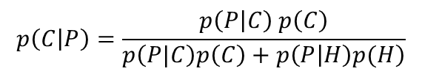

Applications
Bayesian inference with a discrete variable means that X in posterior probability p(X|Y) is discrete (i.e., categorical), e.g., Cancer and Healthy represent two categories. In contrast, Bayesian inference with a continuous variable means that X in p(X|Y) is continuous.
Q1. Suppose we have a cancer-detecting instrument. Its true positive rate or p(P|C), and false positive rate or p(P|H) have been tested with 100 cancer-carrying women and 100 cancer-free women and found to be 0.8 and 0.01, respectively. Now if a woman received a positive test result, what is the probability that she had cancer?
We need a prior p(C) to apply Bayes theorem.
Suppose someone has done a large-scale breast cancer screening of N women and get N_{P} women tested positive. This is sufficient information for us to infer p(C). The number of women have breast cancer is N_{C} = N*p(C), of which N_{C}*0.8 women are expected to be tested positive. The number of cancer-free women is N_{H} = N*[1-p(C)], of which N_{H}*0.01 women are expected to test positive. Thus, the total number of women tested positive is
If the breast cancer screen has N = 2000 and N_{P} = 28, then we have p(C) = 0.005, N_{P∩C} = N*0.005*0.8 =8, N_{P∩H} = N*(1-0.005)*0.01 = 19.9. The probability of a woman having breast cancer given a positive test result is 8/(8+19.9) =0.286738 (I did not even use Bayes theorem!)
$$p\left(C | P\right)=\frac{p\left(P | C\right) p\left(C\right)}{\left.p\left(P|C\right)p\left(C\right)+p\left(P | H\right)p(H\right)}$$
$$N∙p\left(C\right)∙0.8+N∙\left[1−p\left(C\right)\right]∙0.01=N_{P}$$
$$p\left(C\right)=\frac{N_{P}−0.01N}{0.8N−0.01N}$$

Slide 7
Bayesian inference on breast cancer
Population: women aged from 40 to 60
A woman has a chance of 0.01 of getting breast cancer (prior).
80% of those with breast cancer will get positive mammographies.
10% of those without breast cancer will also get a positive mammography.
What is the probability that a woman with a positive mammography actually has breast cancer?
posterior
priors
0.8
0.075=0.008/
(0.008+0.099)
0.008
0.008
0.01
0.2
0.002
0.99
0.099
0.099
0.925
0.891
0.1
0.9

Slide 8

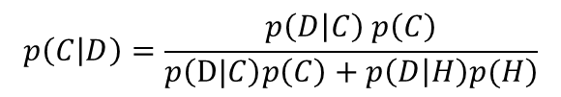

Applications
Q2. Suppose now we have a woman who have done three tests for breast cancer, with two being positive and one negative. What is the probability that she has breast cancer?
Designate the observation data (two positives and one negative) as D
$$p\left(D | C\right)=\frac{3!}{2!1!}{0.8}^{2}{0.2}^{1}=0.384$$
$$p\left(C | D\right)=\frac{p\left(D | C\right) p\left(C\right)}{\left.p\left(D|C\right)p\left(C\right)+p\left(D | H\right)p(H\right)}$$
$$p\left(D | H\right)=\frac{3!}{2!1!}{0.01}^{2}{0.99}^{1}=0.000297$$
$$p\left(C | D\right)=\frac{p\left(D | C\right) p\left(C\right)}{\left.p\left(D|C\right)p\left(C\right)+p\left(D | H\right)p(H\right)}=\frac{0.384∙0.005}{0.384∙0.005+0.000297∙0.995}=0.867$$

Slide 9
Bayes’ theorem
Notes:
Relevant Bayesian problems:
1. Suppose 60% of women carry a handbag, and only 5% of men carry a handbag. Now we have a person carrying a handbag, what is the probability that the person is a woman?
2. Suppose body height distribution is N(170,20) for men, and N(165, 20) for women. Now we have a person with body height of 180, what is his chance of being a man?
2

Slide 10
A simple problem
Suppose we wish to estimate the proportion of males (p) of a fish population in a large lake.
A random sample of 10 fish (N=10) includes 3 males and 7 females (M=3, F=7, N = M+F).
p = M/N is obvious, but how do we get the variance?

Slide 11
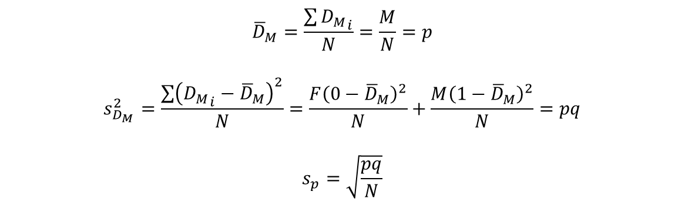
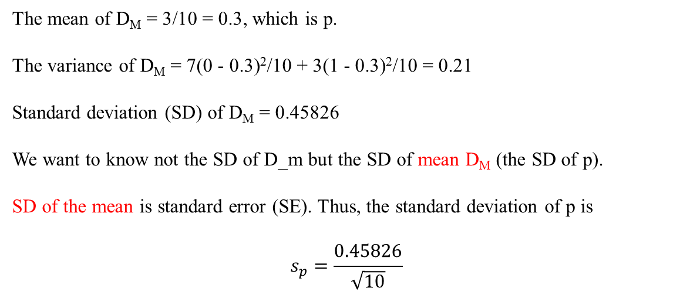
Mean and variance
Fish Sex D_{M}
1 f 0
2 f 0
3 m 1
4 f 0
5 f 0
6 f 0
7 f 0
8 m 1
9 m 1
10 f 0
The mean of D_{M} = 3/10 = 0.3, which is p.
The variance of D_{M} = 7(0 - 0.3)²/10 + 3(1 - 0.3)²/10 = 0.21
Standard deviation (SD) of D_{M} = 0.45826
We want to know not the SD of D_m but the SD of mean D_{M} (the SD of p).
SD of the mean is standard error (SE). Thus, the standard deviation of p is
$$s_{p}=\frac{0.45826}{\sqrt{10}}$$
$${\overline{D}}_{M}=\frac{\sum{{D_{M}}_{i}}}{N}=\frac{M}{N}=p$$
$$s_{D_{M}}^{2}=\frac{\sum{{\left({D_{M}}_{i}−{\overline{D}}_{M}\right)}^{2}}}{N}=\frac{F{\left(0−{\overline{D}}_{M}\right)}^{2}}{N}+\frac{M{\left(1−{\overline{D}}_{M}\right)}^{2}}{N}=pq$$
$$s_{p}=\sqrt{\frac{pq}{N}}$$

Slide 12
Maximum likelihood illustration
The likelihood approach always needs a model. As a fish is either a male or a female, we use the model of binomial distribution, and the likelihood function is
The maximum likelihood method finds the value of p that maximizes the likelihood value. This maximization process is simplified by maximizing the natural logarithm of L instead:
The likelihood estimate of the variance of p is the negative reciprocal of the second derivative,

Slide 13
Same problem with a small sample
Suppose we wish to estimate the proportion of males (p) of a fish population in a large lake.
A random sample of 6 fish caught, all being males.
Likelihood estimate of p is p = 6/6 =1
What is Bayesian approach to the problem?
Key concepts: all Bayesian inference is based on the posterior probability

Slide 14
Three tasks
Formulate f(p), our prior probability density function (referred hereafter as PPDF)
Formulate the likelihood, f(y|p)
Get the integration in the denominator

Slide 15
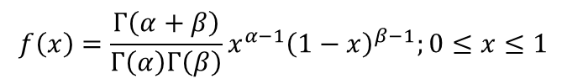

The prior: beta distribution for p
$$f\left(x\right)=\frac{Γ\left(α+β\right)}{Γ\left(α\right)Γ\left(β\right)}x^{α−1}{\left(1−x\right)}^{β−1};0≤x≤1$$
$$f\left(p | M^{′}=3,N^{′}=6\right)=\frac{5!}{2!2!}p^{2}{\left(1−p\right)}^{2}=30p^{2}{\left(1−p\right)}^{2}$$
Prior belief: equal number of males and females
How strong is this belief? α = 3, β = 3 (if α = 1, β = 1, we have uniform distribution)

Slide 16
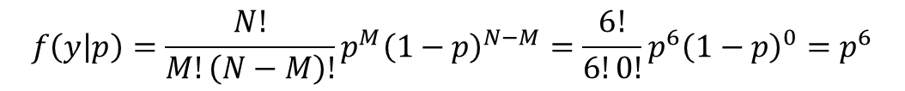
The likelihood function
$$f\left(y | p\right)=\frac{N!}{M!\left(N−M\right)!}p^{M}{\left(1−p\right)}^{N−M}=\frac{6!}{6!0!}p^{6}{\left(1−p\right)}^{0}=p^{6}$$
The numerator: joint probability distribution

Slide 17
The integration
The numerator: joint probability distribution
Integration:
Maple: int(30*p^8*(1-p)^2,p=0..1);
R: myF<-function(x) {30*x^8*(1-x)^2}
integrate(myF,0,1);

Slide 18
The posterior
Likelihood
Posterior
Prior (α = 3, β = 3)

Slide 19
Alternative ways to get posterior
Conjugate prior distributions (avoid the integration)
Discrete approximation (get the integration without an analytical solution)
Monte Carlo integration (get the integration without an analytical solution)
MCMC (avoid the integration)

Slide 20
Conjugate prior distribution
Prior (N'=6,M'=3):
Posterior (N'' = 12, M'' = 9):

Slide 21
Discretization
p_{i} | f(p_{i}) | f(y|p_{i}) | f(y|p_{i})*f(p_{i})
0 | 0 | 0 | 0
0.05 | 0.067688 | 0.000000 | 0.000000
0.1 | 0.243000 | 0.000001 | 0.000000
0.15 | 0.487688 | 0.000011 | 0.000006
0.2 | 0.768000 | 0.000064 | 0.000049
0.25 | 1.054688 | 0.000244 | 0.000257
0.3 | 1.323000 | 0.000729 | 0.000964
0.35 | 1.552688 | 0.001838 | 0.002854
0.4 | 1.728000 | 0.004096 | 0.007078
0.45 | 1.837688 | 0.008304 | 0.015260
0.5 | 1.875000 | 0.015625 | 0.029297
0.55 | 1.837688 | 0.027681 | 0.050868
0.6 | 1.728000 | 0.046656 | 0.080622
0.65 | 1.552688 | 0.075419 | 0.117102
0.7 | 1.323000 | 0.117649 | 0.155650
0.75 | 1.054688 | 0.177979 | 0.187712
0.8 | 0.768000 | 0.262144 | 0.201327
0.85 | 0.487688 | 0.377150 | 0.183931
0.9 | 0.243000 | 0.531441 | 0.129140
0.95 | 0.067688 | 0.735092 | 0.049757
1 | 0 | 1 | 0
Sum | 19.999875 |  | 1.21187329

Slide 22
MC integration
p | f(p) | f(y|p) | f(p)*L | f(p|y) | 495p⁸(1-p)²
0.797392458 | 0.783026967 | 0.257058956 | 0.201284095 | 3.33251813 | 3.321187569
0.365079937 | 1.611889587 | 0.002367706 | 0.003816481 | 0.063186769 | 0.062971934
0.527481851 | 1.86368833 | 0.021539972 | 0.040143794 | 0.66463235 | 0.6623726
0.807263134 | 0.726241527 | 0.276751969 | 0.200988772 | 3.32762868 | 3.316314743
0.55190323 | 1.834808541 | 0.028260355 | 0.051852341 | 0.858482468 | 0.855563628
0.612808637 | 1.688971541 | 0.052960157 | 0.089448199 | 1.480930442 | 1.475895278
0.573633704 | 1.794553082 | 0.035629355 | 0.063938769 | 1.058588895 | 1.054989693
0.624998494 | 1.647954515 | 0.059603783 | 0.098224323 | 1.626230512 | 1.620701328
0.404049408 | 1.739445056 | 0.004351178 | 0.007568635 | 0.125308527 | 0.124882478
… | … | … | … | … | …

Slide 23
MCMC: Metropolis
N <- 200000; #1 chain length
rnd <- sample(1:10000,N,replace=T)/10000 #2 between 0 and 1
p <- rep(0,N) #3 initiate a p vector
p[1] <- 0.5 #4 assign mean of the prior to p[1]
Prior_var<- 3*3/(6^2*7) #5 Eq. (23). Constrains the step size.
for (i in seq(1:(N-1))) { #6
p[i+1] <- rnorm(1,p[i],Prior_var) #7 propose a new p
if(p[i+1]>1) { #8
p[i+1] <- 0.999 #9
} else if(p[i+1]<0) { #10
p[i+1] <- 0.001 #11
} #12
fp0 <- dbeta(p[i],3,3) #13 two prior densities fp0 and fp1
fp1 <- dbeta(p[i+1],3,3) #14
L0 <- p[i]^6 #15 two likelihood values L0 and L1
L1 <- p[i+1]^6 #16
numer <- (fp1*L1) #17 numerator in Eq. (35)
denom <- (fp0*L0) #18 denominator in Eq. (35)
if(numer < denom) { #19
Alpha <- numer/denom #20 Alpha is within (0,1).
if(rnd[i] > Alpha) { #21
p[i+1] <- p[i] #22
p[i] <- 0 #23 steps to be discounted
} #24
} #25
} #26

Slide 24
Extract MCMC data
# after running the previous code.
# extract the Last 10000 p[i] values.
postp_Last <- p[(N-9999):N]
postp_Last <- postp_Last[postp_Last>0] # excluding rejected ones with p[i]=0
# extract the second Last 10000 p[i] values.
postp_2ndLast <- p[(N-19999):(N-10000)]
postp_2ndLast <- postp_2ndLast[postp_2ndLast>0]
par(mfrow=c(1,2)) # plot the two sets of p values
# histogram with break points 0.1, 0.15, ...
freq_Last <- hist(postp_Last,seq(0.1,1,by=0.05))
freq_2ndLast <- hist(postp_2ndLast,seq(0.1,1,by=0.05))
mean(postp_Last);var(postp_Last);
mean(postp_2ndLast);var(postp_2ndLast);

Slide 25
MCMC

Slide 26
Check convergence

Slide 27


Method of moments
$$μ=\frac{r}{n}≈0.74416; σ^{2}=\frac{r\left(n−r\right)}{n^{2}\left(n+1\right)}=0.01388159$$
$$r = 9.4620, n = 12.7150$$

Slide 28
Credible & high density intervals

Slide 29
When prob distribution known
# credible interval
qbeta(c(0.025,0.975),9,3) # generates 0.4822441, 0.9397823
# High density interval
p<-seq(0,1,by=0.001) # reduce 'by' value to increase precision
dbeta<-dbeta(p,9,3) # get corresponding prob. density
sbeta<-sample(dbeta,1e5,replace=TRUE,prob=dbeta) # sample prob. density
critDensity <- quantile(sbeta, 0.05) # for a horizontally cut
phigh <-p[dbeta >= critDensity]
lo<-phigh[1]
hi<-phigh[length(phigh)]
lo;hi;
lo = 0.517 and hi = 0.959.

Slide 30
When prob distribution unknown
quantile(postp_Last,c(0.025,0.975))
res<-hist(postp_Last,100)
x<-res$mids; dx<-res$density
plot(dx~x,type="l");
spl<-smooth.spline(x=x,y=dx,df=10);
lines(spl, col="blue");
pv<-predict(spl,x)
p<-seq(min(x),max(x),by=0.001) # reduce 'by' value to increase precision
dp<-pmax(0,predict(spl,x=p)$y) # pmax changes all negative values to 0.
samp<-sample(p,1e5,replace=TRUE,prob=dp)
quantile(samp,c(0.025,0.975)) # produce credible interval
samp <- sample(dp, 1e5, replace = TRUE, prob = dp) # sample probability densities
critDensity <- quantile(samp, 0.05) # a horizontal line to cut the peak
phigh <-p[dp >= critDensity]
lo<-phigh[1]; hi<-phigh[length(phigh)]
lo; hi # produce high density interval

