Slide 1
Mixture models
Xuhua Xia
xxia@uottawa.ca
http://dambe.bio.uottawa.ca
Notes:
Let me first emphasize the point that taking a systems biology perspective in doing biological research is not new. Its root can be traced at least to Ronald Fisher......
1

Slide 2
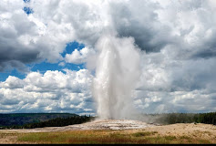
Gaussian mixture model: Data
R comes with a data set named faithful which contains eruption data of the Old Faithful geyser in Yellowstone National Park. It includes two variables:
eruptions: Length of eruption (in mins)
waiting: Interval between eruptions (in mins)
We will use faithful$waiting
> faithful$waiting
[1] 79 54 74 62 85 55 88 85 51 85 54 84 78 47 83 52 62 84 52 79 51 47 78 69 74 83 55 76 78
[30] 79 73 77 66 80 74 52 48 80 59 90 80 58 84 58 73 83 64 53 82 59 75 90 54 80 54 83 71 64
[59] 77 81 59 84 48 82 60 92 78 78 65 73 82 56 79 71 62 76 60 78 76 83 75 82 70 65 73 88 76
[88] 80 48 86 60 90 50 78 63 72 84 75 51 82 62 88 49 83 81 47 84 52 86 81 75 59 89 79 59 81
[117] 50 85 59 87 53 69 77 56 88 81 45 82 55 90 45 83 56 89 46 82 51 86 53 79 81 60 82 77 76
[146] 59 80 49 96 53 77 77 65 81 71 70 81 93 53 89 45 86 58 78 66 76 63 88 52 93 49 57 77 68
[175] 81 81 73 50 85 74 55 77 83 83 51 78 84 46 83 55 81 57 76 84 77 81 87 77 51 78 60 82 91
[204] 53 78 46 77 84 49 83 71 80 49 75 64 76 53 94 55 76 50 82 54 75 78 79 78 78 70 79 70 54
[233] 86 50 90 54 54 77 79 64 75 47 86 63 85 82 57 82 67 74 54 83 73 73 88 80 71 83 56 79 78
[262] 84 58 83 43 60 75 81 46 90 46 74

Slide 3
Visualize distribution
if (!require("ggplot2")) {
install.packages("ggplot2")
library("ggplot2")
}
if (!require("dplyr")) {
install.packages("dplyr")
library("dplyr")
}
if(!require("mixtools")){
install.packages("mixtools")
library("mixtools")
}
x <- faithful$waiting
options(scipen = 999)
p <- ggplot(faithful, aes(x = x)) + geom_density(); p;
p + geom_vline(xintercept = 53, col = "red", size = 2) +
geom_vline(xintercept = 80, col = "blue", size = 2)
0.03
density
0.02
0.01
0.00
50
60
70
80
90
x
p: pplot object
aes: aesthetics (visual properties)
geom: geometric object, e.g., density, histogram, vline, ... (to superimpose a histogram,
ggplot(faithful, aes(x = x)) + geom_histogram (and then copy metafile, ungroup, copy the histogram part and paste)

Slide 4
20
count
10

Slide 5
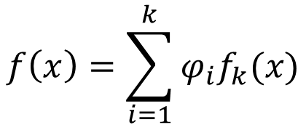
Statistical functions
$$f\left(x\right)=\sum_{i=1}^{k}{φ_{i}f_{k}(x)}$$
$$f\left(x|α,β\right)=\frac{x^{α−1}e^{−x/β}}{β^{α}Γ\left(α\right)}; α,β>0;0≤x≤∞; μ=αβ, σ^{2}=αβ^{2}$$
Time interval between random events typically follow gamma distribution. However, gamma distribution can be approximated by normal distribution when α is large.
For k = 2 and normal distribution:
$$f\left(x\right)=φ_{1}f_{1}\left(x\right)+φ_{2}f_{2}\left(x\right)=φ_{1}𝒩(μ_{1},σ_{1}^{2})+{(1−φ}_{1})𝒩(μ_{2},σ_{2}^{2})$$
$$𝒩\left(μ,σ^{2}\right)=\frac{1}{\sqrt{2πσ^{2}}}e^{−\frac{{\left(x−μ\right)}^{2}}{2σ^{2}}}$$
EXCEL:
=norm.dist(x,μ,σ,FALSE)
R:
dnorm(x,μ,σ)

Slide 6
Statistical functions
We need to estimate five parameters: μ₁, σ₁, μ₂, σ₂, and ϕ₁
If we have μ₁ = 55, σ₁ = 5, μ₂ = 80, σ₂ = 5, ϕ₁ = 0.3, then an x = 79 would have
$$f\left(79\right)=0.3𝒩\left({55,5}^{2}\right)+0.7𝒩\left({80,5}^{2}\right)=0.054746215$$
The log likelihood (lnL) function that we need to maximize is
$$lnL=\sum_{i=1}^{n}{\ln\left[f\left(x_{i}\right)\right]=\ln\left[φ_{1}𝒩\left(79,μ_{1},σ_{1}^{2}\right)+φ_{2}𝒩\left(79,μ_{2},σ_{2}^{2}\right)\right]+…}$$

Slide 7
Estimation with EXCEL Solver

Slide 8
Solution

Slide 9
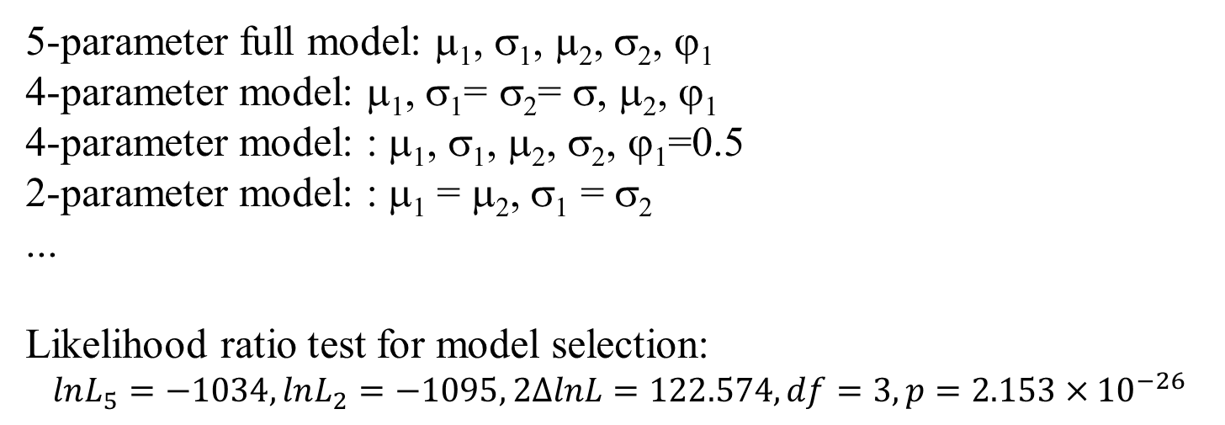
Many possible models
5-parameter full model: μ₁, σ₁, μ₂, σ₂, ϕ₁
4-parameter model: μ₁, σ₁= σ₂= σ, μ₂, ϕ₁
4-parameter model: : μ₁, σ₁, μ₂, σ₂, ϕ₁=0.5
2-parameter model: : μ₁ = μ₂, σ₁ = σ₂
...
Likelihood ratio test for model selection:
$$lnL_{5}=−1034, lnL_{2}=−1095, 2∆lnL=122.574, df=3, p=2.153×{10}^{−26}$$

Slide 10
Assignments
Write an R script that will produce the same (or nearly identical) estimates as in EXCEL solver
Find R functions that perform the same parameter estimation, but are more general (e.g., with more models in additional to Gaussian).
Write a manuscript with
Scientific problems calling for mixture models
Mathematical formulation

