Slide 1
Bioinformatics and translation initiation in eukaryotes
Xuhua Xia
Department of Biology
University of Ottawa
xxia@uottawa.ca
http://dambe.bio.uottawa.ca
Notes:
Let me first emphasize the point that taking a systems biology perspective in doing biological research is not new. Its root can be traced at least to Ronald Fisher......

Slide 2
Yeast 5’ UTR
Xuhua Xia
Slide 2
Notes:
This slide shows something peculiar in the 5’UTR of protein-coding genes in the baker’s yeast.
The axes
A dramatic increase in A and a corresponding decrease in U.
Does this pattern have anything to do with translation efficiency? Among the 6000 or so yeast genes, some are highly expressed, i.e., have high protein production, and some are lowly expressed. Is this pattern more dramatic for the highly expressed genes than the lowly expressed genes?
2

Slide 3
Gene expression and 5’ UTR
Xuhua Xia
Notes:
These two figures contrasts the pattern between the highly expressed and the lowly expressed genes. The pattern is apparently more dramatic for the highly expressed genes than the lowly expressed genes. This pattern suggests that an increase in A and a reduction in U may have something to do with translation efficiency.
3

Slide 4
An oversimplified translation model
Cap
Small subunit
?
Initiation codon
4A
5
2
eIF-4G
5
2
m⁷G
3
1
AAAAAA
3
1
AUG
4A
4B
4B
eIF-4G
PABP
AAAAAAAAAAAAAAAAAAAAAAAAAAAAAAAAAAAAAAAA
Large subunit
PABP
4B
4A
PABP
eIF-4G
PABP
PABP
Poly-A tail
UAA
Polypeptide
Not drawn to scale
Termination codon
Notes:
Here is an oversimplified model of translation for the baker’s yeast. It represents the effort of many scientists who maps physical interactions among proteins, who take microscopic images to confirm the dynamic nature of the physical interactions and who perform structural modeling to understand what cellular environment would be conducive to the interactions. While I myself do not map protein interactions, do not do imaging or cellular components and hardly do any structural modeling, I have tremendous respect to those who have done all these hard works.
The system has many essential items missing. For example, we did not include energy, which is of course essential for cellular function, just as electricity is essential for the success of this symposium. However, because electricity is constant and quite reliable, it is essentially a constant, and a constant is not interesting modeling factors that contribute to the success of a symposium. I am pretty sure that the organizers did not bother to measure the fluctuations in voltage in any of the electric sockets here. Or did you?
For the same reason, we do not need to include everything that seems essential to the system as long as they do not affect the behaviour of the system within the temporal and spatial scales.
To paraphrase Albert Einstein, we should strive to make the system as simple as possible, but not simpler.
Let me give a short introduction to the players of this simple system.
mRNA: cap, 5’ UTR, initiation codon, termination codon, poly(A) tail
Cap and poly(A) tail help to stabilize mRNA against degradation, and also facilitate the recycling of the ribosomes.
Translation itself has three subprocesses: initiation elongation and termination.
Translation initiation requires not only mRNA, but also translation ribosome and translation initiation factors that help position the ribosome on the mRNA. These initiation factors are loaded onto the 5’ UTR. In this sense, the 5’ UTR is the loading dock for translation factors and ribosomal subunits.
Initiation factors: the most essential ones are eIF-1, eIF-1A and eIF-2. But for efficient translation , eIF-4F is essential. Here eIF-4F is depicted with three components, eIF4E (cap-binding), eIF4A and eIF4G.
Initiation factors interact with the 5’ UTR, which is the loading dock for ribosomes. Efficient initiation means that many ribosomes can be loaded onto the 5’ UTR in a short time. Different mRNA molecules are known to have dramatically different translation initiation efficiency, and it is very natural to infer that the difference must be at least partially attributable to the difference in 5’UTR among mRNA molecules.
The key input of this system is the mRNA, amino acids, and energy, and the key output of this system is the translated protein. These input and output determine the system behaviour, which is the protein production rate.
One key observation is that different mRNA input often leads to different protein synthesis rate. Some mRNA gets translated very efficiently, whereas others don’t. Why? Addressing this question not only have biological significance, but also industrial significance as well because many drugs are proteins in nature and increasing protein synthesis rate is important.
As a first approximation, let’s see if differences in 5’ UTR is sufficient to explain the system behaviour, i.e., different translation rate. So we need to characterize the 5’ UTR, and Takashi Ito’s laboratory just developed a new method for this purpose in 2006.
With the 5’ UTR for thousands of yeast genes, we made a simple plot:
4

Slide 5
Poly(A) and PABP
Cap
Small subunit
?
Initiation codon
4A
5
2
eIF-4G
5
2
m⁷G
3
1
AAAAAA
3
1
AUG
4A
4B
4B
eIF-4G
PABP
PABP
PABP
AAAAAAAAAAAAAAAAAAAAAAAAAAAAAAAAAAAAAAAA
AAAAAAA……
Large subunit
PABP
PABP
PABP
4B
AAAAAAA……
4A
PABP
PABP
eIF-4G
PABP
PABP
AAAAAAA……
PABP
Poly-A tail
UAA
Polypeptide
Not drawn to scale
Termination codon
Gallie and Tanguay 1994 JBC
Gilbert et al. 2007 Science
Xuhua Xia
Notes:
The patterns shown in previous slides reminded us some early studies in Daniel Gallie’s lab on translation involving in vitro translation systems derived from rabbit reticulocyte and wheat germ. eIF-4F and eIF-4B were shown to bind to pre-AUG poly(A) and enhance translation. Exogenous poly(A) added to the translation system will sequester these initiation factors away from pre-AUG poly(A) and inhibit translation. Addition of PABP will restore the translation initiation efficiency, presumably because these PABP would bind to the poly(A) and free the translation initiation factors to bind to pre-AUG poly(A).
These studies also suggest that PABP has an additional function preventing the poly(A) tail from sequestering translation initiation factors.
One question that will immediately arise in your mind is what would happen if PABP binds also binds to pre-AUG poly(A) so it will displace the binding of translation factors and inhibit translation? PABP is one the most abundant proteins in the cell and it will bind to poly(A), regardless of where the poly(A) is.
With this question in mind, let’s examine a few more studies on pre-AUG poly(A).
5

Slide 6
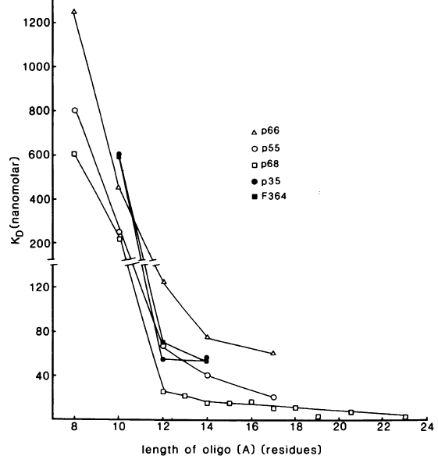
Studies on pre-AUG poly(A)
1. Shirokikh and Spirin 2008 PNAS:
Translation initiation is more efficient with longer poly(A) tracts: A₂₅ > A₁₂ > A₅.
However, there is only one yeast gene has a pre-AUG poly(A) that is as long as 25 or longer.
(The study was carried out without PABP.)
2. Sachs et al. 1987 MCB; BAG 2001 JBC; BAG and BHATTACHARJEE 2010 RNA Biol:
Binding affinity increases with the length of poly(A)
Sachs et al. 1987 MCB
Notes:
The first study showed that longer poly(A) is more efficient in binding to the 48S initiation complex. However, the study is done without PABP. By the way, it is also done without eIF-4G, which I will come back later.
The second group of studies suggest that PABP has a fixed length in its binding site. In the baker’s yeast, the binding site is 12 consecutive A’s.
These studies led us to infer that if the pre-AUG poly(A) is shorter than 12, then it can escape the binding of PABP, but will short poly(A) tracts still be sufficient to bind to translation initiation factors? If they are, then we expect those yeast genes with short pre-AUG poly(A) to produce more proteins than those without poly(A) or with poly(A) whose length is 12 or longer.

Slide 7
A graphic model
eIFs
PABP

Slide 8
Poly(A) length & protein synthesis
Xia et al. 2011 Genetics
Notes:
Protein synthesis rate adjusted for mRNA and

Slide 9
Poly(A) length and Occupancy
Xia et al. 2011 Genetics
Notes:
Occupancy is the proportion of mRNA in polysomes.

Slide 10
Ribosomal density
Mean density adjusted for mRNA length.
The confounding effect of elongation efficiency
Xia et al. 2011 Genetics
Notes:
Mean density adjusted for mRNA length.
The confounding effect of elongation efficiency

Slide 11
Tentative Conclusions
Pre-AUG poly(A) can bind to translation initiation factors to enhance translation initiation, but long (≥12) pre-AUG poly(A) will bind to Pab1p, resulting in repression of translation.
This interpretation is consistent with the observation that, when PABP is absent, longer pre-AUG poly(A) is associated with more efficient translation initiation.
This interpretation is consistent with the observation that pre-AUG poly(A) is short in the early genes but long in the late genes of vaccinia virus.

Slide 12
Yeast cyclin gene
PCL5/YHR071W mRNA: A₂₉
Pcl5 protein:
half-life = 2-3 minutes
Low abundance:
Rapid degradation or inefficient translation initiation?
Xuhua Xia
Slide 12

Slide 13
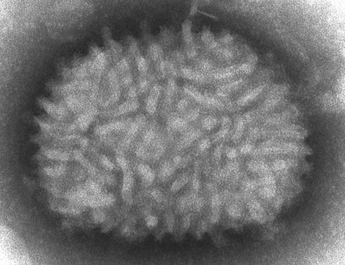
A graphic model
eIFs
PABP
Notes:
The vaccinia virus saved millions of lives. Its infection does not cause serious disease, but the infected person is protected against the deadly smallpox virus. So the smallpox vaccine is in fact vaccinia virus.
VV has a peculiar property that its early genes have short poly(A) in its 5’ UTR, mostly shorter than 10, but its late genes have very long poly(A), often longer than 30. This graphic model offers a potential explanation. The early genes are translated

Slide 14
Internal ribosome entry
Cap
Small subunit
?
Initiation codon
4A
5
2
eIF-4G
5
2
m⁷G
3
1
AAAAAA
3
1
AUG
4A
4B
4B
eIF-4G
PABP
AAAAAAAAAAAAAAAAAAAAAAAAAAAAAAAAAAAAAAAA
Large subunit
PABP
4B
4A
PABP
eIF-4G
PABP
PABP
Poly-A tail
UAA
Polypeptide
Not drawn to scale
Termination codon
Notes:
So far we have explored the factors contributing to efficient translation initiation for the conventional cap-dependent translation involving the routine repertoire of eukaryotic translation initiation factors. However, many viral proteins, especially proteins of retroviruses, are produced when the host cap-dependent translation mechanism has been shutdown. It is now known that almost all organisms have a set of genes that are typically translated in a cap-independent manner. That is, they are usually not translated or only weakly translated when the cap-dependent translation mechanism is working well, but increased their translation when the cap-dependent translation has been shutdown. These genes typically function in stressful conditions. For example, when food become limited in the yeast. How are the mRNA from these genes translated? What factors contribute to their efficient translation?
The mechanism of translation for these genes are now known to be through internal ribosomal entry

Slide 15
Internal Ribosomal Entry Site (IRES)
Figure 1. SSS/IRES-dependent translation initiation.
A prediction of secondary structure of HIV-1 Vif 5´UTR, adapted and modified from Yilmaz et al. 2006.
Khalouei and Xia 2008
Notes:
During the last few years, several papers have been published in Nature and Science proposing the following hypothesis. The ribosomal small and large subunits are recruited by translation initiation factors. If you have a sequence that form the secondary or tertiary structure that can mimic the structure of translation initiation factors positioned on mRNA, then the RNA secondary structure can function in the same way as the translation initiation factors. Several papers in Nature and Science presented RNA structures indeed mimic that of the translation initiation factor complex.
Marilyn Kozak criticized this hypothesis vehemently, claiming that these pretty structural pictures are nothing more than being pretty. She has got a good point, as no one is able to show that RNA sequences forming such structures can actually facilitate internal ribosomal entry.
At one point I was very enthusiatic about the structural hypothesis, and I thought that Marilyn Kozak was too old to appreciate the potential of structural biology. So I compiled IRES sequences to check if their secondary structural stability has anything to do with IRES activities. Surprisingly, the opposite was found……

Slide 16
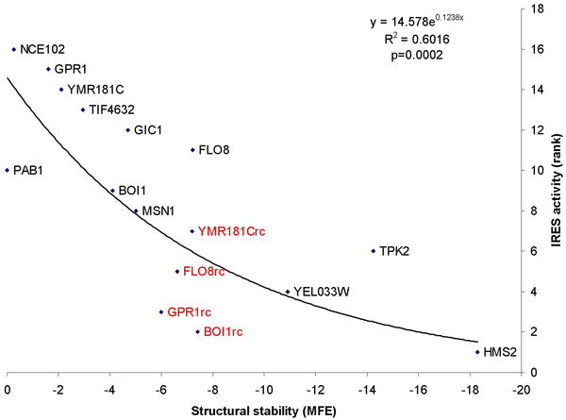
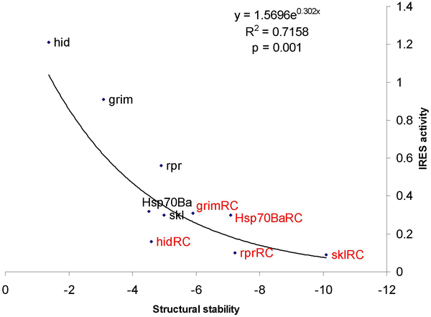
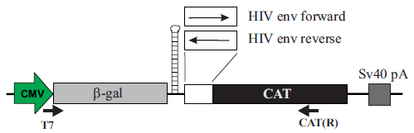
Yeast
Xia and Holcik 2009 PLoS One
IRES activity for
Yeast from Gilbert et al. 2007 Science.
Drosophila from Vazquez-Pianzola et al. Cell Death Differ 14: 286-295.
Fruitfly
IRES?
Notes:
Here is an illustration of internal ribosome entry. The first gene is translated by the regular cap-dependent mechanism, i.e., the ribosome binds to the cap and scan down to find the translation initiation codon to start translation elongation. The second gene cannot be translated in this way because a strong secondary structure prevents the ribosome from scanning downstream. However, some sequence segments, when inserted into the 5’UTR of the second gene, can allow the ribosome to bind to the 5’UTR of this downstream message internally to allow it to be translated. The sequence segment that allows the ribosome to enter internally is called internal ribosome entry site or (IRES). IRES activity measures how well these IRESs can facilitate internal ribosomal entry.
IRESs and IRES activities have been determined in a number of yeast and fruitfly genes. Here is the relationship between IRES activity and the stability of IRES secondary structure. The X-axis is the minimum folding energy. The more negative, the more stable. We see a consistent pattern. That is, IRES activity decreases rapidly with increasing secondary structure. Thus, a strong IRES is one without any secondary structure.
But is the reverse is also true？ That is, will a sequence without any secondary structure necessarily have IRES activities? It would be nice it this is also true, but unfortunately it is not. Both poly(A) and poly(U) will form no stable secondary structure, but poly(A) enhanced translation initiation but poly(U) does not. Far more poly(A)s are present in verified IRESs than poly(U)s.

Slide 17
Translation initiation consensus
Cap
Small subunit
?
Initiation codon
4A
5
2
eIF-4G
5
2
m⁷G
3
1
AAAAAA
3
1
AUG
4A
4B
4B
eIF-4G
PABP
AAAAAAAAAAAAAAAAAAAAAAAAAAAAAAAAAAAAAAAA
Large subunit
PABP
4B
4A
PABP
eIF-4G
PABP
PABP
Poly-A tail
UAA
Polypeptide
Not drawn to scale
Termination codon
Notes:
So far we have explored the factors contributing to efficient translation initiation. The mission of the translation initiation factors is to ultimately assemble the small and large ribosomal subunits at the translation initiation codon AUG. However, there are multiple AUGs in the mRNA sequence, but only one is typically used as the translation initiation codon. How could translation initiation factor determine which is the true translation initiation codon?

Slide 18
Amino acid constraint
-3 +4
Kozak consensus: RCCaugGNN NNN
P1’ P2’
Two hypotheses on preponderance of +4G
  Translation initiation recognition:
  Prediction: GNN codons should be over-represented at P1’ site.
  Amino acid constraint
    More than half of the proteins undergoes cleavage of initiator Met
    The cleavage of initiator Met depends on the size of the penultimate amino acid, i.e., cleavage is efficient only when the penultimate amino acid is small
    Glycine and Alanine are the smallest amino acids, coded by GGN and GCN codons, respectively.
    Prediction: not all GNN codons are over-represented at P1’. Only GCN and GGN are.
Xia, X. 2007. PLoS One
Notes:
All molecular biology textbooks will say the same, that nucleotides flanking the AUG are important. For vertebrate species, the initiation consensus sequence is RCCaugG
One lesson I learned from this is that we should always keep our mind open.

