Slide 1
Phylogenetic methods: distance-based, MP, ML
Xuhua Xia
xxia@uottawa.ca
http://dambe.bio.uottawa.ca

Slide 2
Distance-based methods
Objectives
  Grasp the basic concepts distance-based tree-building algorithms
  Learn the least-squares criterion and the minimum evolution criterion and how to use them to construct a tree
Distance-based methods
  Genetic distance: generally defined as the number of substitutions per site.
    JC69 distance
    K80 distance
    TN84 distance
    F84 distance
    TN93 distance
    LogDet distance
  Tree-building algorithms (UPGMA):
    UPGMA
    Neighbor-joining
    Fitch-Margoliash
    FastME

Slide 3
A simple way: JC69
 | A | G | C | T
A | -3α | α | α | α
G | α | -3α | α | α
C | α | α | -3α | α
T | α | α | α | -3α
D = 3αt
The equilibrium frequency is obtained when dP_{A(t)}/dt = 0, i.e.,
-4αP_{A(t)} + α = 0
P_{A(t)} = 1/4
(e)
[1 – P_{ii(t)}] / 3
Notes:
Sol:=dsolve({diff(Pa(t),t)=-4*a*Pa(t)+a,Pa(0)=1},{Pa(t)});
The equilibrium frequency is obtained when t approaches infinity, i.e., P_A =P_G =P_C=P_T = 1/4

Slide 4
Substitution Models: JC69
π_{A} = π_{C} = π_{G} = π_{T} = 1/4
 | A | G | C | T
A | -3α | α | α | α
G | α | -3α | α | α
C | α | α | -3α | α
T | α | α | α | -3α
Q =
Notes:
with(LinearAlgebra);
Q:=Matrix([[-3*a,a,a,a],[a,-3*a,a,a],[a,a,-3*a,a],[a,a,a,-3*a]]);
MatrixExponential(Q);
(v,e) := Eigenvectors(Q);
v;e;
eInv:=MatrixInverse(e);
DiagMat:=Matrix([[1,0,0,0],[0,1,0,0],[0,0,1,0],[0,0,0,1]]);
for i from 1 to 4 do DiagMat[i,i]:=exp(v[i]) end do;
e.DiagMat.eInv;

Slide 5
Genetic Distances
Genetic distances: Assuming a substitution model, we can obtain the genetic distance (i.e., difference) between two nucleotide or amino acid sequences, e.g.,
JC
K80
TN93:

Slide 6
Calculation of K_{JC69}
AACGACGATCG: Species 1
AACGACGATCG
AACGACGATCG: Species 2
t
The time is 2t between Species 1 to Species 2
t
Sp1: AAG CCT CGG GGC CCT TAT TTT TTG
|| | ||| ||| | ||| ||| ||
Sp2: AAT CTC CGG GGC CTC TAT TTT TTT
p = 6/24 = 0.25
K = 0.304099
Genetic distances are scaled to be the number of substitutions per site.

Slide 7
Numerical Illustration
Sp1: AAG CCT CGG GGC CCT TAT TTT TTG
|| | ||| ||| | ||| ||| ||
Sp2: AAT CTC CGG GGC CTC TAT TTT TTT
What are P and Q?
P = 4/24, Q = 2/24
Comparison of distances:
P = 0.25
Poisson P = -ln(1-p) = 0.288
K_{JC69} = 0.304099
K_{K80} = 0.3150786

Slide 8
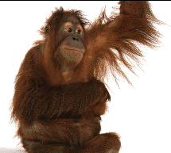
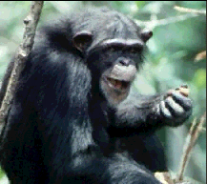
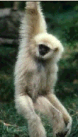
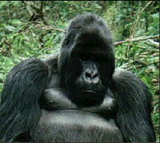
A Star Tree (Completely Unresolved Tree)
Human
Chimpanzee
Gorilla
Orangutan
Gibbon

Slide 9
Genetic Distance Matrix
Matrix of Genetic distances (D_{ij}):
Human Chimp Gorilla Orang Gibbon
Human 0.015 0.045 0.143 0.198
Chimp 0.030 0.126 0.179
Gorilla 0.092 0.179
Orang 0.179
Gibbon

Slide 10
UPGMA
Human
Human Chimp Gorilla Orang Gibbon
Human 0.015 0.045 0.143 0.198
Chimp 0.030 0.126 0.179
Gorilla 0.092 0.179
Orang 0.179
Gibbon
D_{(hu-ch),go} = (D_{hu,go} + D_{ch,go})/2 = 0.038
D_{(hu-ch),or} = (D_{hu,or} + D_{ch,or})/2 = 0.135
D_{(hu-ch),gi} = (D_{hu,gi} + D_{ch,gi})/2 = 0.189
hu-ch Gorilla Orang Gibbon
hu-ch 0.038 0.135 0.189
Gorilla 0.092 0.179
Orang 0.179
Gibbon
Chimp
Gorilla
Orang
Gibbon
Gorilla
Orang
Gibbon
Human
Chimp
(hu,ch),(go,or,gi)
Orang
Gibbon
Gorilla
Human
Chimp
((hu,ch),go),(or,gi)

Slide 11
UPGMA
Human Chimp Gorilla Orang Gibbon
Human 0.015 0.045 0.143 0.198
Chimp 0.030 0.126 0.179
Gorilla 0.092 0.179
Orang 0.179
Gibbon
D_{(hu-ch-go),or} = (D_{hu,or} + D_{ch,or} + D_{go,or})/3 = 0.120
D_{(hu-ch-go),gi} = (D_{hu,gi} + D_{ch,gi} +D_{go,gi})/3 = 0.185
hu-ch-go Orang Gibbon
hu-ch-go 0.120 0.185
Orangutan 0.179
Gibbon
D_{(hu-ch-go-or),gi} = (D_{hu,gi} + D_{ch,gi} +D_{go,gi} + D_{or,gi})/4 = 0.184
Orang
Gibbon
Gorilla
Human
Chimp
Gibbon
Orang
Gorilla
Human
Chimp
(((hu,ch),go),or),gi)

Slide 12
Phylogenetic Relationship from UPGMA
Human Chimp Gorilla Orang Gibbon
Human 0.015 0.045 0.143 0.198
Chimp 0.030 0.126 0.179
Gorilla 0.092 0.179
Orang 0.179
Gibbon
hu-ch Gorilla Orang Gibbon
hu-ch 0.038 0.135 0.189
Gorilla 0.092 0.179
Orang 0.179
Gibbon
hu-ch-go Orang Gibbon
hu-ch-go 0.120 0.185
Orang 0.179
Gibbon

Slide 13
Branch Lengths
D_{hu-ch} = 0.015
D_{(hu-ch),go} = (D_{hu,go} + D_{ch,go})/2 = 0.038
D_{(hu-ch),or} = (D_{hu,or} + D_{ch,or})/2 = 0.135
D_{(hu-ch),gi} = (D_{hu,gi} + D_{ch,gi})/2 = 0.189
D_{(hu-ch-go),or} = (D_{hu,or} + D_{ch,or} + D_{go,or})/3 = 0.120
D_{(hu-ch-go),gi} = (D_{hu,gi} + D_{ch,gi} +D_{go,gi})/3 = 0.185
D_{(hu-ch-go-or),gi} = (D_{hu,gi} + D_{ch,gi} +D_{go,gi} + D_{or,gi})/4 = 0.184
((hu,ch),(go,or,gi))
(((hu,ch),go),(or,gi))
((((hu,ch),go),or),gi)
0.0075
Human
Chimp
Gorilla
Orang
Gibbon
0.019
0.06
((hu:0.0075,ch:0.0075),(go,or,gi))
(((hu:0.0075,ch:0.0075):0.019,go:0.019),(or,gi))
((((hu:0.0075,ch:0.0075):0.0115,go:0.019):0.041,or:0.06):0.032,gi:0.092)
0.092

Slide 14
Final UPGMA Tree
Human
Chimp
Gorilla
Orang
Gibbon
19 13 8 6 MY
0.092 0.060 0.019 0.0075
((((hu:0.0075,ch:0.0075):0.0115,go:0.019):0.041,or:0.06):0.032,gi:0.092);

Slide 15
Distance-based method
Distance matrix
Tree-building algorithms
  UPGMA
  Neighbor-joining
  FastME
  Fitch-Margoliash
Criterion-based methods: the least squares method
  Branch-length estimation
  Tree-selection criterion

Slide 16
For three OTUs
1 2 3
1 0.092 0.179
2 0.179
3
1 2 3
1 d₁₂ d₁₃
2 d₂₃
3
1
d₁₂ = x₁ + x₂
d₁₃ = x₁ + x₃
d₂₃ = x₂ + x₃
x₁
x₃
3
x₂
2

Slide 17
Least-square method
4
Sp1
Sp2 0.3
Sp3 0.4 0.5
Sp4 0.4 0.6 0.6
d’₁₂ = x₁ + x₂
d’₁₃ = x₁ + x₅+ x₃
d’₁₄ = x₁ + x₅ + x₄
d’₂₃ = x₂ + x₅ + x₃
d’₂₄ = x₂ + x₅ + x₄
d’₃₄ = x₃ + x₄
4
Sp1
Sp2 d₁₂
Sp3 d₁₃ d₂₃
Sp4 d₁₄ d₂₄ d₃₄
1
3
x₁
x₃
x₅
x₂
x₄
2
4

Slide 18
The LS method in linear regression
Y = a + b x
X | Y | R(Residual)
3 | 11.5 | a+b*3 – 11.5
2 | 7.5 | a+b*2 – 7.5
1 | 5 | a+b*1 – 5
4 | 14 | a+b*4 – 14
RSS = 0 means a perfect fit of the linear model to the data. A large RSS means a poor fit.

Slide 19
Least-square method
1
3
x₁
x₃
x₅
x₂
x₄
2
4
d’₁₂ = x₁ + x₂
d’₁₃ = x₁ + x₅+ x₃
d’₁₄ = x₁ + x₅ + x₄
d’₂₃ = x₂ + x₅ + x₃
d’₂₄ = x₂ + x₅ + x₄
d’₃₄ = x₃ + x₄
(d₁₂ - d’₁₂)²= [d₁₂ – (x₁ + x₂)]²
(d₁₃ - d’₁₃)² = [d₁₃ – (x₁ + x₅+ x₃)]²
(d₁₄ - d’₁₄)² = [d₁₄ – (x₁ + x₅ + x₄)]²
(d₂₃ - d’₂₃)² = [d₂₃ – (x₂ + x₅ + x₃)]²
(d₂₄ - d’₂₄)² = [d₂₄ – (x₂ + x₅ + x₄)]²
(d₃₄ - d’₃₄)² = [d₃₄ – (x₃ + x₄)]²
Least-squares method: Find x_{i} values that minimize SS

Slide 20
Least-squares method
SS = [d₁₂ – (x₁ + x₂)]² + [d₁₃ – (x₁ + x₅+ x₃)]² + [d₁₄ – (x₁ + x₅ + x₄)]²
+ [d₂₃ – (x₂ + x₅ + x₃)]²+ [d₂₄ – (x₂ + x₅ + x₄)]²+ [d₃₄ – (x₃ + x₄)]²
Take the partial derivative of SS with respective to x_{i}, we have
∂SS/∂x₁ := -2 d₁₂ + 6 x₁ + 2 x₂ - 2 d₁₃ + 4 x₅ + 2 x₃ - 2 d₁₄ + 2 x₄
∂SS/∂x₂ := -2 d₁₂ + 2 x₁ + 6 x₂ - 2 d₂₃ + 4 x₅ + 2 x₃ - 2 d₂₄ + 2 x₄
∂SS/∂x₃ := -2 d₁₃ + 2 x₁ + 4 x₅ + 6 x₃ - 2 d₂₃ + 2 x₂ - 2 d₃₄ + 2 x₄
∂SS/∂x₄ := -2 d₁₄ + 2 x₁ + 4 x₅ + 6 x₄ - 2 d₂₄ + 2 x₂ - 2 d₃₄ + 2 x₃
∂SS/∂x₅ := -2 d₁₃ + 4 x₁ + 8 x₅ + 4 x₃ - 2 d₁₄ + 4 x₄ - 2 d₂₃ + 4 x₂ - 2 d₂₄
Setting these partial derivatives to 0 and solve for x_{i}, we have
x₁ = d₁₃/4 + d₁₂/2 - d₂₃/4 + d₁₄/4 - d₂₄/4
x₂ = d₁₂/2 - d₁₃/4 + d₂₃/4 - d₁₄/4 + d₂₄/4,
x₃ = d₁₃/4 + d₂₃/4 + d₃₄/2 - d₁₄/4 - d₂₄/4,
x₄ = d₁₄/4 - d₁₃/4 - d₂₃/4 + d₃₄/2 + d₂₄/4,
x₅ = - d₁₂/2 + d₂₃/4 - d₃₄/2 + d₁₄/4 + d₂₄/4 + d₁₃/4

Slide 21
Least-squares method
x₁ = d₁₃/4 + d₁₂/2 - d₂₃/4 + d₁₄/4 - d₂₄/4
x₂ = d₁₂/2 - d₁₃/4 + d₂₃/4 - d₁₄/4 + d₂₄/4,
x₃ = d₁₃/4 + d₂₃/4 + d₃₄/2 - d₁₄/4 - d₂₄/4,
x₄ = d₁₄/4 - d₁₃/4 - d₂₃/4 + d₃₄/2 + d₂₄/4,
x₅ = - d₁₂/2 + d₂₃/4 - d₃₄/2 + d₁₄/4 + d₂₄/4 + d₁₃/4
4
Sp1
Sp2 0.3
Sp3 0.4 0.5
Sp4 0.4 0.6 0.6
x₁ = 0.075
x₂ = 0.225
x₃ = 0.275
x₄ = 0.325
x₅ = 0.025
1
3
x₁
x₃
x₅
x₂
x₄
2
4

Slide 22
Minimum Evolution Criterion
1
3
x₁
x₃
x₅
x₂
x₄
2
4
1
2
x₁
x₃
The minimum evolution (ME) criterion: The tree with the shortest TreeLen is the best tree.
x₅
x₂
x₄
3
4
1
2
x₁
x₃
x₅
x₂
x₄
4
3

Slide 23
Molecular clock
Comprehend one of the two major components in molecular phylogenetics, dating speciation events. (What is the other component?)
Understand the concept of a molecular clock and its two meanings:
  as a measure of time (after calibration)
  as a measure of the rate of change
Learn to calibrate the molecular clock and how to use it to solve practical biological problems

Slide 24
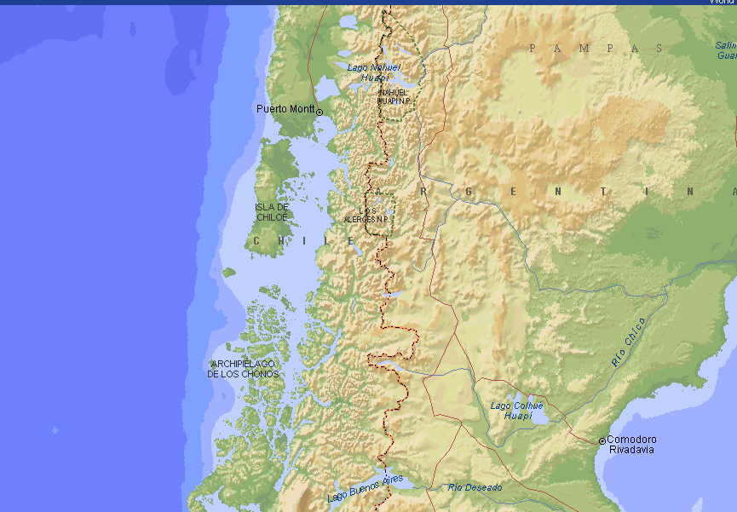
The Origin of Darwin’s Fox
Chiloé Island
Yahnke, C. J., W. E. Johnson, E. Geffen, D. Smith, F. Hertel, M. S. Roy, C. F. Bonacic et al. 1996. Darwin's fox: A distinct endangered species in a vanishing habitat. Conservation Biology 10:366-375.

Slide 25
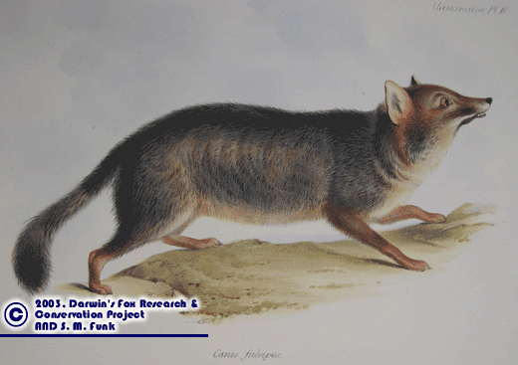
Dusicyon fulvipes
In the evening we reached the island of S. Pedro...two of the officers landed to take a round of angles with the theodilite. A fox, of a kind said to be peculiar to the island, and very rare in it, and which is an undescribed species, was sitting on the rocks. He was so intently absorbed in watching their manoeuvres, that I was able, by quietly walking up behind, to knock him on the head with my geological hammer. This fox, more curious or more scientific, but less wise, than the generality of his brethren, is now mounted in the museum of the Zoological Society.
--C. Darwin. 1839. Journal of researches in the geology and natural history of the various countries visited by H.M.S. Beagle, under the command of Captain Fitzroy, R. N. from 1832-1836. Henry Colburn, London. P. 341.

Slide 26
Conventional Hypothesis
Gray foxes on the mainland have frequently migrated to the island during the ice ages when the sea level was much lower than it is today
After the last glaciation period which ended about 15000 years ago, the sea level rose isolating the island from the mainland. The gray fox population on the island then evolved independently from that of the mainland and the two gradually diverge from each other.
The Darwin’s fox is the product of this isolated evolution of the ancestral gray fox on the Chiloé Island.
Prediction: The genetic difference should be small and comparable to the divergence time of ~15000 years.

Slide 27
How Does a Molecular Clock Tick?
ATGACCCCGACACGCAAAATTAACCCACTAATAAAATTAATTAATCACTCATTTATCGAC
ATGACCCCGACACGCAAAATTAACCCACTAATAAAGTTAATTAATCACTCATTTATCGAC
ATGACCTCGACACGCAAAATTAACCCACTAATAAAGTTAATTAATCACTCATTTATCGAC
ATGACCTCGACACGCAAAATGAACCCACTAATAAAGTTAATTAATCACTCATTTATCGAC
ATGACCTCGACACGCAAAATGAACCCACTAATAAAGTTAATTAATCACTCATTTATCGAC
Each nucleotide substitution is equivalent to one tick in a mechanical clock. The more nucleotide substitutions, the longer the time is.

Slide 28
Divergence from a Common Ancestor
AAA CCC CGG GGC CCC TAT TTT TTG
AAA CCC CGG GGC CCC TAT TTT TTG
AAG CCC CGG GGC CCC TAT TTT TTG
AAA CCC CGG GGC CCC TAT TTT TTT
AAG CCT CGG GGC CCC TAT TTT TTG
AAT CTC CGG GGC CCC TAT TTT TTT
AAG CCT CGG GGC CCT TAT TTT TTG
AAT CTC CGG GGC CTC TAT TTT TTT

Slide 29
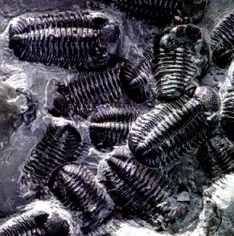
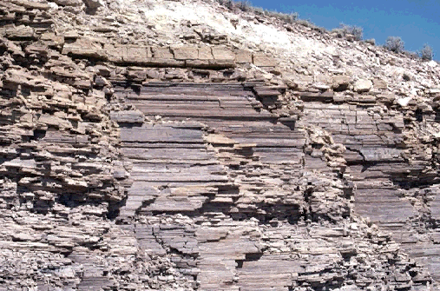
Sedimentary Rocks and Fossils
Sedimentary rocks form on top of older rocks, with fossils buried inside.
If fossils of rats and mice are found in one stratum, but not in any older strata, then, if the stratum is found to be 15 million years old, we can infer that mice and rats must have diverged 15 millions years ago.

Slide 30
Calibration of the Molecular Clock: I
The same calibration can be made with any genetic distances (e.g., those calculated from DNA hybridization or allelic frequencies)

Slide 31
The Challenge to the Hypothesis
Mitochondrial DNA genes were sequenced from Darwin’s fox, the gray fox and other related foxes.
According a calibrated molecular clock, the divergence time is estimated to be ~2 million years, which is much greater than the expected divergence time of ~15000 years.
Darwin’s fox
Mainland gray fox
2 myr

Slide 32
Conclusions
Darwin’s fox had diverged from the gray fox millions of years ago on the mainland, long before the Chiloé island was formed.
After the formation of Chiloé Island, some Darwin’s foxes, not gray foxes, migrated to the island and became established. Meanwhile, the mainland population had gone extinct.
Darwin’s fox is an independent species and its conservation is urgent (only about 500 left).

Slide 33
Divergence time
Island Darwin’s fox
Mainland Darwin’s fox
Mainland gray fox
2 myr
Afternoon Lab: Testing the validity of the molecular hypothesis

Slide 34
Testing the Molecular Clock
Distance-based tests
Likelihood ratio tests
  The tree-based test
  The relative-rate test
    Nucleotide-based analysis (Muse and Gaut 1992)
    Codon-based analysis (Muse and Gaut 1994)

Slide 35
Relative-rate tests
Ingroup 1
α₁
β₁
α₃
β₃
Outgroup
α₂
β₂
Ingroup 2
Constraint both: α₁= α₂ = α , β₁ = β₂ = β (2 parameters)
General model: α1, α2 , β1 , β2 (4 parameters)
Constrain α: α₁= α₂ = α , β₁, β₂ (3 parameters)
Constrain β: α₁, α₂ , β₁ = β₂ = β (3 parameters)
Likelihood ratio test: χ² = 2ΔlnL, DF = ΔParameter
Notes:
An valid outgroup is one that does not belong to the ingroup, an ideal outgroup is one that is closest to the ingroup (while remains valid).

Slide 36
Tree-based tests
x₁₁
AlligatorMississippiensis
x₁₀
GallusGallus
x₁
HomoSapiens
x₇
x₄
PanTroglodytes
x₃
x₂
x₉
PongoPygmaeus
x₈
x₅
BalaenopteraMusculus
x₆
BosTaurus
x₁
x₂
HomoSapiens
x₃
PanTroglodytes
x₄
PongoPygmaeus
x₆
BosTaurus
x₅
BalaenopteraMusculus
GallusGallus
AlligatorMississippiensis
DF for LRT: n - 2

Slide 37
Tree-based tests
x₁₁
d’₁₂ = x₁ + x₂
d’₁₃ = x₁ + x₄ + x₃
...
d’₆₇ = x₁₀ + x₁₁
RSS_{nc} = Σ(d_{ij} – d’_{ij})²
d’₁₂ = 2 x₁
d’₁₃ = 2 (x₁ + x₂)
...
d’₆₇ = 2 ( x₅ + x₆)
RSS_{c} = Σ(d_{ij} – d’_{ij})²
S7
x₁₀
S6
x₁
S1
x₇
x₄
S2
x₃
x₂
x₉
S3
x₈
x₅
S4
x₆
S5
x₁
x₂
S1
x₃
S2
S3
x₄
x₆
S4
x₅
S5
S6
S7
Xia, X. 2009. Molecular Phylogenetics and Evolution 52:665-676
Notes:
Eqs: where p is the number of parameters in the model (e.g., the number of branch lengths plus one, i.e., the additional σ²), n is the number of pairwise distances in our case, and RSS is RSSnc for the non-clocked phylogeny and RSSc for the clocked phylogeny.

Slide 38
Dating
Two major objectives of molecular phylogenetics
  Branching patterns (speciation or gene duplication events)
  Dating of the speciation or gene duplication events
Classification of methods
  Criteria used
    Maximum likelihood (ML) method (e.g., PAML)
    Bayesian methods (e.g., BEAST)
    Least-squares (LS) method based on distance-based matrices (e.g., DAMBE)
  Hard- or soft-bound
  Global or local clock
Data needed
  A topology
  A set of aligned sequences OR a distance matrix satisfying the molecular clock hypothesis (either globally or locally)
  Calibration points
    One or more from fossil record
    From sampling time for rapidly evolving species (e.g., RNA viruses)

Slide 39
Rationale
Given two species i and j, we can compute the evolutionary distance between them (d_{ij} which is the number of substitutions per site), but how do we know the time (t) that these two species have diverged from their common ancestor?
Knowing d_{ij} alone does not give us time. We also need to know the rate of change (r, which is equivalent to speed).
If we know that a runner runs at a constant speed of 10 km/hr and that he has covered a distance of 20 km, then he has run 2 hours ( = 20km/(10 km/hr)
If we know that r is 0.02 substitutions/myr, and d_{ij} = 0.04 substitutions, then the two species have diverged from each other 2 myr (or 1 million each from their common ancestor).
Estimation: r (rate) and T (time).

Slide 40
The LS method in linear regression
Y = a + b x
X | Y | R(Residual)
3 | 11.5 | a+b*3 – 11.5
2 | 7.5 | a+b*2 – 7.5
1 | 5 | a+b*1 – 5
4 | 14 | a+b*4 – 14
RSS = 0 means a perfect fit of the linear model to the data. A large RSS means a poor fit.

Slide 41
The rational of the LS method
1
t₃
4
Sp1
Sp2 d₁₂
Sp3 d₁₃ d₂₃
Sp4 d₁₄ d₂₄ d₃₄
t₂
2
3
T₁
4

Slide 42
Multiple calibration points
1
T₃
4
Sp1
Sp2 d₁₂
Sp3 d₁₃ d₂₃
Sp4 d₁₄ d₂₄ d₃₄
t₂
2
3
T₁
4

Slide 44
gibbon
sumatran
20.655±1.221
3.104±0.273
orangutan
14±0
gorilla
Hard calibration point = 14 million years
7.079±0.527
bonobo
a)
1.754±0.184
Hard calibration point = 7 million years
7±0
chimpanzee
human
gibbon
sumatran
20.903±1.503
3.206±0.280
orangutan
14.757±0.217
gorilla
Soft calibration point = 14 million years
7.258±0.530
bonobo
b)
1.818±0.180
Soft calibration point = 7 million years
chimpanzee
5.487±0.434
human

Slide 45
Dating with local clocks
OTU1
OTU2 7
OTU3 10 7
OTU4 16 13 12
a)
6
b)
OTU4
T₁ = 10
3
OTU3
3
t₂ = 5
2
r₂
OTU2
RSS = 0
r₀ = 0.6, r₁ = 3, r₂ = 1.2
2
t₃ = 1.6667
5
r₁
OTU1
c)
OTU4
T₁ = 10
OTU3
t₂ = 6.2195
OTU2
RSS = 13.1667
r = 0.6833
t₃ = 5.1220
OTU1

Slide 46
Method comparison
RY07
BEAST

Slide 47
calibration time = 10 Myr
7.890±1.308
Pan
calibration time = 35 Myr
9.450±1.522
Homo
12.988±2.053
Gorilla
32.564±4.103
Pongo
56.059±5.436
Macaca
Callithrix
Daubentonia
26.761±3.528
Cheirogaleus
calibration time = 77 Myr
Mirza
7.9±1.4
M.ravelobensis
M.tavaratra
78.210±1.871
21.639±2.906
M.berthae
49.231±4.101
2.2±0.4
M.myoxinus
5.3±0.9
2.3±0.4
M.rufus1
37.682±3.785
4.617±0.808
9.7±1.3
M.rufus2
4.348±0.845
M.sambiranensis
7.089±1.119
M.griseorufus
M.murinus
66.992±5.038
Lepilemur
36.351±2.849
Propithecus
9.608±1.533
Hapalemur
26.049±2.955
Lemur
14.668±1.861
18.125±2.285
Eulemur
Varecia
46.073±5.575
Loris
Galago

Slide 48
[31.6677,53.3297]
Galago
Loris
Varecia
[14.5445,23.4733]
Eulemur
[10.9426,17.9562]
Lemur
[20.9195,33.1815]
[6.8351,11.8498]
Hapalemur
Propithecus
[53.26,79.827]
[25.534,38.8127]
Lepilemur
[4.8645,8.6395]
M.murinus
calibration time = 77 my
M.griseorufus
[7.3,11.7]
M.sambiranensis
[2.7447,4.8025]
M.rufus2
[22.6131,34.6002]
[3.3,5.3]
M.rufus1
[3.7,6.0]
[1.6314,2.9896]
[13.8197,21.595]
M.myoxinus
[68.927,92.9419]
[39.2193,60.6649]
[1.3,2.6]
M.berthae
M.tavaratra
[5.7784,9.3783]
M.ravelobensis
[18.7945,29.488]
Mirza
Cheirogaleus
Daubentonia
Callithrix
[46.4962,69.6653]
Macaca
[27.9235,37.5614]
Pongo
calibration time = 35 my
calibration time = 10 my
[11.2396,17.6519]
Gorilla
[8.059,12.1832]
Homo
[5.5629,9.3534]
Pan
Notes:
An alternative way of presenting variation of the estimated time is by a confidence interval.

Slide 50
Rationale of Tip-Dating
s6@1965
25 yr
t₄=?
40
s5@1960
30 yr
t₅=?
50
s4@1970
20 yr
t₂=?
30
s3@1980
10 yr
t₃=?
40
s2@1975
15 yr
t₁=?
20
RSS=(d₁₂/r+15-2*t₁)²+(d₁₃/r+10-2*t₃)²+(d₁₄/r+20-2*t₃)²
+(d₁₅/r+30-2*t₅)²+(d₁₆/r+25-2*t₅)²+(d₂₃/r+15+10-2*t₃)²
+(d₂₄/r+15+20-2*t₃)²+(d₂₅/r+15+30-2*t₅)²+(d₂₆/r+15+25-2*t₅)²
+(d₃₄/r+10+20-2*t₂)²+(d₃₅/r+10+30-2*t₅)²+(d₃₆/r+10+25-2*t₅)²
+(d₄₅/r+20+30-2*t₅)²+(d₄₆/r+20+25-2*t₅)²+(d₅₆/r+30+25-2*t₄)²
s1@1990
r = 0.01

Slide 51
Final dated tree
s6@1965
1950
s5@1960
1940
s4@1970
1960
s3@1980
1950
s2@1975
1970
s1@1990

Slide 52
Dating and cospeciation
H14
P14
H13
P13
H12
P12
H11
P11
H10
P10
H9
P9
H8
P8
H7
P7
H6
P6
H5
P5
H4
P4
H3
P3
H2
P2
H1
P1

Slide 53
Dating and cospeciation
H14
P14
H13
P13
H12
P12
H11
P11
H10
P10
H9
P9
H8
P8
H7
P7
H6
P6
H5
P5
H4
P4
H3
P3
H2
P2
H1
P1
12 10 8 6 4 2 0
0 2 4 6 8 10 12
Notes:
Coincidental cophylogeny

Slide 54
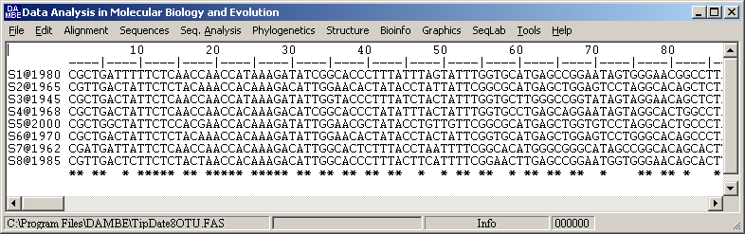
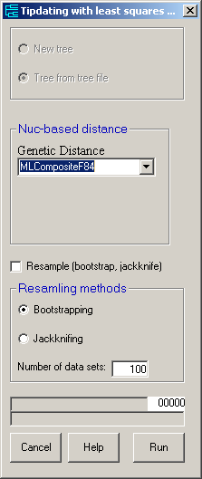
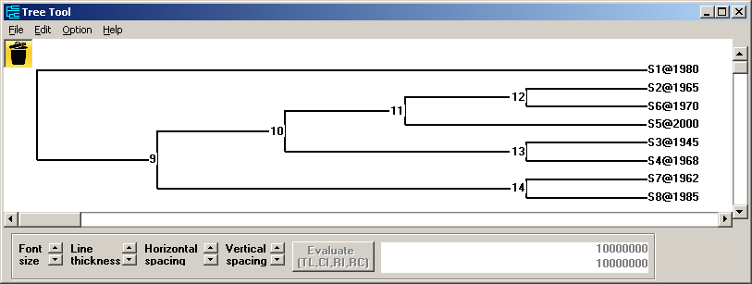
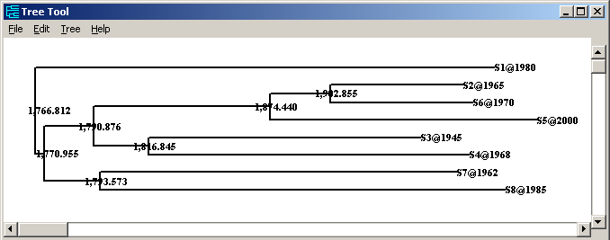

Slide 55
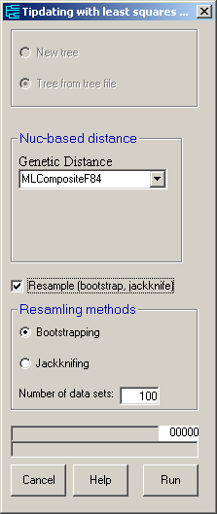
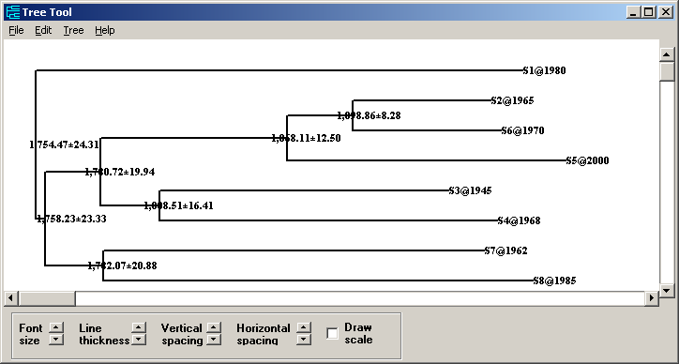

Slide 56
Dating gene duplication
Dating gene duplication events:
1. The gene duplication event occurred at T₀.
2. Two approaches are used to approximate T₀.
If the duplicated genes, or their third codon positions, conform to molecular clock, then estimate T₀ (next slide)
If duplicated genes do not conform to molecular clock, then use genes that do conform to molecular clock to estimate T₁, which underestimates T₀.
S2B
S2A
S1B
T₂
S1A
S3B
T₀
S3A
T₁
S4B
S4A
S5B
S5A
S6B
S6A
S7A
S8A
S9A
S10A
S12A
S11A

Slide 57
Estimating T₀
T_{i} and T_{i}' can be estimated with either nonsynonymous substitutions or synonymous substitutions, designated T_{i.N} and T_{i.N}', and T_{i.S} and T_{i.S}'
Ideally, both paralogous genes conform to molecular clock and T_{i} = T_{i}', i = 1..5. :
T_{i.N} ≈ T_{i.N}', and T_{i.S} ≈ T_{i.S}': Rare.
T_{i.N} ≈ T_{i.N}', and T_{i.S} ≠ T_{i.S}': Very rare
T_{i.N} ≠ T_{i.N}', and T_{i.S} ≈ T_{i.S}': Common
T_{i.N} ≠ T_{i.N}', and T_{i.S} ≠ T_{i.S}': Most common.
T₃
S2B
T₂
S1B
T₄
S3B
T₁
S4B
T₅
S5B
S6B
T₀
T₃'
S2A
T₂'
S1A
T₄'
S3A
T₁'
S4A
T₅'
S5A
S6A
S7A
S8A
S9A
S10A
S12A
S11A

Slide 58
Dating gene duplication
The loss of the paralogous lineage leading to S5B and S6B (or S5A and S6A) leads to an underestimate of the gene duplication time, shifting from Node M to Node N.
Failing to sample the lineage leading to S5B and S6B has the same effect.
S2B
S2A
S1B
N
S1A
S3B
S3A
M
S4B
S4A
S5B
S5A
S6B
S6A
S7A
S8A
S9A
S10A
S12A
S11A

