Slide 1
RNA-Seq data analysis
Xuhua Xia
University of Ottawa
xxia@uottawa.ca
http://dambe.bio.uottawa.ca

Slide 2
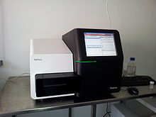
RNA-Seq
FASTQ files:
@SEQ_ID1.1
GATTTGGGGTTCAAAGCA...
+
!''*((((***+))%%%+...
@SEQ_ID2.1
GATTTGGGGTTCAAAGCA...
+
!''*((((***+))%%%+...
......
RNA-Seq
SRA files for Data storage, transmission and analysis
Transcriptome
Genome
Gene1
Gene2
Gene3

Slide 3
SRA organization in NCBI
BioSample (SAMN accession, e.g., SAMN00004417, with links to BioProjects)
BioProject (PRJ accession)
Experiment (SRX accession): info on what type of nucleic acid is extracted, enriched in which way, etc., with links to Run (SRR accession)
SRP accession: all metadata describing a particular study, with links to all experiments (SRX) within the study. All SRX accessions from the same study all reference the same SRP accession.

Slide 4
Storage, transmission and analysis
Next-Generation sequencing
FASTQ files:
@SEQ_ID1.1
NATTTGGGGTTCAAAGCA...
+
!''*((((***+))%%%+...
@SEQ_ID2.1
GATTTGGGGTTCAAAGCA...
+
%''*((((***+))%%%+...
......
Quality assessment
De novo genome assembly
Sequence reads matching/aligning against a known genome
Phred quality score Q=-10log₁₀p, where p is base-calling error probability.
Global quality assessment
Read-specific quality assessment
Site-specific quality assessment
Download by researchers
Submission
Key research objectives:
Differential gene expression
Ribosomal profiling
Alternative splicing
Gene discovery
Signal at TSS and TTS
……
Submission to one of the three data centers (NCBI, DDBJ, EBI):
SRA (sequence read archive) compressed files

Slide 5
Key concepts
Read quality, representation in FASTQ and visualization
Overall quality
Difference between forward and reverse reads
Site-specific quality
Normalization to FPKM (Fragments Per Kilobase of exon per Million reads)
Allocation of sequences among paralogues
Data reduction
In contig assembly
In gene expression studies

Slide 6
Phread quality score: Q=-10log₁₀p
p | Q | Ch | Asc
0.794328 | 1 | ! | 33
0.630957 | 2 | " | 34
0.501187 | 3 | # | 35
0.398107 | 4 | $ | 36
0.316228 | 5 | % | 37
0.251189 | 6 | & | 38
0.199526 | 7 | ' | 39
… | … | … | …
3.16E-09 | 85 | u | 117
2.51E-09 | 86 | v | 118
2E-09 | 87 | w | 119
1.58E-09 | 88 | x | 120
1.26E-09 | 89 | y | 121
1E-09 | 90 | z | 122
7.94E-10 | 91 | { | 123
6.31E-10 | 92 | | | 124
5.01E-10 | 93 | } | 125
3.98E-10 | 94 | ~ | 126
p Q
0.1 10
0.01 20
0.001 30
0.0001 40
…
0.000001 60
0.000000001 90
with equal nuc frequencies, maximum p is expected to be 0.75

Slide 7
Quality assessment: Nucleotide
SRR1536586: Single, ReadLen = 50
SRR892245: Paired, ReadLen = 100
SRR2056426: Paired, ReadLen = 250

Slide 8
Read-based quality
SRR1536586: Single, ReadLen = 50
SRR2056426: Paired, excluding N-containing read

Slide 9
v
Fig. 7. Quality of individual reads for sequences in SRR2056426.sra with paired-end reads. Read 2 (Count2, in orange) is generally poor in quality. The graph includes only sequences without ambiguous codes, otherwise the quality would be worse. The quality score of the first ~20 sites may be ignored because the sequencing machine needs to accumulate enough information to generate quality scores properly.

Slide 10
Site-specific quality by nucleotide
Fully resolved paired reads
Paired reads containing unresolved nucleotides
Read 1
Read 1
Read 2
Read 2
SRR2056426

Slide 11
Gene expression
N_{TMR} = 2230000 (TMR: total mapped reads); L₁ = 500 nt, L₂ = 3000 nt, L₃ = 400 nt
GE: FPKM₁ = (1000*N₁/L₁)*(1000000/N_{TMR}) FPKM₂ = (1000*29/3000)/2.23 FPKM₃ = (1000*4/400)/2.23
= 5.38 = 4.33 = 4.48
Count N₁ = 6 N₂ = 29 N₃ = 4
BLAST, FASTA, etc.
Transcriptome
Genome
Gene1
Gene2
Gene3
FPKM: Fragments Per Kilobase of exon per Million reads: "per kilobase": fair comparison among genes; "per million reads": fair comparison among samples
Notes:
FPKM is a function of SeqLength, NumRead and TMR.

Slide 12
Gene expression with duplicated genes
N_{I} = 29
N_{A.H}= 6
N_{A.U}= 4
N_{B.H} = 3
N_{B.U} = 3
Paralogue A
Paralogue B
Invariant segment
Different but with clear homology
Homology lost in evolution or no homology to start with
P_{A} = (N_{A.H} + N_{A.U})/(N_{A.H} + N_{B.H} + N_{A.U} + N_{B.U})
= (6+4)/(6+4+3+3) = 0.625
N_{A} = N_{A.H} + N_{A.U} + N_{I}*P_{A} = 6+4+29*0.625 = 28.125
N_{B} = N_{B.H} + N_{B.U} + N_{I}*(1-P_{A}) = 3+3+29*0.375 = 16.875
Scale N_{A} and N_{B} to FPKM
Subscripts: H - different but homologous; I - identical segment; U - unique/divergent segment
Notes:
One could simplify the computation by focusing only on the homologous parts. However, sometimes the homologous parts happen to be identical.

Slide 13
Duplicated genes of different lengths
N_{I} = 29
N_{A.H}= 6
N_{A.U}= 4
N_{B.H} = 3
N_{B.U} = 3
L_{A.U}
Paralogue A
Paralogue B
L_{B.U}
Identical segment
Different but with clear homology
Homology lost in evolution
Two alternatives:
1. P_{A} = N_{A.H} /(N_{A.H} + N_{B.H}) = 6/(6+3) = 0.66667
2. n_{A.H} = 6/L_{H}; n_{B.H} = 3/L_{H}; n_{A.U} = 4/L_{A.U}; n_{B.U} = 3/L_{B.U}
P_{A} = (n_{A.H} + n_{A.U})/(n_{A.H} + n_{B.H} + n_{A.U} + n_{B.U})
N_{A} = N_{A.H} + N_{A.U} + N_{I}*P_{A}
N_{B} = N_{B.H} + N_{B.U} + N_{I}*(1-P_{A})

Slide 14
Gene family of two members

Slide 15
Gene expression with duplicated genes
N_{I} = 29
N_{A.U}= 4
N_{B.U} = 2
N_{C.U} = 1
N_{A.H}= 6
N_{B.H} = 2
N_{C.H} = 1
Paralogue A
Paralogue B
Paralogue C
Identical segment
Different but with clear homology
Homology lost in evolution
P_{A} = (N_{A.H} + N_{A.U})/(N_{A.H} + N_{B.H} + N_{A.U} + N_{B.U}+ N_{B.H} + N_{A.U} + N_{B.U})
= (6+4)/(6+4+2+2+1+1) = 0.625
N_{A} = N_{A.H} + N_{A.U} + N_{I}*P_{A} = 6+4+29*0.625 = 28.125
N_{B} = N_{B.H} + N_{B.U} + N_{I}*P_{B}
N_{C} = N_{C.H} + N_{C.U} + N_{I}*P_{C}
Subscripts: H - different but homologous; I - identical segment; U - unique/divergent segment

Slide 16
Gene family of >2 members
Gene family of 2 members
Extension to gene families of >2 members?
C
B
A

Slide 17
Allocation of shared reads in a gene family with three paralogous genes A, B and C with three idealized segments with a conserved identical middle segment, strongly homologous first segment that is identical in B and C, and a diverged third segment. Reads and the gene segment they match to are of the same color.

Slide 18
A
B
C
Allocation of shared reads in a gene family with three paralogous genes A, B and C with three idealized segments with a conserved identical middle segment, strongly homologous first and third segments that are identical in B and C. Reads and the gene segment they match to are of the same color.
A
4+3
23
B
0
38
C
0

Slide 19
Ribosomal density
Mean density adjusted for mRNA length.
The confounding effect of elongation efficiency
Xia et al. 2011 Genetics

Slide 20
Poly(A) length & protein synthesis
Xia et al. 2011 Genetics
Notes:
Protein synthesis rate adjusted for mRNA and

Slide 21
Transcription: TSS and TTS
Exp. 1
Exp. 2
TSS₁ TSS₂
TTS₁ TTS₂
AUG… …UAA

Slide 22
Alternative splicing
Cell type 1
Cell type 2
E₁
E₃
E₁
E₂
E₃
Alternative splicing
5'SS
I₁
3'SS
5'SS
I₂
3'SS
E₁
E₂
E₃

Slide 23
New approaches in data analysis
RNA-Seq data files are too large:
Among the 6472 RNA-Seq STUDIES on human available at NCBI/DDBJ/EBI by Apr. 14, 2016, 196 STUDIES each contribute more than 1 TB of nucleotide bases, with the top one contributing 86.4 TB.
Even NCBI has found it difficult to keep pace with the explosive growth of RNA-Seq data.
The RNA-Seq data do not need to be so huge.
SRR1536586.sra (E. coli K12) contains 6,503,557 sequences of 50 nt each, but 195310 sequences are all identical, all from sites 929-978 in E. coli 23S rRNA genes. There is no information lost if all these 195310 identical sequences is listed by a single sequence with a sequence ID such as SeqID_195310.

Slide 24
Most frequent 50-mers in SRR1536586.sra
Gene | N_{copy} |  | Gene | N_{copy}
LSU rRNA | 195310 |  | LSU rRNA | 14193
LSU rRNA | 86308 |  | hisR⁽²⁾ | 13720
5S rRNA | 73440 |  | hisR⁽²⁾ | 13618
LSU rRNA | 58400 |  | LSU rRNA | 13615
SSU rRNA | 47323 |  | LSU rRNA | 13012
LSU rRNA | 45695 |  | 5S rRNA | 13001
LSU rRNA | 36258 |  | LSU rRNA | 12820
5S rRNA | 33674 |  | LSU rRNA | 12695
SSU rRNA | 30417 |  | LSU rRNA | 12523
LSU rRNA | 29508 |  | SSU rRNA | 11696
5S rRNA | 28187 |  | LSU rRNA | 11298
LSU rRNA | 24982 |  | glnX_V⁽¹⁾ | 11081
SSU rRNA | 23286 |  | 5S rRNA | 10968
LSU rRNA | 19991 |  | 5S rRNA | 10890
SSU rRNA | 19268 |  | 5S rRNA | 10750
glnX_V⁽¹⁾ | 18652 |  | b3555|b3556⁽³⁾ | 10513
LSU rRNA | 18381 |  | LSU rRNA | 10362
hisR⁽²⁾ | 18354 |  | LSU rRNA | 10164
LSU rRNA | 18300 |  | LSU rRNA | 10000
LSU rRNA | 17113 |  | trpT | 9955
glnX_V⁽¹⁾ | 16902 |  | rpsE⁽⁴⁾ | 9877
LSU rRNA | 16796 |  | LSU rRNA | 9090
LSU rRNA | 14642 |  | rplV⁽⁴⁾ | 9071
Notes:
tRNA genes glnX and glnV
tRNA gene hisR
mapped to the sequence between genes b3555 and b3556
coding sequences.

Slide 25
Storage, transmission and analysis
Next-Generation sequencing
FASTQ files:
@SEQ_ID1.1
NATTTGGGGTTCAAAGCA...
+
!''*((((***+))%%%+...
@SEQ_ID2.1
GATTTGGGGTTCAAAGCA...
+
%''*((((***+))%%%+...
......
De novo genome assembly
Sequence reads matching/aligning against a known genome
Submission
Download by researchers
FASTAQ+ file:
>SeqGroup1_3
GATTTGGGGTTCA
>SeqGroup2_391
GATTTGGGGTTCAAAGCA
>SeqGroup3_92
GATTTGGGGTTCAAAGCA
>SeqGroup4_512
GATTTGGGGTTCAAAGCA
......
Key research objectives:
Differential gene expression
Ribosomal profiling
Alternative splicing
Gene discovery
Signal at TSS and TTS
……
Submission to one of the tree data centers (NCBI, DDBJ, EBI):
SRA (sequence read archive) compressed files
Download
Submission

Slide 26
Formatted BLAST output
b0001|190_255,SeqGr49062_16,100.00,49,0,0,18,66,1,49,3e-019,91.6
b0001|190_255,SeqGr382517_1,100.00,48,0,0,19,66,1,48,1e-018,89.8
b0001|190_255,SeqGr536414_1,100.00,46,0,0,21,66,1,46,2e-017,86.1
b0001|190_255,SeqGr181138_10,100.00,45,0,0,22,66,1,45,5e-017,84.2
b0001|190_255,SeqGr138539_1,100.00,44,0,0,23,66,1,44,2e-016,82.4
b0001|190_255,SeqGr297866_1,100.00,42,0,0,25,66,1,42,3e-015,78.7
b0002|337_2799,SeqGr935243_1,100.00,50,0,0,185,234,1,50,4e-018,93.5
b0002|337_2799,SeqGr925087_1,100.00,50,0,0,1398,1447,1,50,4e-018,93.5
b0002|337_2799,SeqGr922536_1,100.00,50,0,0,2050,2099,1,50,4e-018,93.5
b0002|337_2799,SeqGr918509_1,100.00,50,0,0,201,250,1,50,4e-018,93.5
……

Slide 27
Gene expression output
Gene | SeqLen | Count | Count/Kb | FPKM
thrL|190_255 | 66 | 76 | 1151.515 | 389.894
thrA|337_2799 | 2463 | 2963 | 1203.004 | 407.328
thrB|2801_3733 | 933 | 1121 | 1201.501 | 406.819
thrC|3734_5020 | 1287 | 1782 | 1384.615 | 468.82
yaaX|5234_5530 | 297 | 97 | 326.599 | 110.584
yaaA|C5683_6459 | 777 | 113 | 145.431 | 49.242
yaaJ|C6529_7959 | 1431 | 143 | 99.93 | 33.836
talB|8238_9191 | 954 | 1561 | 1636.268 | 554.028
mog|9306_9893 | 588 | 289 | 491.497 | 166.417
yaaH|C9928_10494 | 567 | 100 | 176.367 | 59.716
yaaW|C10643_11356 | 714 | 13 | 18.207 | 6.165
yaaI|C11382_11786 | 405 | 2 | 4.938 | 1.672
dnaK|12163_14079 | 1917 | 6863 | 3580.073 | 1212.186
dnaJ|14168_15298 | 1131 | 1671 | 1477.454 | 500.255
insL1|15445_16557 | 1113 | 584 | 524.708 | 177.662
mokC|C16751_16960 | 210 | 20 | 95.238 | 32.247
hokC|C16751_16903 | 153 | 6 | 39.216 | 13.278
nhaA|17489_18655 | 1167 | 518 | 443.873 | 150.292
… | … | … | … | …

Slide 28
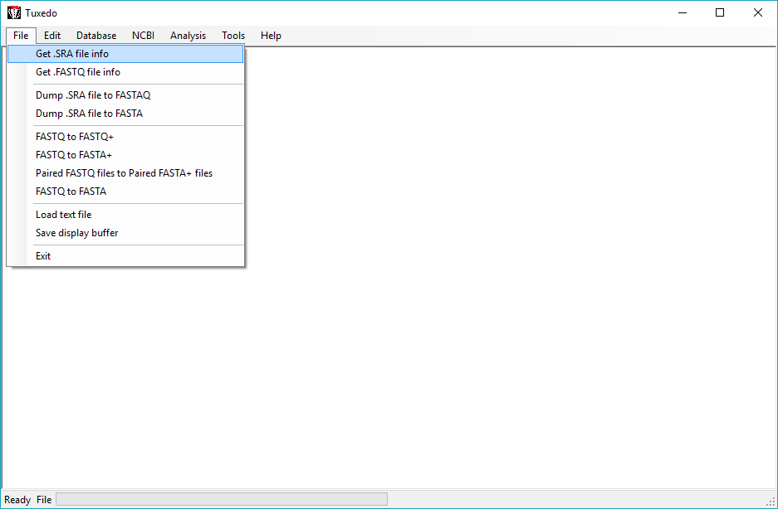
File menu

Slide 29
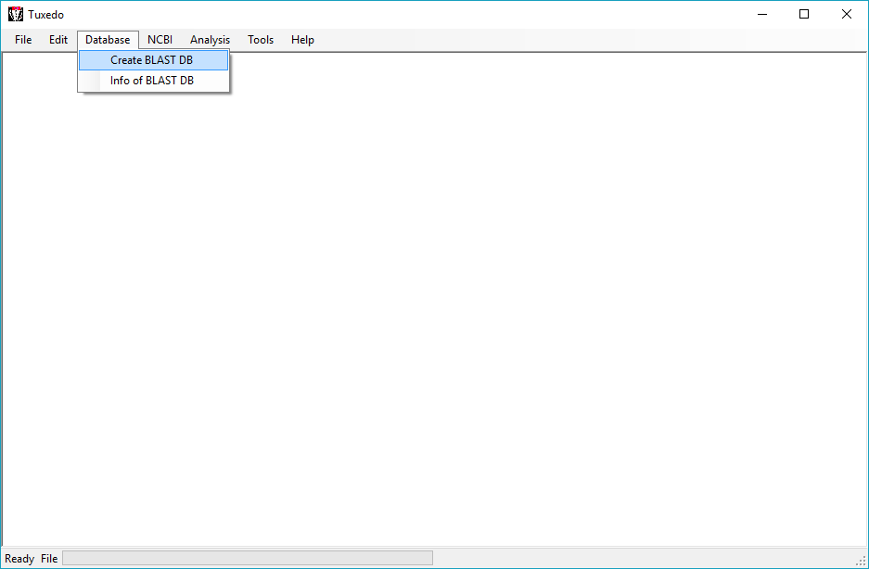
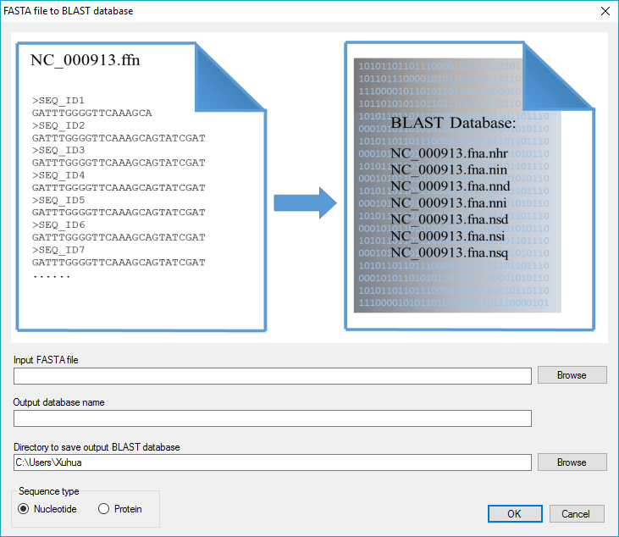
Database menu

Slide 30
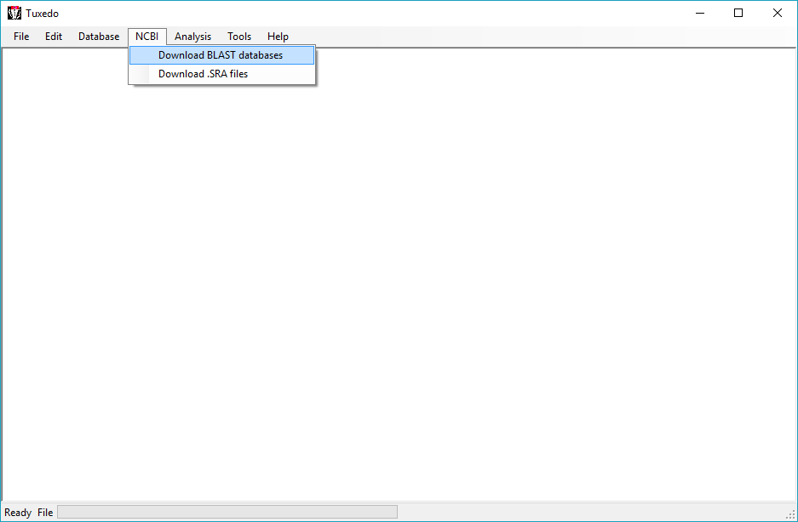
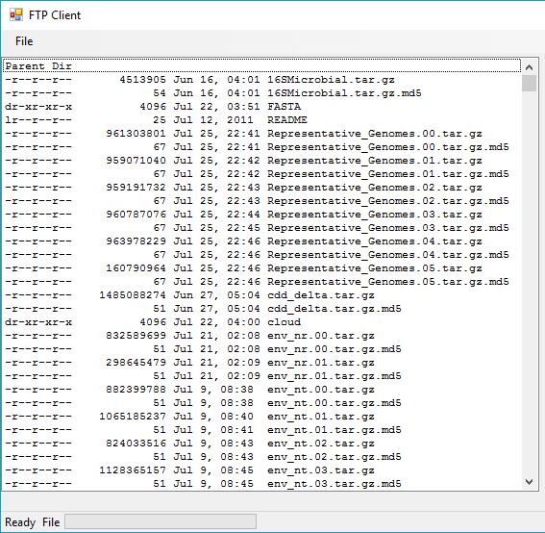
NCBI download menu

Slide 31
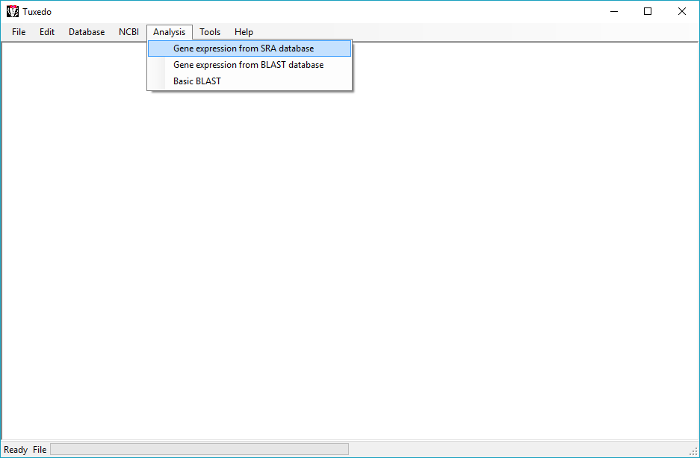
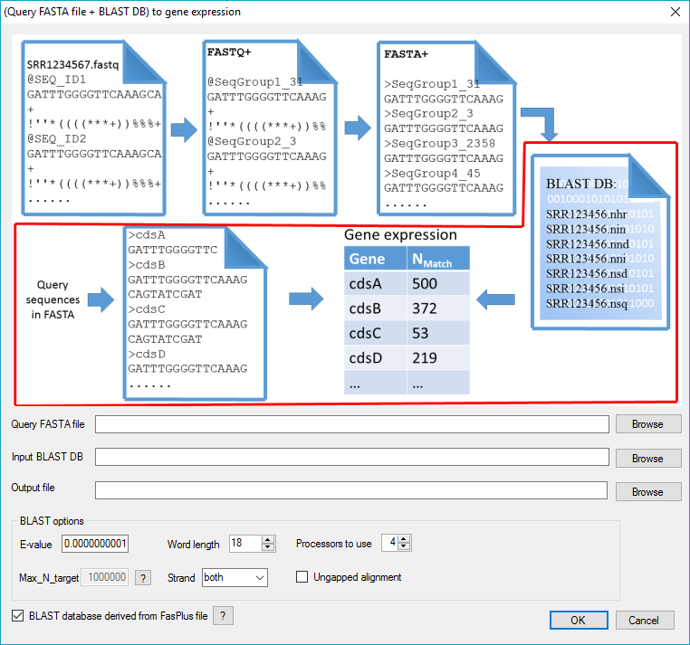
Analysis menu

Slide 32
Major types of high-throughput data

