Slide 1
Sequence alignment with constant and Affine function gap penalties
Xuhua Xia
xxia@uottawa.ca
http://dambe.bio.uottawa.ca

Slide 2
Normal and Thalassemia HBb
10 20 30 40 50 60
----|----|----|----|----|----|----|----|----|----|----|----|--
Normal AUGGUGCACCUGACUCCUGAGGAGAAGUCUGCCGUUACUGCCCUGUGGGGCAAGGUGAACGU
Thalass. AUGGUGCACCUGACUCCUGAGGAGAAGUCUGCCGUUACUGCCCUGUGGGGCAAGGUGAACGU
**************************************************************
70 80 90 100 110 120
--|----|----|----|----|----|----|----|----|----|----|----|----
Normal GGAUGAAGUUGGUGGU-GAGGCCCUGGGCAGGUUGGUAUCAAGGUUACAAGACAGG......
Thalass. GGAUGAAGUUGGUGGUUGAGGCCCUGGGCAGGUUGGUAUCAAGGUUACAAGACAGG......
**************** ***************************************
Are the two genes homologous?
What evolutionary change can you infer from the alignment?
What is the consequence of the evolutionary change?

Slide 3
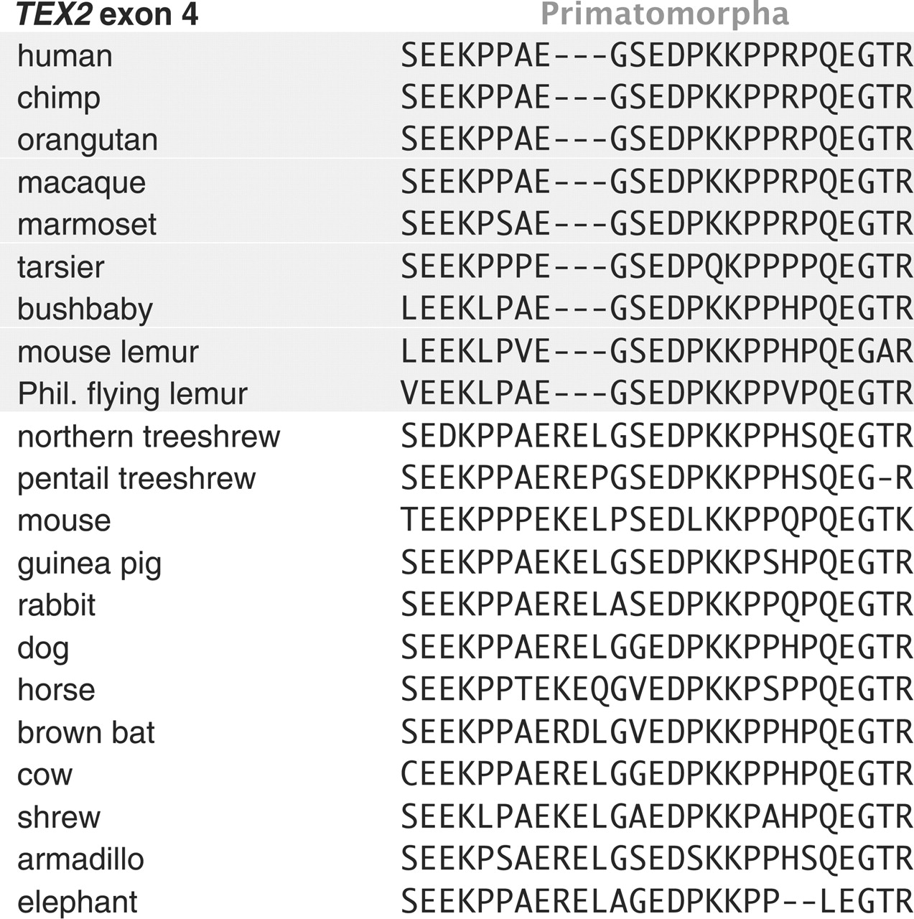
Janeka, JE et al. 2007 Science 318:792
Notes:
TEX2: testis-expressed. Membrane protein. May be involved in speciation.

Slide 4
Example of poor alignment
(a) 190 200 210
---|----|----|----|----|----...
FauNEOPT GAUGUUCCACCUCCAGUA---GAAUUUU...
ApaukNEOPT CGCCUCCCGGUA---------GAACUGU...
CpoNEOPT GGCAAGCAACCUGUG------GAACUGU...
PquNEOPT AACGGUCGCGCGCCGGUC---GAGCUGU...
PamNEOPT GACACACCACCUCCAGUG---GAAUUCU...
AdoNEOPT AAUUUGCCACCUCCA---GUGGAGUUUU...
(b)
FauNEOPT GAUGUUCCACCU---CCAGUAGAAUUUU...
ApaukNEOPT CGCCUC---------CCGGUAGAACUGU...
CpoNEOPT GGCAAGCAA------CCUGUGGAACUGU...
PquNEOPT AACGGUCGCGCG---CCGGUCGAGCUGU...
PamNEOPT GACACACCACCU---CCAGUGGAAUUCU...
AdoNEOPT AAUUUGCCACCU---CCAGUGGAGUUUU...
Poor alignment from Regier et al. 2010. Nature 463:1079-1083
A better alignment (Why is it better? By what criterion do we consider it better?)
Notes:
Fig. 1. Illustrations of poor alignment (in red) in the sequence data from the supplementary file (nature08742-s2.nex) in Regier et al. (2010) for a subset of six species (a), with the shared gaps deleted. The proper alignment of the red-colored sequences is shown in (b). The top alignment was said to be aligned by MAFFT.

Slide 5
Testing phylogenetic hypotheses
OutGroup
“Using molecular sequence data to determine the phylogenetic relationships of the major groups of organisms has yielded some spectacular successes but has also thrown up some conundrums. One such is the relationship of birds to the rest of the tetrapods. Morphological data and most molecular studies have placed the birds closer to the crocodiles than to any other tetrapod group, but analysis of sequence data from 18S ribosomal RNA (rRNA) has persistently allied the birds more closely to the mammals. There have been several attempts to account for this niggling doubt, and Xia et al. (2003, Syst. Biol. 52:283) now show that the discrepancy arose because of methodological flaws in the analysis of 18S rRNA data, which caused, among other things, misalignment of sequences from the different taxa. When structure-based alignment is carried out, the resulting phylogeny matches those obtained by other means, with the birds allied to the crocodiles via a common reptilian ancestor.”
Science 301:279 (Editors’ Choice)
“Reptilian”
Mammal
Bird
OutGroup
Mammal
Bird
“Reptilian”

Slide 6
Fundamental concepts
The purpose of sequence alignment:
  Identification of sequence homology and homologous sites
  Homology: similarity that is the result of inheritance from a common ancestor (identification and analysis of homologies is central to phylogenetic systematics).
  An Alignment is an hypothesis of positional homology between bases/Amino Acids.
The fundamental assumptions: Shared ancestry that is computationally identifiable.
  The criterion: maximum alignment score given a scoring scheme
  The algorithm: dynamic programming

Slide 7
An alignment is a hypothesis
Compare the Favorite with Favourite
After alignment, we have
123456789
Favo-rite
Favourite
Assumption and inference we have implicitly made:
  The two words share ancestry, with one being evolved from the other or both from a common ancestor.
  If “Favorite” is ancestral, then an insertion event of “u” between sites 4 and 5 has happened during the evolution of the word
  If “Favourite” is ancestral, then a deletion event of “u” at site 5 has happened during the evolution of the word
  Note the importance of knowing the ancestral states: assuming a wrong ancestral state will lead to a wrong inference of evolutionary events.
Or alternatively:
Favor Favour
Favorite Favourite
Much of modern science is about formulating and testing hypotheses.

Slide 8
Type of Alignment
Dynamic programming to obtain optimal alignments
  Global alignment
    Representative: Needleman & Wunsch 1970
    Application: aligning homologous genes, e.g., between normal and mutant sequences of human hemoglobin β-chain
  Local alignment
    Representative: Smith & Waterman 1981
    Application: searching local similarities, e.g., homeobox genes
Heuristic alignment methods
  D. E. Knuth 1973: author of Tex
  D. J. Lipman & W. R. Pearson 1985: FASTA algorithm
  S. Altschul et al. 1990. BLAST algorithm.
All heuristic alignment methods currently in use are for local sequence alignment, i.e., searching for local similarities
This lecture focuses on global alignment by dynamic programming, but do find (in the textbook) the three key differences between the global and the local alignment by dynamic programming.

Slide 9
What is an optimal alignment?
An alignment is the stacking of two or more sequences:
  Alignment1: Favorite-
  Favourite
  Alignment2: ---Favorite
  Favourite--
  Alignment3: Favorite------
  -----Favourite
  Alignment4: Favo-rite
  Favourite
An optimal alignment
  One with maximum number of matches and minimum number of mismatches and gaps
  Operational definition: one with highest alignment score given a particular scoring scheme (e.g., match: 2, mismatch: -1, gap: -2)
Which of the 4 alignments above is the optimal alignment?
We need a criterion.

Slide 10
Importance of scoring schemes
Two alternative alignments:
Alignment 1: ACCCAGGGCTTA
ACCCGGGCTTAG
Alignment 2: ACCCAGGGCTTA-
ACCC-GGGCTTAG
Scoring scheme 1: Match: 2, mismatch: 0, gap: -5
Scoring scheme 2: Match: 2, mismatch: -1, gap: -1
Which of the two is the optimal alignment according to scoring scheme 1? Which according to scoring scheme 2?
Importance of biological input concerning scoring schemes

Slide 11
Dynamic Programming
Constant gap penalty:
Scoring scheme:
Match (M): 2
Mismatch (MM): -1
Gap (G): -2
For each cell, compute three values:
Upleft value + IF(Match, M, MM)
Left value + G
Up value + G

Slide 12
Three kinds of alignment blocks

Slide 13
Initialization based on the scoring scheme

Slide 15
SeqX
SeqY
Notes:
Note the ‘<=‘ in obtaining backtrack matrices. If we separate ‘<=‘ into ‘<‘ and ‘=‘, then B matrices may have cell entries with two values.
The sequence alignment is obtained with sequences x (row sequence ACGT,n=4) and y (columm sequence ACGGCT, m=6) and the three backtrack matrices B₀, B₁ and B₂ (no need for score matrices G, E, F, and V).
1. Checking the value of B₀(m,n). If it is 0, then we align x(n) against y(m), and move upleft to align x(n-1) against y(m-1), x(n-2) against y(m-2), ……, until B₀(i,j) <>0.
2. If B₀(i,j) = 1, then we move to matrix B₁, align a gap character “-” against x(j) and move to the left cell indexed by (i, j-1). We continue to align the gap character against x(j) until we have B₁(i,j) = 1 which means that we have encountered a gap open event signalling the end of the block. At this point we jump back to the corresponding cell in B₀, check to see if it is equal to 0, 1 or 2 and repeat the process.
3. If B₀(i,j) = 2, then we move to matrix B₂, align a gap character against y(i), and move up the matrix. We continue to align the gap character against y(i) until we have B₂(i,j) = 1 which signals the end of the indel events. At this point we jump back to the corresponding cell in B₀, check to see if it is equal to 0, 1 or 2 and repeat the process.
What might be confusing is that when we encountered 1 in B1 and B2, we will still align a nucleotide with a gap before jumping back to the cell in B0 corresponding to the next unaligned nucleotides.

Slide 16
B₀
x\y | A | C | C | G | T | C | G | C | G | G | A | T | T | C
G | 0 | 0 | 0 | 0 | 0 | 0 | 0 | 0 | 0 | 0 | 0 | 0 | 0 | 0
T | 2 | 0 | 0 | 0 | 0 | 1 | 1 | 0 | 1 | 0 | 0 | 0 | 0 | 1
A | 0 | 2 | 0 | 0 | 2 | 0 | 0 | 0 | 0 | 0 | 0 | 0 | 0 | 0
C | 2 | 0 | 0 | 0 | 0 | 0 | 0 | 0 | 0 | 0 | 0 | 0 | 0 | 0
C | 2 | 2 | 0 | 0 | 0 | 0 | 0 | 0 | 0 | 1 | 1 | 1 | 0 | 0
G | 2 | 2 | 2 | 0 | 1 | 0 | 0 | 2 | 0 | 0 | 1 | 1 | 1 | 1
T | 2 | 2 | 2 | 2 | 0 | 1 | 1 | 0 | 1 | 0 | 0 | 0 | 0 | 0
T | 2 | 2 | 2 | 2 | 2 | 0 | 0 | 0 | 0 | 2 | 0 | 0 | 0 | 0
G | 2 | 2 | 2 | 2 | 2 | 2 | 0 | 1 | 0 | 0 | 1 | 0 | 0 | 0
C | 2 | 2 | 2 | 2 | 2 | 0 | 2 | 0 | 1 | 1 | 1 | 1 | 0 | 0
A | 0 | 2 | 2 | 2 | 2 | 2 | 2 | 2 | 0 | 0 | 0 | 0 | 0 | 0
T | 2 | 2 | 2 | 2 | 2 | 2 | 2 | 2 | 2 | 0 | 0 | 0 | 0 | 1
G | 2 | 1 | 2 | 2 | 2 | 2 | 2 | 2 | 2 | 2 | 2 | 2 | 2 | 2
T | 2 | 2 | 1 | 2 | 2 | 1 | 2 | 2 | 2 | 2 | 2 | 2 | 2 | 2
A | 2 | 1 | 2 | 1 | 2 | 2 | 1 | 2 | 2 | 2 | 2 | 2 | 2 | 2
C | 2 | 2 | 1 | 2 | 1 | 2 | 2 | 1 | 2 | 2 | 2 | 2 | 2 | 2
C | 2 | 2 | 1 | 1 | 2 | 2 | 2 | 2 | 1 | 2 | 2 | 2 | 2 | 2
G | 2 | 2 | 1 | 1 | 1 | 2 | 2 | 2 | 2 | 1 | 2 | 2 | 2 | 2
T | 2 | 2 | 1 | 1 | 1 | 1 | 2 | 2 | 2 | 2 | 1 | 2 | 2 | 2
T | 2 | 2 | 1 | 1 | 1 | 1 | 1 | 2 | 2 | 2 | 2 | 1 | 2 | 1
G | 2 | 2 | 1 | 1 | 1 | 1 | 1 | 1 | 2 | 2 | 2 | 2 | 2 | 2
C | 2 | 2 | 1 | 1 | 1 | 1 | 1 | 1 | 1 | 2 | 2 | 2 | 2 | 2
A | 2 | 1 | 1 | 1 | 1 | 1 | 1 | 1 | 1 | 1 | 2 | 2 | 2 | 2
T | 2 | 2 | 1 | 1 | 1 | 1 | 1 | 1 | 1 | 1 | 1 | 2 | 1 | 2
G | 2 | 2 | 2 | 2 | 2 | 2 | 2 | 2 | 2 | 2 | 2 | 2 | 2 | 2
T | 1 | 2 | 2 | 1 | 2 | 2 | 1 | 2 | 1 | 1 | 2 | 2 | 2 | 2
A | 2 | 1 | 1 | 2 | 1 | 1 | 1 | 1 | 1 | 1 | 1 | 1 | 1 | 1
C | 2 | 2 | 1 | 1 | 2 | 1 | 1 | 1 | 1 | 1 | 1 | 1 | 1 | 1
C | 2 | 1 | 2 | 1 | 2 | 2 | 1 | 1 | 1 | 1 | 2 | 1 | 1 | 1
G | 2 | 2 | 1 | 2 | 1 | 1 | 2 | 1 | 1 | 1 | 1 | 1 | 1 | 1
T | 2 | 2 | 2 | 1 | 1 | 1 | 1 | 2 | 1 | 1 | 1 | 1 | 1 | 1
T | 2 | 2 | 2 | 2 | 1 | 1 | 1 | 1 | 2 | 1 | 1 | 1 | 1 | 1
G | 2 | 2 | 2 | 2 | 2 | 1 | 1 | 1 | 2 | 2 | 1 | 1 | 1 | 1
C | 2 | 2 | 2 | 2 | 2 | 2 | 1 | 1 | 1 | 1 | 2 | 1 | 2 | 1
A | 2 | 2 | 2 | 2 | 2 | 2 | 2 | 1 | 1 | 1 | 1 | 1 | 1 | 1
T | 2 | 2 | 2 | 2 | 2 | 2 | 2 | 2 | 1 | 1 | 1 | 1 | 1 | 2
(a) --
TC
(b) AT--
ATTC
(c) --AT--
GGATTC
(d) ACCGTTGC--AT--
ACCGTCGCGGATTC
(e) GTACCGTTGC--AT--
--ACCGTCGCGGATTC
B₁
B₂
What might be confusing is that when we encountered 1 in B1 and B2, we will still align a nucleotide with a gap before jumping back to the cell in B0 corresponding to the next unaligned nucleotides.

Slide 17
Scoring Schemes
We have used a very simple scoring schemes:
Match (S_{m}): 2; mismatch (S_{mm}): -1; Gap (S_{g}): -3
Different scoring schemes differ in two ways:
  Match-mismatch matrices
  Treatment of gap penalties

Slide 18
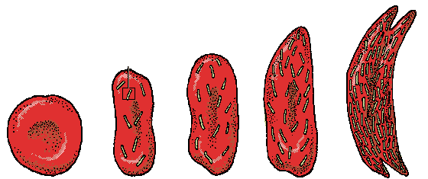
Match-Mismatch Matrices
 | A | G | C | T | R | Y | …
A | 1 | -1 | -2 | -2 | 0 | -2
G | -1 | 1 | -2 | -2 | 0 | -2
C | -2 | -2 | 1 | -1 | -2 | 0
T | -2 | -2 | -1 | 1 | -2 | 0
R | 0 | 0 | -2 | -2 | 0 | -2
Y | -2 | -2 | 0 | 0 | -2 | 0
…
Nucleotide:
  Identity matrix
  International IUB matrix
  Transition bias matrix
Amino acid:
  BLOSUM (BLOcks SUbstitution Matrix, Henikoff and Henikoff 1992)
  PAM (Dayhoff 1978)
  StadenPep
  StructGapPep
  Gonnet
  JTT92
  JohnsonOverington
BLOSUM62
 | A | R | N | D | C | Q | E | G | H | I | L | K | M | F | P | S | T | W | Y | V
A | 4
R | -1 | 5
N | -2 | 0 | 6
D | -2 | -2 | 1 | 6
C | 0 | -3 | -3 | -3 | 9
Q | -1 | 1 | 0 | 0 | -3 | 5
E | -1 | 0 | 0 | 2 | -4 | 2 | 5
G | 0 | -2 | 0 | -1 | -3 | -2 | -2 | 6
H | -2 | 0 | 1 | -1 | -3 | 0 | 0 | -2 | 8
I | -1 | -3 | -3 | -3 | -1 | -3 | -3 | -4 | -3 | 4
L | -1 | -2 | -3 | -4 | -1 | -2 | -3 | -4 | -3 | 2 | 4
K | -1 | 2 | 0 | -1 | -3 | 1 | 1 | -2 | -1 | -3 | -2 | 5
M | -1 | -1 | -2 | -3 | -1 | 0 | -2 | -3 | -2 | 1 | 2 | -1 | 5
F | -2 | -3 | -3 | -3 | -2 | -3 | -3 | -3 | -1 | 0 | 0 | -3 | 0 | 6
P | -1 | -2 | -2 | -1 | -3 | -1 | -1 | -2 | -2 | -3 | -3 | -1 | -2 | -4 | 7
S | 1 | -1 | 1 | 0 | -1 | 0 | 0 | 0 | -1 | -2 | -2 | 0 | -1 | -2 | -1 | 4
T | 0 | -1 | 0 | -1 | -1 | -1 | -1 | -2 | -2 | -1 | -1 | -1 | -1 | -2 | -1 | 1 | 5
W | -3 | -3 | -4 | -4 | -2 | -2 | -3 | -2 | -2 | -3 | -2 | -3 | -1 | 1 | -4 | -3 | -2 | 11
Y | -2 | -2 | -2 | -3 | -2 | -1 | -2 | -3 | 2 | -1 | -1 | -2 | -1 | 3 | -3 | -2 | -2 | 2 | 7
V | 0 | -3 | -3 | -3 | -1 | -2 | -2 | -3 | -3 | 3 | 1 | -2 | 1 | -1 | -2 | -2 | 0 | -3 | -1 | 4

Slide 19
Gap penalty
Different scoring schemes differ in two ways:
  treatment of gap penalties:
Simple:
  Match (S_{m}): 2; mismatch (S_{mm}): -1; Gap (S_{g}): -3
  Alignment score = N_{m} * S_{m} + N_{mm} * S_{mm} + N_{g} * S_{g}
Affine function:
  Gap open: q, gap extension r (q and r < 0)
  Gap penalty: q + N_{r} * r
  Alignment score = N_{m}*S_{m} + N_{mm}*S_{mm} + N_{q}*q + N_{r}*r
Notes:
The two ways of counting gap extension

Slide 20
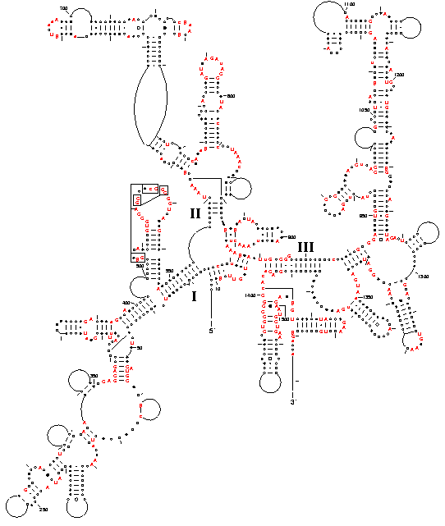
Alignment with secondary structure
Sequences:
Seq1: CACGACCAATCTCGTG
Seq2: CACGGCCAATCCGTG
Seq1: CACGA
|||||
GUGCU
Seq2: CACGA
|||||
GUGCU
Seq2: CACGG
|||||
GUGCC
CCAAUC
Deletion
CCAAU
Missing link
CCAAU
Correlated substitution
Conventional alignment:
Seq1: CACGACCAATCTCGTG
Seq2: CACGGCCAATC-CGTG
Correct alignment:
Seq1: CACGACCAATCTCGTG
Seq2: CACGGCCAAT-CCGTG
Kjer, 1995; Notredame et al., 1997; Hickson et al., 2000; Xia 2000; Xia et al. 2003

Slide 21
Type of alignment
Align two sequences: pairwise alignment by dynamic programming
Align one sequence against a profile (i.e., a set of aligned sequences): Profile alignment
Align two sequence profiles: Profile-profile alignment

Slide 22
Multiple alignment
Dynamic programming involving more than two sequences is both memory hungry and computation intensive.
Solution: a heurestic approach
  Build a guide tree (Illustrated numerically later)
  Perform pairwise alignment along the tree all the way to the root
 | Seq₁ | Seq₂ | Seq₃ | Seq₄ | …
Seq₁ |  | S₁₂ | S₁₃ | S₁₄ | …
Seq₂ |  |  | S₂₃ | S₂₄ | …
Seq₃ |  |  |  | S₃₄ | …
Seq₄ |  |  |  |  | …
…
 | Seq₁ | Seq₂ | Seq₃ | Seq₄ | …
Seq₁ |  | D₁₂ | D₁₃ | D₁₄ | …
Seq₂ |  |  | D₂₃ | D₂₄ | …
Seq₃ |  |  |  | D₃₄ | …
Seq₄ |  |  |  |  | …
…
D_{ij} = MaxS - S_{ij}

Slide 23
Multiple Alignment: Guide Tree
Seq16
ATTCCAAG
ATTCCAAG
ATTTCCAAG
ATTCCCAAG
ATCGGAAG
ATCCGAAG
ATCCAAAG
ATCCAAAG
AATTCCAAG
AATTCCAAG
AATTTCCAAG
AATTCCCAAG
AAGTCCAAG
AAGTCCAAG
AAGTCCAAG
AAGTCAAG
ATT-CC-AAG
ATT-CC-AAG
ATTTCC-AAG
ATTCCC-AAG
AT--CGGAAG
AT-CCG-AAG
AT-CCA-AAG
AT-CCA-AAG
AATTCC-AAG
AATTCC-AAG
AATTTCCAAG
AATTCCCAAG
AAGTCC-AAG
AAGTCC-AAG
AAGTCC-AAG
AAGTC--AAG
Seq15
Seq14
Seq13
Seq12
Seq11
Seq10
Seq9
Seq8
Seq7
Seq6
Seq5
Seq4
Seq3
Seq2
Seq1

Slide 24
Aligned FOXL2 Sequences

Slide 25
Align nuc seq. against aling AA seq
S1 ATG CCG GGA CAA
S2 ATG CCC GGG ATT CAA
S1 MPGQ
S2 MPGIQ
S1 MPG-Q
S2 MPGIQ
Alignment 1 S1 ATG CCG GGA --- CAA
S2 ATG CCC GGG ATT CAA
*** ** ** ***
Match: 1, Mismatch: -3; Gap open: 5, Gap extension: 2
Alignment 2 S1 ATG CC- GGG A-- CAA
S2 ATG CCC GGG ATT CAA
*** ** *** * ***
Match Mismatch GO GE Score
Alignment 1 10 2 1 2 10-6-5-4=-5
Alignment 2 12 0 2 1 12-0-10-2=0
Notes:
Alignment 1: 10*1 – 2*3 – 5 – 2*2 = 10 – 6 – 5 – 4 =-5
Alignment 2: 12*1 – 0*3 – 2*5 – 1*2 = 12 – 10 – 2 =0

